Slide 1
Desert Basics

Slide 2
Unit 13: Deserts & Wind

Slide 3
Distribution and causes of dry lands
Dry regions cover 30 percent of Earth’s land surface
Two climatic types are commonly recognized
Desert or arid
Steppe or semiarid

Slide 4
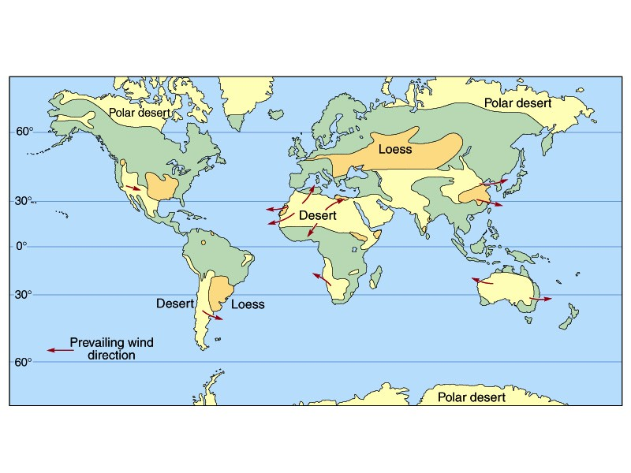

Slide 5
Geologic processes in arid climates
Weathering
Not as effective as in humid regions
Mechanical weathering produces unaltered rock and mineral fragments
Clay
Thin soils
Oxidized minerals
Chemical weathering is not completely absent in deserts. Over long time spans, clay and thin soils do form.

Slide 6
Geologic Processes in the Desert
The role of water
In the desert, most streams are ephemeral-they only carry water after it rains
Dry creeks/streams=arroyos

Slide 7
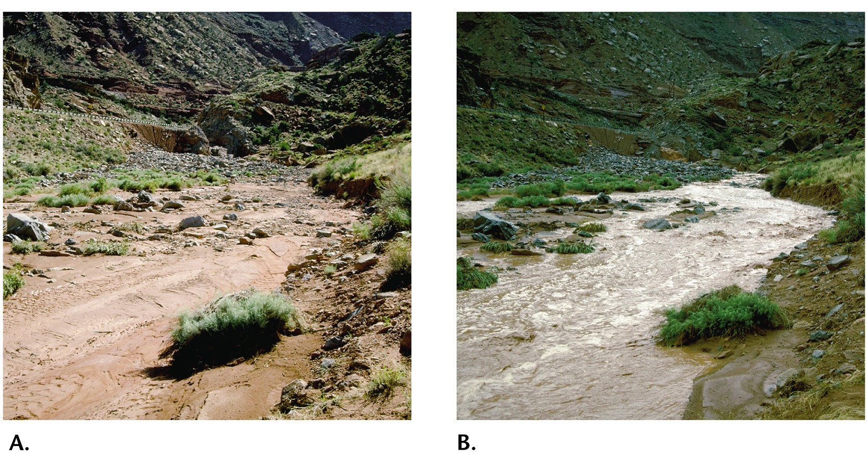

Slide 8
Flash Flooding in the Desert
◆ Why?
• So much rain falls that the soil cannot absorb it
• Lack of vegetation allows water to quickly run off the land
• Floods end quickly!In areas of the Mississippi, it takes days for the flood levels to peak and can take days for them to recede back to normal

Slide 9
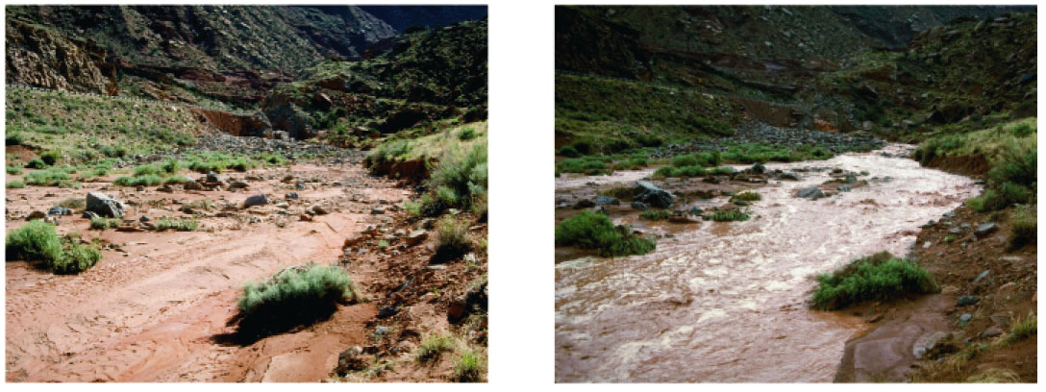
A Dry Stream Desert Channel Before and After a Heavy Rainfall

Slide 10
Basin and Range-A Desert Landscape
◆ Most desert streams dry up long before they ever reach the ocean. The streams are quickly depleted by evaporation and soil infiltration.
◆ Interior drainage into basins produces
• alluvial fan—a fan-shaped deposit of sediment formed when a stream’s slope is abruptly reduced
• playa lake—a flat area on the floor of an undrained desert basin (playa) that fills and becomes a lake after heavy rain

Slide 11
Basin and Range
◆ Most desert erosion results from running water. Although wind erosion is more significant in deserts than elsewhere, water does most of the erosional work in deserts.

Slide 12
Desert Features in the Southwestern United States

Slide 13
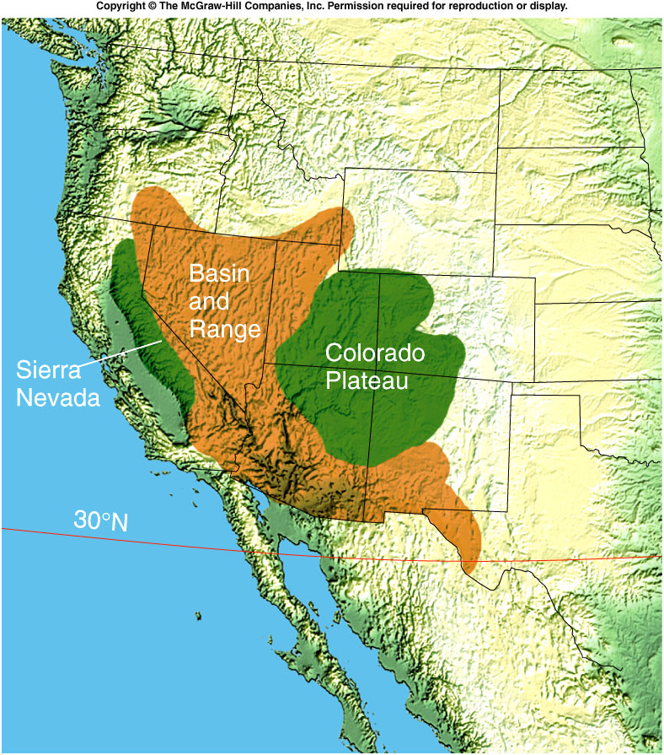
Desert Features In The Southwestern United States
The arid climate of the southwestern United States is contributed to two factors:
it is close to 30º North latitude.
and partly because of the rain shadow effect of the Sierra Nevada and other mountain ranges.
Within this region of low rainfall are two areas of very different geologic structure.
The Colorado Plateau
The Basin and Range Province

Slide 14
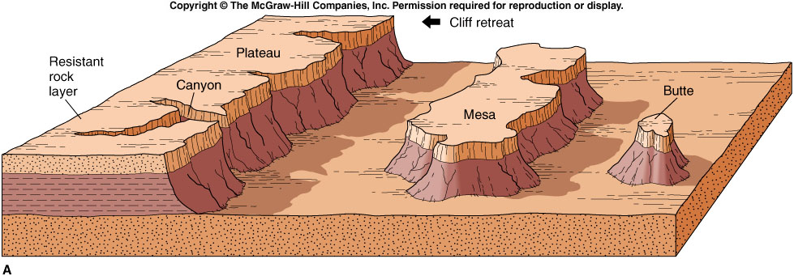
Desert Features In The Southwestern United States
The Colorado Plateau
Mostly flat-lying beds of sedimentary rock over 1,500 meters above sea level.
They are vulnerable to erosion by the little rain that does fall in the region.
Flat-lying layers of resistant rock, such as sandstone, limestone, and lava flows, form plateaus –broad, flat-topped areas elevated above the surrounding land and bounded, at least in part, by cliffs..
As erosion removes the rock at its base, the cliff is gradually eroded back into the plateau.
Remnants of the resistant rock layer may be left behind, forming flat-topped mesas or narrow buttes.
A mesa is a broad, flat-topped hill bounded by cliffs and capped with a resistant rock layer.
A butte is a narrow hill of resistant rock with a flat top and very steep sides.
Most buttes form by continued erosion of mesas.

Slide 15
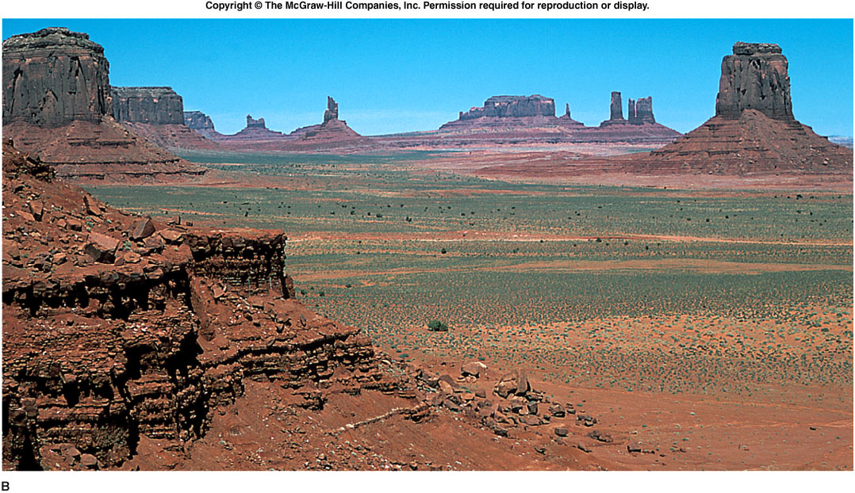
Monument Valley, AZ
(Photo by David McGeary)

Slide 16
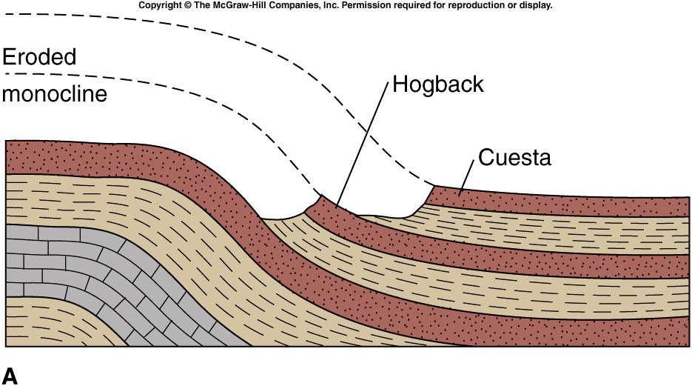
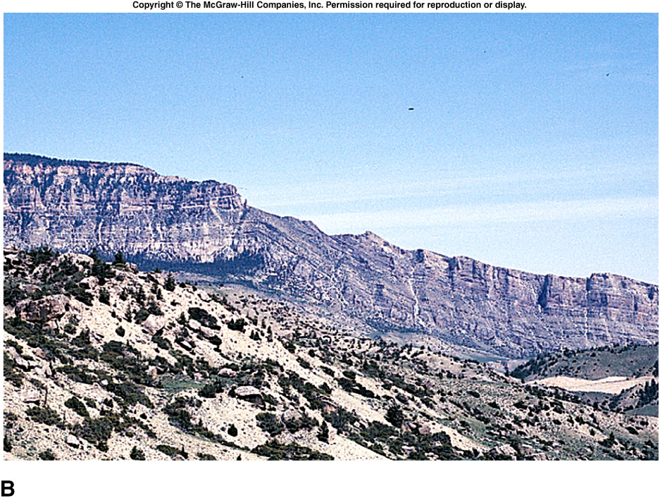
Desert Features In The Southwestern United States
The Colorado Plateau is also marked by step-like folds in rock layers called monoclines.
Erosion of monoclines leaves resistant rock layer protruding above the surface as ridges.
A steeply tilted resistant layer erodes to form a hogback – a sharp ridge that has steep slopes.
A gently tilted resistant layer forms a cuesta – a ridge with one steep side and one gently sloping side.
Neither of these features are unique to deserts, but they are very well exposed in this type of arid climate with sparse vegetation and thin soil.

Slide 17
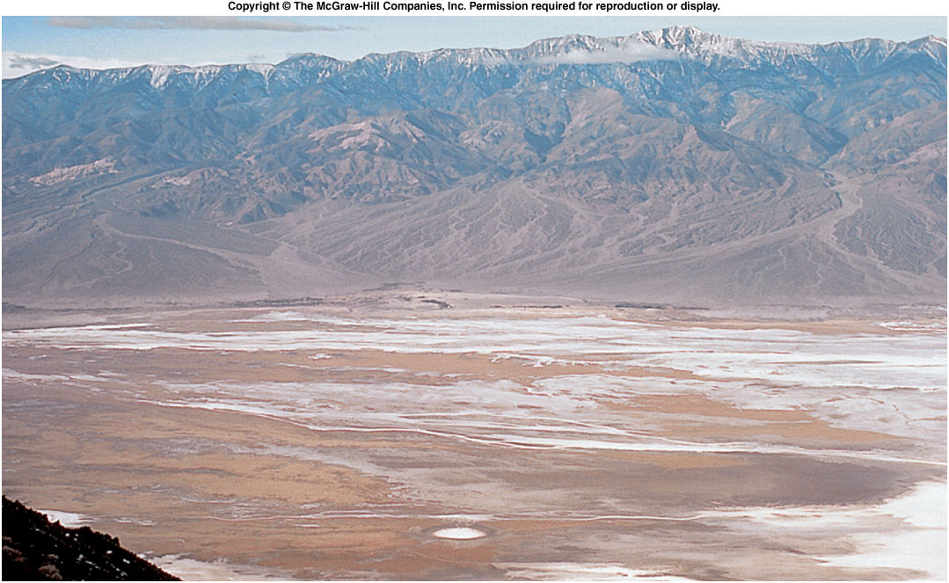
Basin and Range topography in Death Valley, CA
(photo by David McGeary)

Slide 18
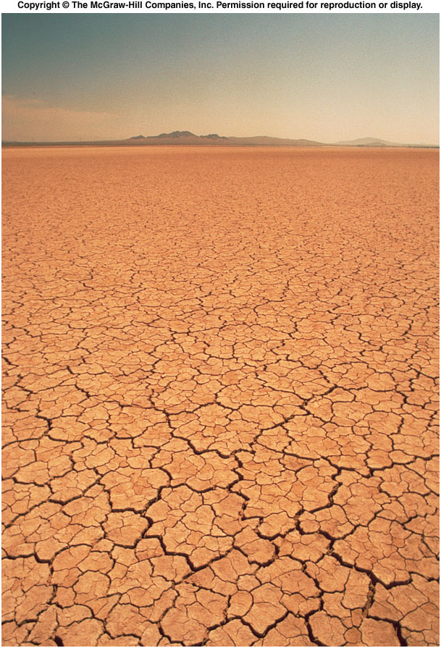
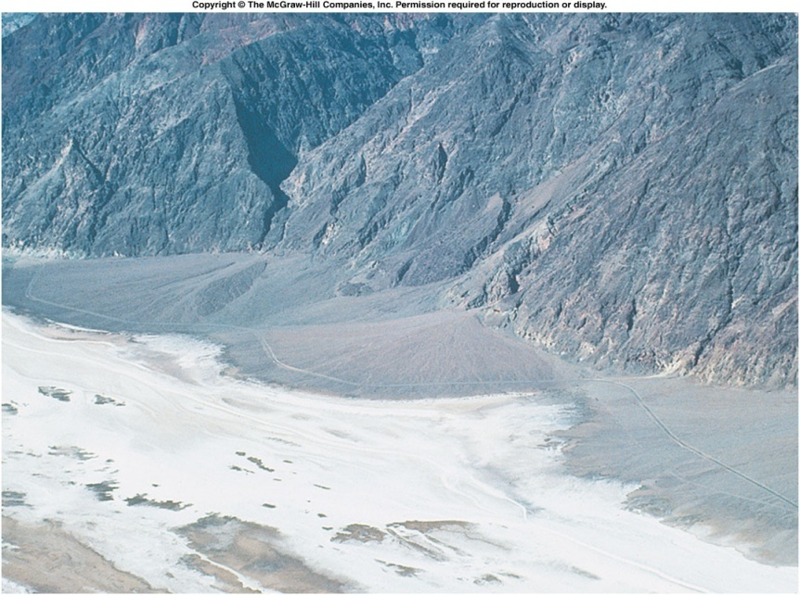
Desert Features In The Southwestern United States
The Basin and Range
Although most of the sediment carried by runoff is deposited in alluvial fans, some fine clay may be carried by runoff in suspension onto the flat valley floor.
If no outlet drains the valley, runoff water may collect and form a playa lake on the valley floor.
These lakes are usually very shallow and temporary, lasting for only a dew days after a rainstorm.
After the water is evaporated, only a thin layer of fine mud may be left on the valley floor.
This mud dries in the sun, forming a Playa.
Playa – a very flat surface underlain by hard, mud-cracked clay.

Slide 19
Desert Features In The Southwestern United States
The Basin and Range
Continued deposition near the base of the mountains may create a bajada.
Bajada – a broad, gently sloping depositional surface formed by the coalescing of individual alluvial fans.
Erosion of the mountain can eventually form a pediment.
Pediment – a gently sloping surface, commonly covered with a veneer of gravel, cut into the solid rock of the mountain.
The pediment develops uphill from a bajada as the mountain front retreats.

Slide 20
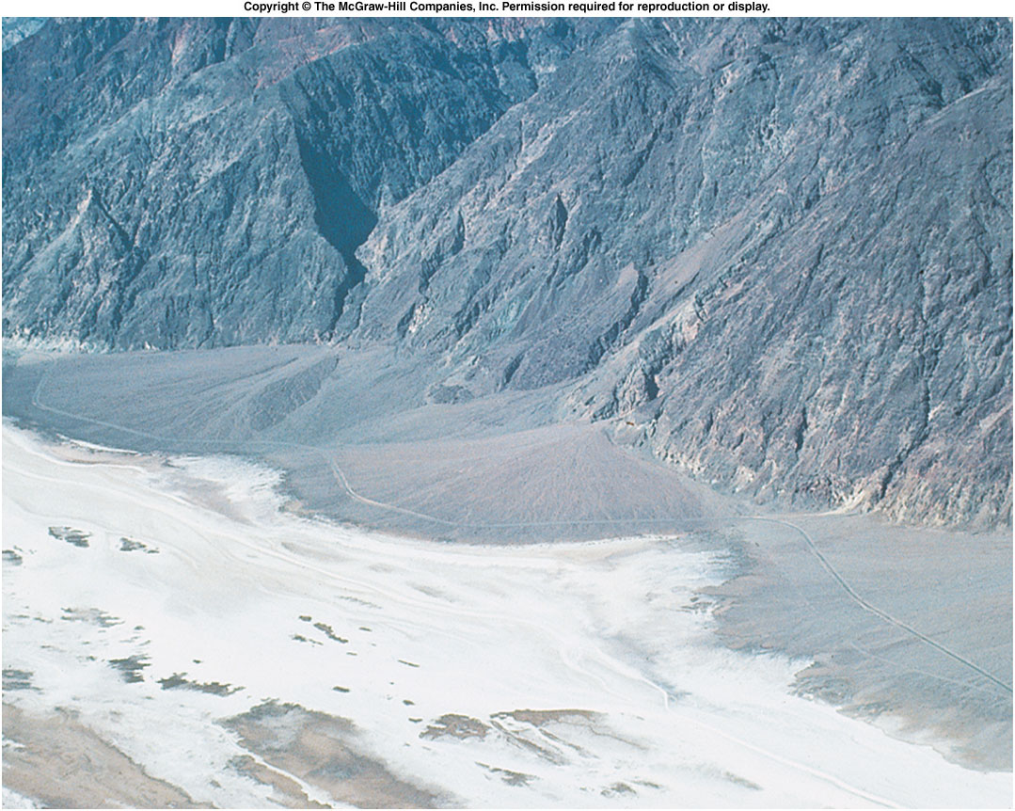
Alluvial fans and white salt flats of a playa in Death Valley, CA
(photo by David McGeary)

Slide 21
Wind

Slide 22
Wind in the desert
Transportation of sediment by wind
Differs from that of running water in two ways
Wind is less capable of picking up and transporting coarse materials
Wind is not confined to channels and can spread sediment over large areas

Slide 23
Landscapes Shaped by Wind
◆ Wind erodes in the desert in two ways.
1. Deflation is the lifting and removal of loose particles such as clay and silt. It produces
• blowouts-shallow depressions
• desert pavement—a layer of coarse pebbles and gravel created when wind removed the finer material
2. Abrasion-occurs when windblown sand cuts and polishes exposed rock surfaces

Slide 24
Desert Deflation

Slide 25
Wind Deposits
◆ The wind can create landforms when it deposits its sediments, especially in deserts and along coasts. Both layers of loess and sand dunes are landscape features deposited by the wind.
◆ Loess
• Deposits of windblown silt
• Extensive blanket deposits
• Primary sources are deserts and glacial stratified drift.

Slide 26
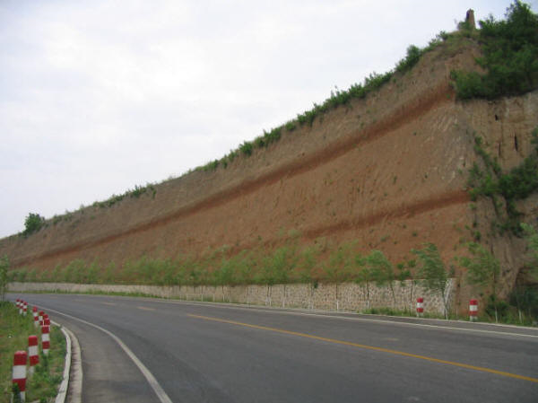
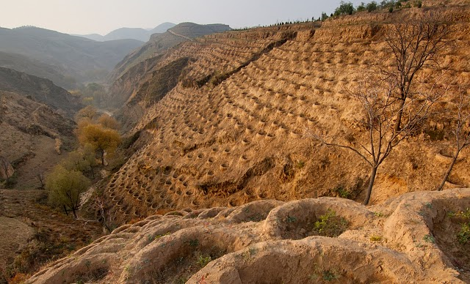
Landscapes Shaped by Wind

Slide 27
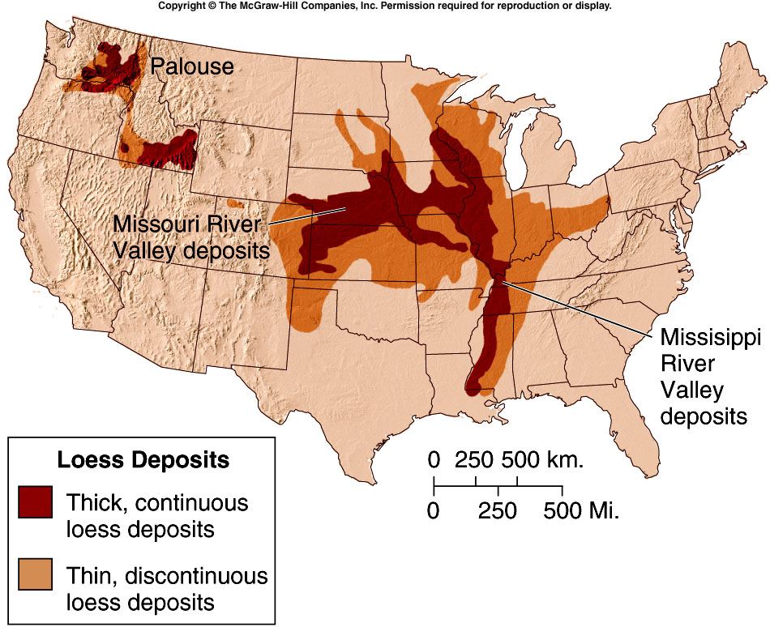
Landscapes Shaped by Wind

Slide 28
Wind Deposits
◆ Sand Dunes
• Unlike deposits of loess, which form blanket-like layers over broad areas, winds commonly deposit sand in mounds or ridges called dunes.
• Characteristic features
- Steeper on sheltered side, less step on side facing wind
- Cross beds are the sloping layers of sand in the dune.

Slide 29
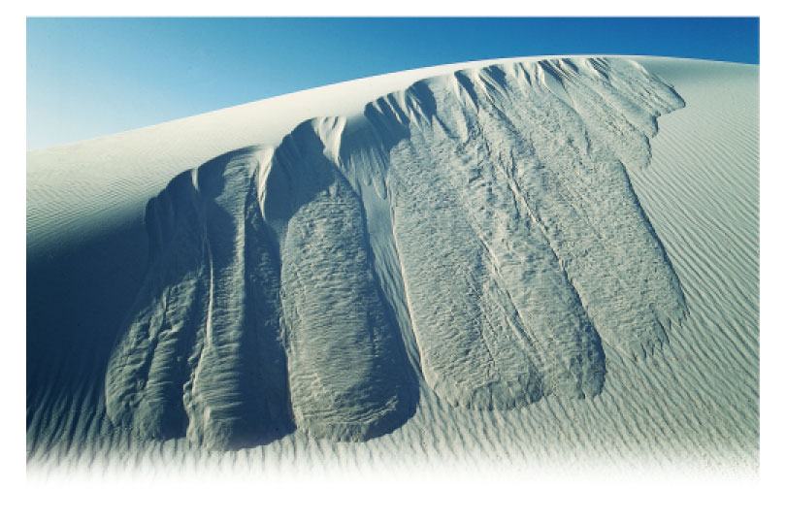
A Dune in New Mexico’s White Sands National Monument

Slide 30
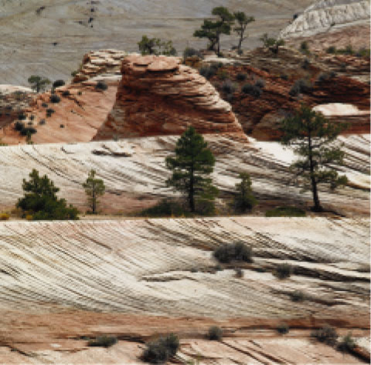
Cross Beds Are Part of Navajo Sandstone in Zion National Park, Utah.

Slide 31
Wind Deposits
◆ Types of Sand Dunes
What form sand dunes assume depends on the wind direction and speed, how much sand is available, and the amount of vegetation.
- Barchan dunes
- Transverse dunes
- Barchanoid dunes
- Longitudinal dunes
- Parabolic dunes
- Star dunes

Slide 32
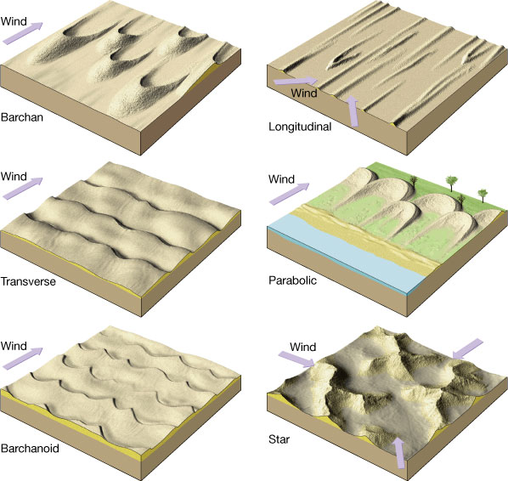
Types of Sand Dunes

Slide 33
Types of Sand Dunes
Barchan Dunes
look like crescents
Form on flat, hard ground where supplies of sand and vegetation are limited
Only reach a height of about 30 m
Transverse Dunes
form in steady winds, with abundant sand and little vegetation
Ridges are 90º to the direction of wind
Typically in coastal areas
Can be 200 m high

Slide 34
Types of Sand Dunes
Barchanoid Dunes
in between transverse and barchan dunes
Scalloped rows of sand that form at right angles to wind direction
This is what is in White Sands National Monument
Longitudinal Dunes
long ridges of sand parallel to wind direction
Moderate sand supplies and wind direction varies slightly
Can be up to 100 m high

Slide 35
Types of Sand Dunes
Parabolic Dunes
look like backwards barchan dunes
Tips point into the wind instead of away from it
Occur where some vegetation covers the sand
Star Dunes
isolated hills of sand mostly found in the Sahara and Arabian deserts
Bases resemble stars and usually have 3 or 4 sharp ridges that meet in the middle
Form in areas with varying wind direction
Can reach heights of 90 m

