Slide 1
Unit 15- Earth’s History

Slide 2
The Geologic Time Scale
Structure of the Time Scale
◆ Based on their interpretations of the rock record, geologists have divided Earth’s 4.56-billion-year history into units that represent specific amounts of time. Taken together, these time spans make up the geologic time scale.

Slide 3
The Geologic Time Scale
Structure of the Time Scale
Eons represent the greatest expanses of time. Eons are divided into eras. Each era is subdivided into periods. Finally, periods are divided into smaller units called epochs.
Phaneroic-derived from Greek meaning “visible life”
◆ There are three eras within the Phanerozoic eon: the Paleozoic, which means “ancient life,” the Mesozoic, which means “middle life,” and the Cenozoic, which means “recent life.”

Slide 4
The Geologic Time Scale
Structure of the Time Scale
◆ Each period within an era is characterized by somewhat less profound changes in life forms as compared with the changes that occur during an era.
◆ The periods of the Cenozoic era are divided into still smaller units called epochs, during which even less profound changes in life forms occur.

Slide 5
12.4 The Geologic Time Scale
Precambrian Time
Precambrian time-540 mya
Represents 88% of earth’s time history
During Precambrian time, there were fewer life forms. These life forms are more difficult to identify and the rocks have been disturbed often.
Three eons within this time: starting from most recent-Proterzoic, Archean, Hadean

Slide 6
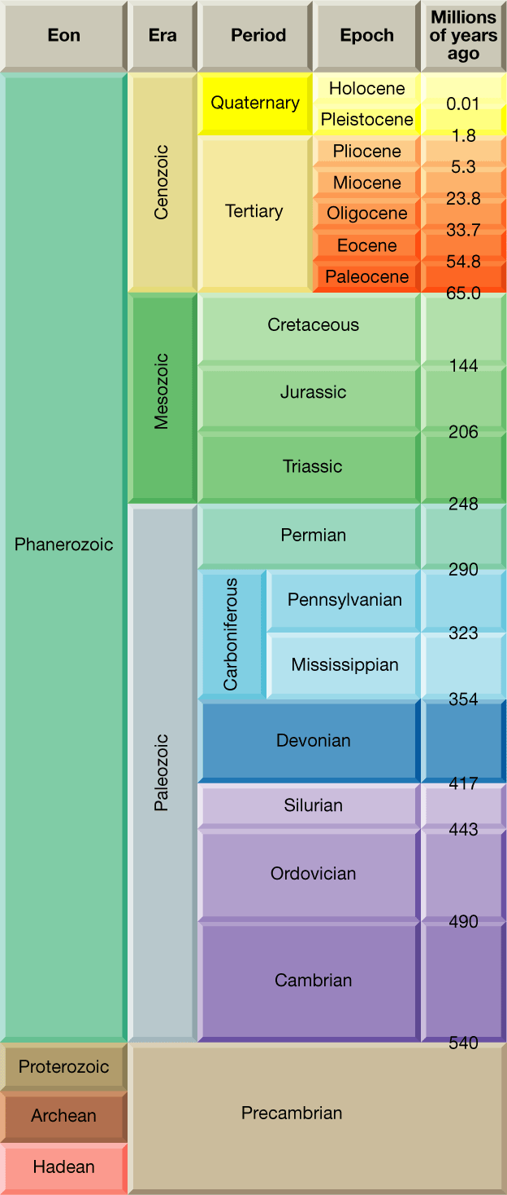
The Geologic Time Scale
Notes:
Makes no sense without caption in book

Slide 7
Precambrian Time: Vast and Puzzling
Encompasses the most geologic time from about 4.56 billion years ago until the start of the Cambrian period, 4 billion years later.
All time between origin of earth and 570 mya

Slide 8
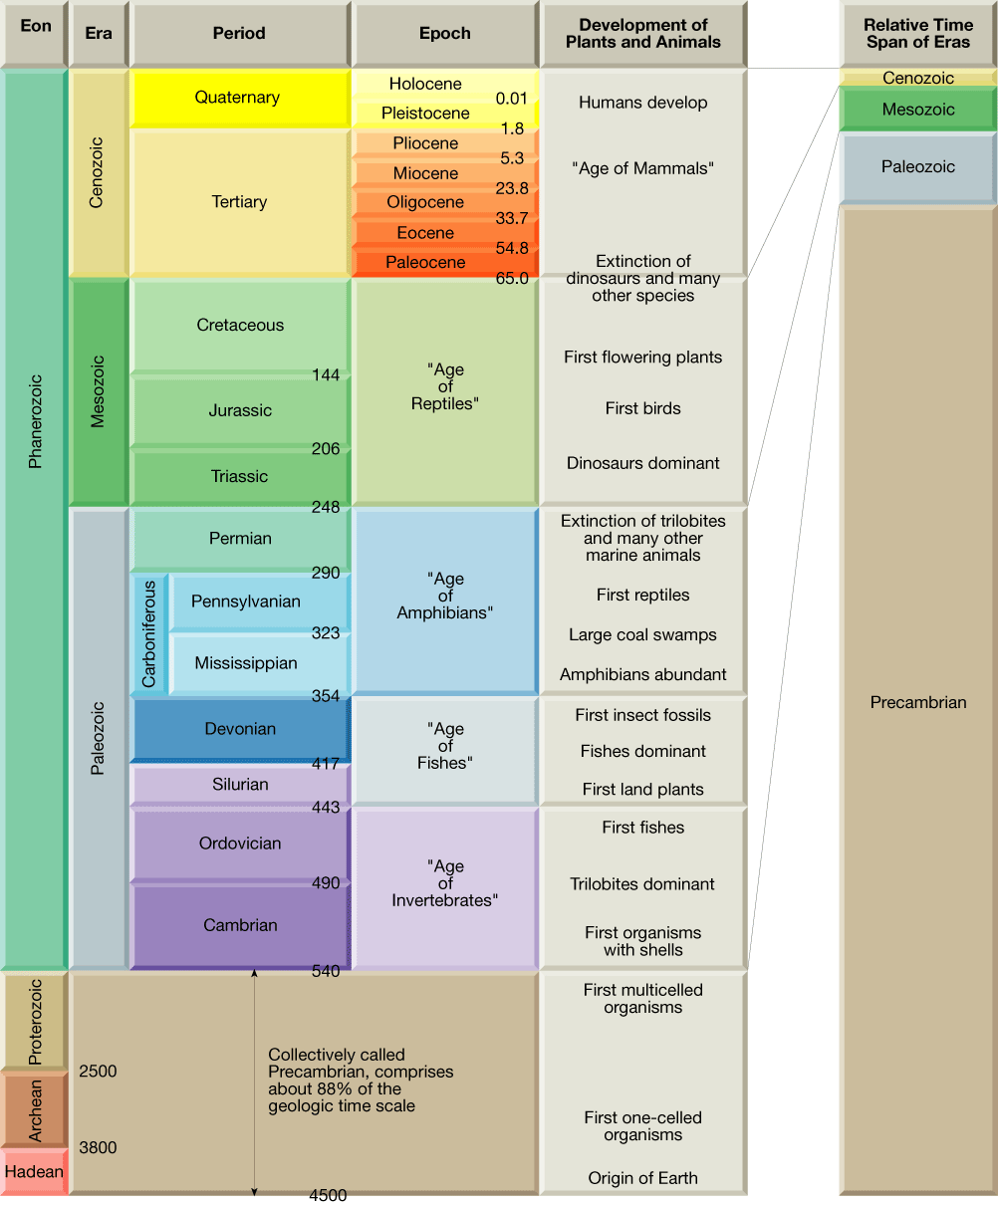

Slide 9
Precambrian Time
Most Precambrian rocks do not contain fossils
Much of what we know about Precambrian rocks comes from ores mined from shields
Shields-large relatively, flat expanses of ancient metamorphic rock within the stable continental interior
Ex.-iron, nickel, gold, silver, copper, chromium, uranium, and diamond mines have provided samples
Oldest Rocks/Fossils-Stromatolites

Slide 10
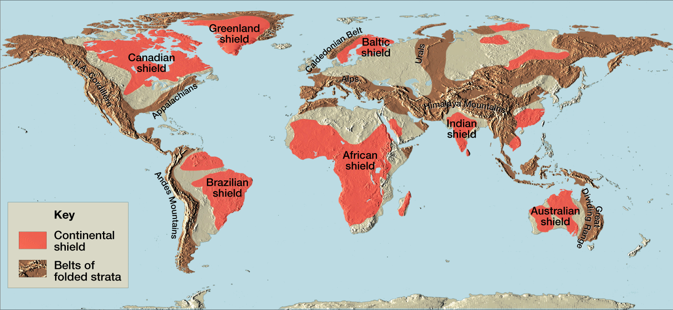
Precambrian Rocks

Slide 11
Earth’s Atmosphere Evolves
Earth’s original atmosphere was made up of gases similar to those released in volcanic eruptions today– water vapor, carbon dioxide, nitrogen, and several trace gases but NO oxygen
Later, primary plants evolved that used photosynthesis and released oxygen
At first, most oxygen combined with iron to make rust
Oxygen began to accumulate about 2.5 bya

Slide 12
Precambrian Fossils
The most common Precambrian Fossils are Stromatolites
Stromatolites are distinctively layered mounds or columns of calcium carbonate. They are NOT the remains of actual organisms but are the material deposited by aglae
They did not become common until the middle of the Precambrian time, about 2 bya.
Many of these ancient fossils are preserved in chert-a hard dens chemical sedimentary rock

Slide 13
Paleozoic Era: Life Explodes

Slide 14
Following the long Precambrian time, the most recent 540 million years of Earth’s History are divided into three eras:
Paleozoic
Mesozoic
Cenozoic
The Paleozoic era encompasses about 292 million years
Before the Paleozoic, life forms possessed NO hard parts like shells, scales, bones, or teeth
Paleozoic contains many more diverse fossils due to the emergence of life forms with hard parts

Slide 15
Paleozoic is divided into Early Paleozoic (Carmbrian, Ordovician, Silurian periods) & Late Paleozoic (Devonian, Mississippian, Pennsylvanian, Permian periods)

Slide 16
Early Paleozoic History
Consists of 123 million year time span that includes Cambrian, Ordovician, and Silurian periods
During this time, the vast southern continent of Gondwana encompassed 5 continents (South America, Africa, Australia, Antarctica, and part of Asia)

Slide 17
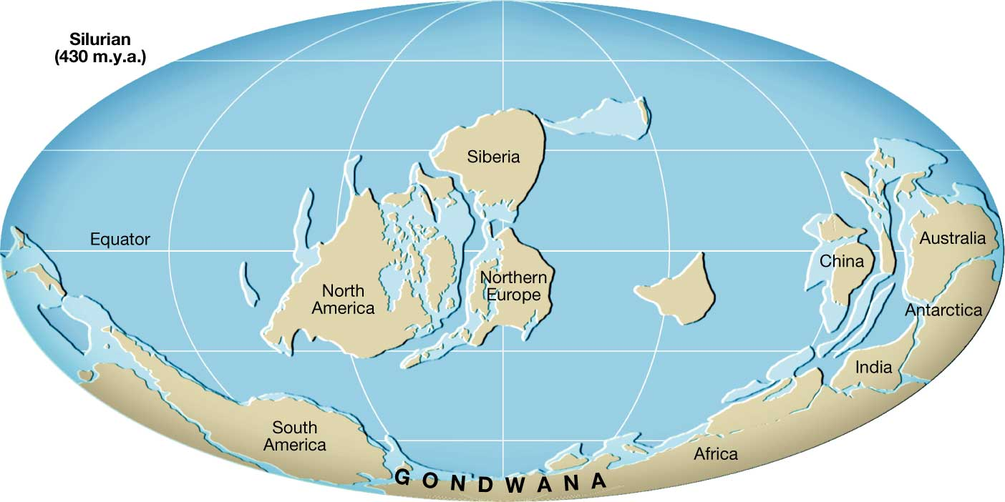

Slide 18
Early Paleozoic Life
Early Paleozoic Life was restricted to the seas
No vertebrates had evolved so all were invertebrates
Beginning of Cambrian time-1st animals with hard parts like shells for protection and adaptation
By Cambrian time-Trilobites
By Ordovician times-Brachiopods & Cephalopods
Cephalopod-mobile and most developed mollusks; were big predators
1st large organism on earth

Slide 19
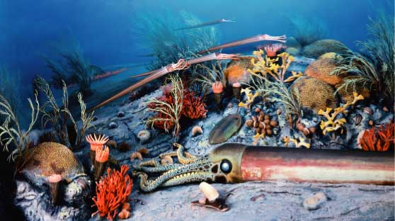
Life in the Ordovician Period

Slide 20
Late Paleozoic History
Spans about 160 million years
Includes Devonian, Mississippian, Pennsylvanian, and Permian
Laurasia is the continental mass that formed the northern portion of Pangea, consisting of the present-day North America and Eurasia
As Laurasia was forming, Gondwana moved northward
By the end of the Paleozoic, all of the continents had fused into the supercontinent of Pangaea
Changed climate drastically. Most of the interior became arid.

Slide 21
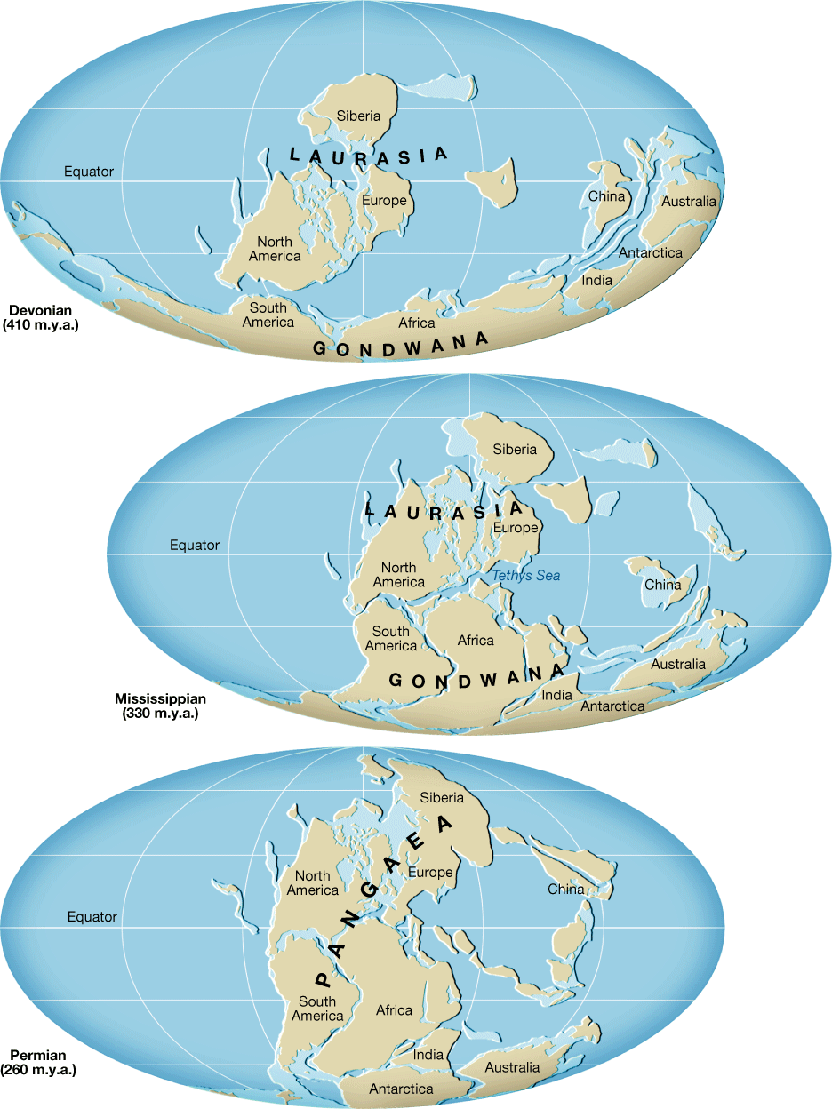

Slide 22
Late Paleozoic Life
During this time, organisms diversified dramatically
Some 400 million years ago, plants that had adapted to survive at the water’s edge began moving inland, becoming land plants
Earliest land plants were about the size of index finger, by end of paleozoic, had forests with trees tens of meters high
Ocean life developed more light-weight scales
During Devonian-primative sharks
Devonian age-”Life of the Fishes”

Slide 23
Late Paleozoic Life
By end of Devonian period, amphibians started to emerge
The amphibians rapidly developed and diversified because they had minimal competition from other land dwellers
By the end of the Pennsylvanian period, large tropical swamps extended across North America, Europe, and Siberia
Coal deposits originated in these swamps
1st Reptiles appeared

Slide 24
The Great Paleozoic Extinction
The world’s climate became very seasonal probably causing the dramatic extinction of many species
During Permian period-Pangaea
The late Paleozoic extinction was the greatest of at least five mass extinctions over the past 500 million years
By end of Permian, 75 species of amphibians gone, at least 80% of marine life gone,

Slide 25
The Great Paleozoic Extinction
Cause is uncertain-
Sea levels had dropped because of climates
Climate changes from Pangaea
At least 2 million cubic yards of lava flowed across Siberia
May have been from impact from extraterrestrial body

Slide 26
The Mesozoic Era: Age of the Reptiles

Slide 27
Mesozoic Era
Spanned about 183 million years
Divided into three periods
Triassic
Jurassic
Cretaceous
Beginning of the breakup of Pangaea continued for 200 million years through the Mesozoic and into the Cenozoic era
Dinosaurs became dominant and remained unchallenged for over 100 million years

Slide 28
Mesozoic History
Began with most of worlds land above sea level; then shallow seas invaded much of western North America, the Atlantic, and Gulf coastal regions
These shallow seas created great swamps like those of the Paleozoic era forming Cretaceous coal deposits that are important in Western US and Canada
As Pangaea broke apart, North American plate began to override Pacific Plate. Lead to forming mountains of Western US. By end of Mesozoic, Rockies began to form

Slide 29
Mesozoic Life
When era began, life forms were the survivors of great extinction in Paleozoic era.
The gymnosperms are seed-bearing plants that do not depend on free-standing water for fertilization
Quickly became dominate plants of the era
Ex-confers, ginkgoes trees

Slide 30
Mesozoic Life
The shelled egg
Unlike amphibians, reptiles have shell-covered eggs that can be laid on the land
The elimination of a water dwelling stage was an important evolutionary stage

Slide 31
Mesozoic Life
Because of the shelled egg, reptiles quickly became the dominant land animals
Some dinosaurs were carnivores (meat-eaters) some were herbivores (plant-eaters)
Not all dinosaurs were large
Some began to fly
Some returned to the sea
By end of the Mesozoic era-many reptile groups became extinct

Slide 32
Mesozoic Life
After extinction only a few reptiles survived to recent times-turtles, snakes, crocodiles, lizards
Extinction of dinosaurs and other animals most likely caused by a large meterorite that collided with Earth
They think the impact created large quantities of dust that blocked out the sun
Without the sun, plants died, then herbivores died, then carnivores died.

Slide 33
The Cenozoic Era-Age of Mammals

Slide 34
Cenozoic Era
Cenozoic Era-”era of recent life”
Encompasses past 65 million years
Post-dinosaur era, the time of mammals, including humans (Quaternary)
Divided into to periods of very unequal duration, the Tertiary period (63 million years) and the Quaternary Period (last 2 million years)

Slide 35
Cenozoic North America
Plate interactions during the Cenozoic era caused many events of mountain building, volcanism, and earthquakes in the West
The Atlantic and Gulf coastal regions were far removed from an active plate boundary, so they were stable

Slide 36
Cenozoic Life
Even though Cenozoic is called age of mammals, could also be age of Angiosperms
Angiosperms-flowering plants with covered seeds-replaced gymnosperms as dominant land plants
Influenced evolution of birds and mammals

Slide 37
Cenozoic Life
Mammals replaced reptiles as the dominant land animals
Mammals bear live young and maintain steady body temperature
Even though mammals and dinosaurs emerged at the same time in the late Triassic period, mammals remained small and primitive
Adaptations like being warm-blooded (could search for food during any season or time of day), developing insulating body hair, and having more efficient heart and lungs allow mammals to lead more active lives than reptiles

Slide 38
Large Mammals and Extinction
Some groups of mammals became very large
Many were common up to 11,000 years ago
However, a wave of late Pleistocene extinctions rapidly eliminated these animals from the landscape (during the last Ice Age)
In North America, the mastodon and mammoth both relatives of the elephant became extinct
Cause of recent extinction debatable…..

Slide 39
Some think it is because of the last ice age
BUT-the animals had survived other glacial advances and intergalical periods
Some scientists believe that the early humans hurried the decline of these mammals by selectively hunting large forms
Humans first appear in the Quaternary Period

Slide 40
NM Geologic History
Rocks from each of the four eras can be found within the state

Slide 41
NM Geologic History
Precambrian igneous and metamorphic rocks of more than 1.5 billion years old have been found
These rocks form the core of mountain ranges along the east side of the Rio Grande River
Oldest of the Precambrian rocks found in northern part of state in the Brazos, Taos, and Nacimiento mountains dating 1.8 billion years old
Most likely have been buried and later exposed by the uplift of mountain chains and erosion of sediments
During Precambrian=-NM had volcanic activity, mountain building, periodic episodes of submersion under the sea
Only remnants of these old mountain systems remain

Slide 42
Paleozoic Era
During later part of Paleozoic, Rocky Mountains formed, uplifting the central part of the state
Toward southern part of NM, a great barrier reef developed. As the reef was cut off from the sea, the evaporation of water left deposits of salt, potash, and gypsum that can be found today
State was covered by vast shallow sea, from which large deposits of limestone, sandstone, and shale accumulated

Slide 43
Mesozoic Era
Drying trend
Dinosaurs roamed much of the state
Many of the rocks of the northern part of the state including the colorful red, green, gray, brown, and white sandstone and shale were deposited by rivers that flowed towards the seas
Later in the era, the inland sea once again returned and NM was on the western shore of a great shallow ocean covering most of the central US

Slide 44
Cenozoic
Within the last 10 million years, NM has seen tremendous volcanic eruptions, such as those that produced the Jemez Mountains, Capullin Peak, and Mt. Taylor
The continuous erosion and deposition of sediments in recent times have produced many of the more scenic landscapes of the state, such as its colorful mesas, badlands, and deserts
Much change in NM landscape
Rocky Mountains rose and volcanoes produced a thick layer of igneous rock that covered much of NM
Shiprock was formed about 25 million years ago
In addition, stresses in the crust produced the large central depression that divides the state in half, called the Rio Grande rift

