Slide 1
Unit 7 Earth’s Interior & Plate Tectonics

Slide 2
8.4-Earth’s Layered Structure

Slide 3
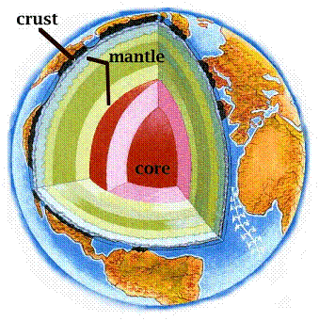
Layers Defined by Composition (What it is made of)
Crust
Mantle
Core

Slide 4
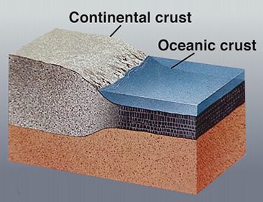
The Crust
Outer layer
Coolest Layer
2 types of crust
Oceanic (very dense, made of basalt, younger, 5-10 km thick)
Continental (less dense, made of granite, older, 30 km thick)

Slide 5
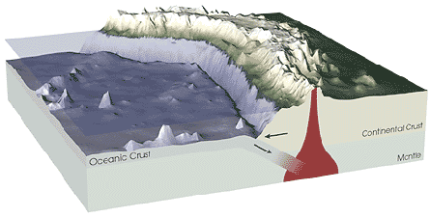
Oceanic and Continental Crust

Slide 6
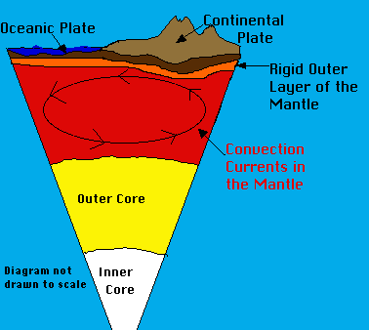
The Mantle
10 km below oceanic crust
Middle layer
Very thick layer
2900 km thick
Over 82% of Earth’s volume
Dominate rock type in uppermost mantle is peridotite

Slide 7
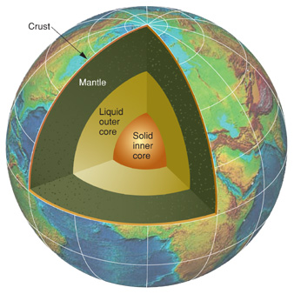
The Core
2900 km below surface
Made mostly of iron & nickel
1/3 of the earth’s mass
Very hot (hottest layer)
About 1250 km thick

Slide 8
Earth’s Layers
How are the earth’s layers similar to an egg?
Shell=crust
Egg white=mantle
Yolk=core

Slide 9
Physical Structure of the Earth (5 Layers)
Lithosphere- found in crust and uppermost mantle; about 100 km thick; cool, rigid, solid
Asthenosphere- found beneath lithosphere in the upper mantle; to a depth of about 660 km; soft, weak layer that is easily deformed
Lower Mantle- middle layer found in lower mantle; 660-2900 km; more rigid layer; rocks are very hot and capable of gradual flow (runs like hot asphalt)
Outer Core- found below lower mantle; liquid layer; 2270 km thick, convective flow of metallic Iron within generates Earth’s magnetic field
Inner Core- found at the core of the Earth; solid, very dense; sphere with a radius of 1216 km

Slide 10
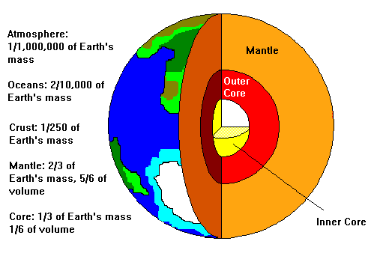

Slide 11
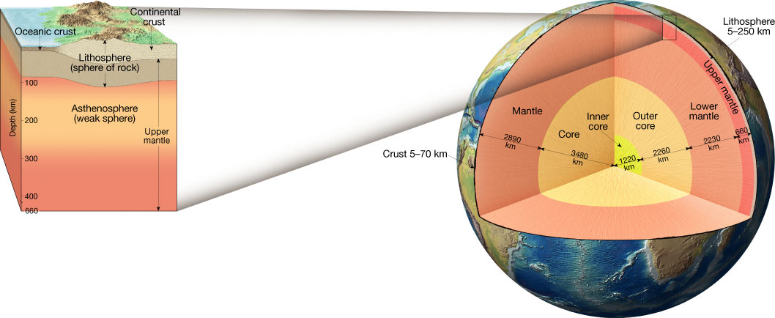

Slide 12
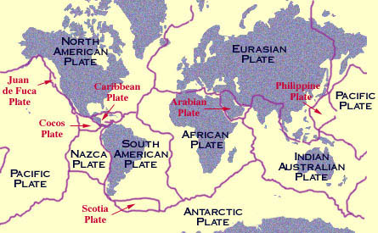
Tectonic Plates-Ch 9 Preview
Earth’s crust is broken into about 19 pieces

Slide 13
Discovering Earth’s Layers
Moho
The boundary separating the crust from the mantle, discernable by an increase in velocity of seismic waves
Velocity of seismic waves increases abruptly below crust
Shadow Zone
Absence of P waves from about 105 degrees to 140 degrees around the globe from an EQ
Can be explained if Earth contains a core composed of materials unlike the overlying mantle

Slide 14
Earth’s Interior Showing P and S Wave Paths

Slide 15
Discovering Earth’s Composition
Crust
Continental crust made mostly of lighter granitic rocks based on early seismic data and drilling technology
Mantle
More speculative composition
Some of the lava that reaches the Earth’s surface comes from the asthenosphere
Core
Dense Iron and Nickel, similar to metallic meteroites

Slide 16
9.1-Continental Drift

Slide 17
Continental Drift and Pangaea
1915- Wegener proposed continental drift hypothesis
Stated continents had once been joined to form a super continent, Pangaea
Pangaea-all land
Proposed it began to break apart ~200 mya
Evidence for continental drift
Continental Puzzle
Matching Fossils
Rock Types and Structures
Ancient Climates

Slide 18
Breakup of Pangaea

Slide 19
Evidence
Continental Puzzle
Matching Fossils
Continents fit together like a jigsaw puzzle
Includes several fossil organisms found on different landmasses
Ex. Mesosaurus found in South American and South Africa

Slide 20
Evidence
Rock Types and Structures
Ancient Climate
Several mountain belts end at one coastline and reappear on a landmass across the ocean
Ex. Appalachian Mountains found in US and on British Isles and Scandinavia
Glacial sheets covered large areas of Southern Hemisphere 220-300 mya
Glacial till found in southern Africa, South America, India, and Australia

Slide 21
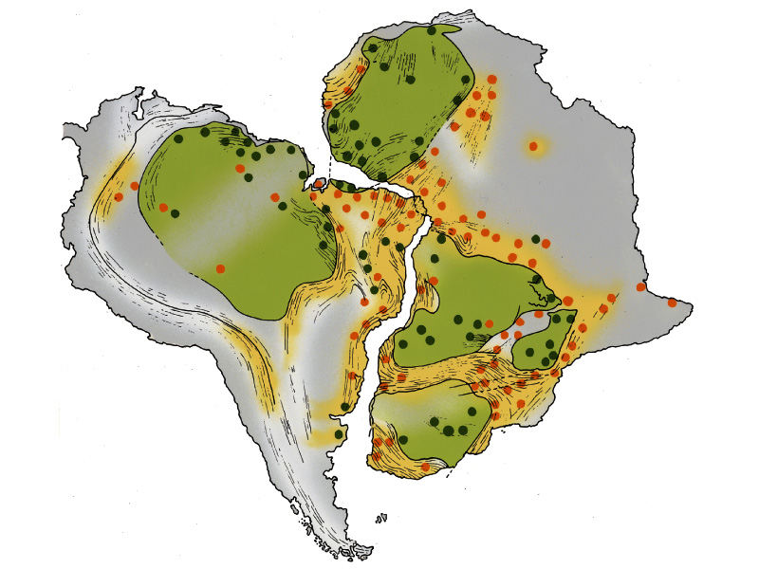
Rock type & structure evidence

Slide 22
Matching Mountain Ranges

Slide 23
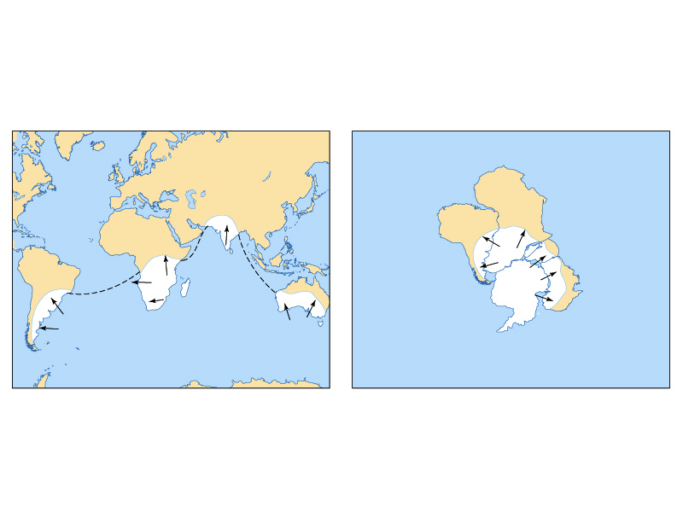
Reconstruction from glacial deposits

Slide 24
Glacier Evidence

Slide 25
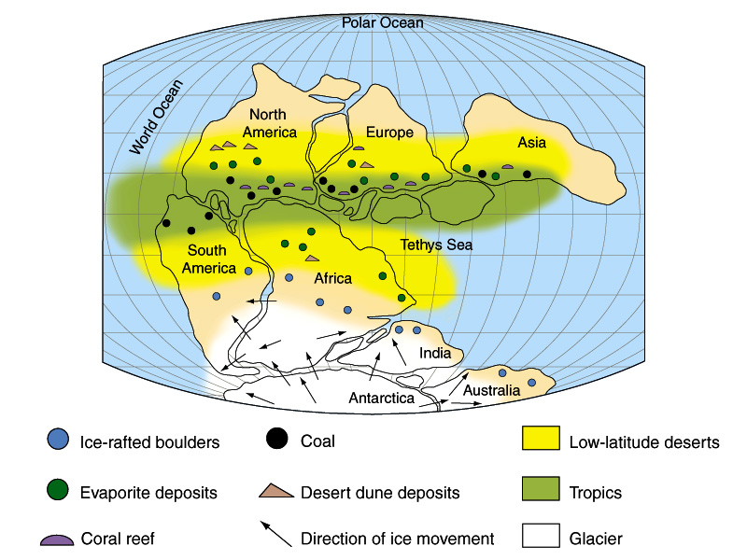
Paleoclimate evidence

Slide 26
Rejection and Criticism
Wegener could not explain why continents moved
Many criticized him and rejected his hypothesis
Later technology leads to the findings for plate tectonic theory

Slide 27
9.2 Plate Tectonics

Slide 28
Plate Tectonic Theory
The uppermost mantle, along with crust, behaves as a strong, rigid layer known as the lithosphere
A plate is one of the numerous rigid sections of the lithosphere that moves as a unit over the material of the asthenosphere
Major Difference from Wegener: now, continents moved with ocean floor not through it

Slide 29
Major Plates of the Earth

Slide 30
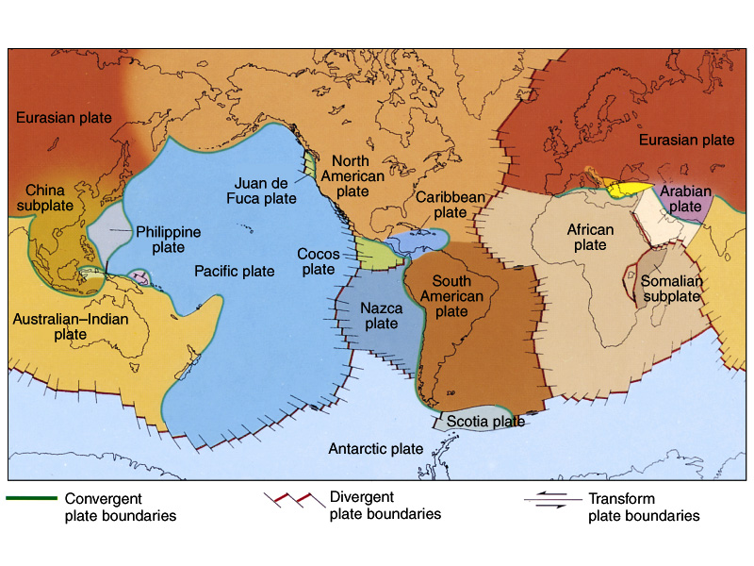
Major tectonic boundaries

Slide 31
More about Plates
7 major plates
Largest plate: Pacific Plate
None of the plates are defined by the margins of a continent
Plates move very slowly, about 5 cm per year, about the rate of fingernails growing
Movement driven by unequal distribution of heat within the Earth

Slide 32
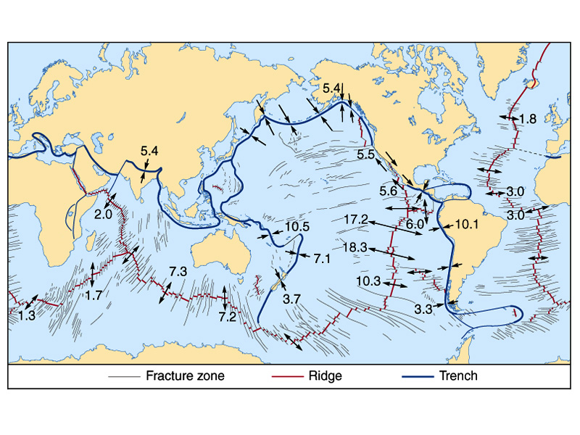
Rates of plate motion around the world

Slide 33
9.3 Actions at Plate Boundaries

Slide 34
Types of Plate Boundaries
Divergent (also called spreading centers)
Two plates move apart
Constructive plate margins-new oceanic lithosphere made
Convergent
Two plates move together; collide
Destructive plate margins-lithosphere “destroyed”
Transform Fault
Margins where two plates grind past each other without the production or destruction of the lithosphere

Slide 35
Types of Plate Boundaries

Slide 37
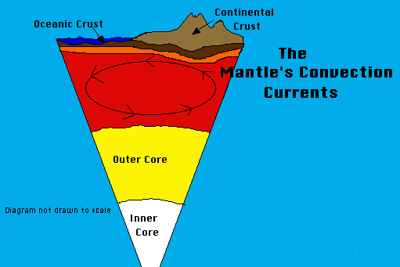
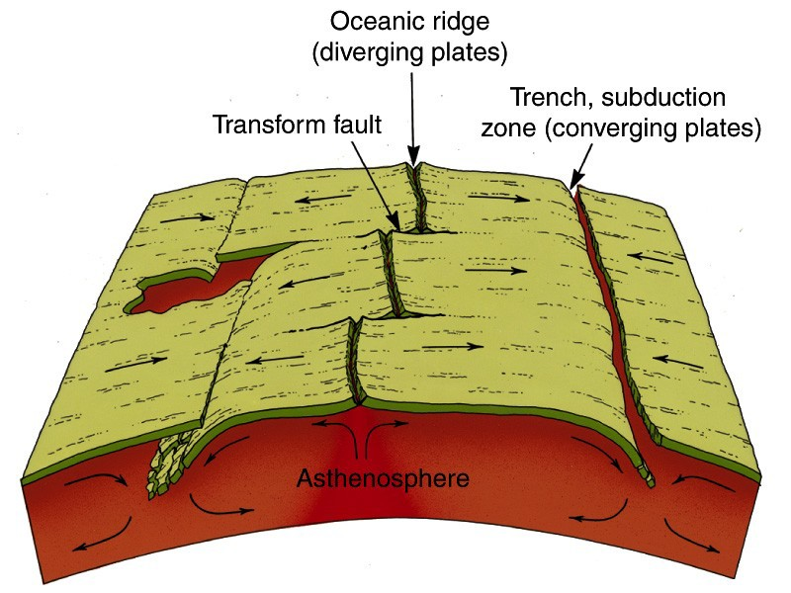

Slide 38
Divergent Plate Boundaries
Oceanic Ridges and Seafloor Spreading
Oceanic Ridges
Continuous elevated zones on the floor of all major ocean basins. The rifts at the crest of ridges represent divergent plate boundaries
Rift Valleys
Deep faulted structures found along the axes of divergent plate boundaries; can develop on seafloor or on land
Seafloor spreading
Produces new oceanic lithosphere
~5 cm/year

Slide 39
Spreading Center

Slide 40
Divergent Boundaries
Continental Rifts
When spreading centers develop within a continent, the landmass may split into two or more smaller segments, forming a rift
Ex. East African rift valley; Rhine Valley in NW Europe

Slide 41
East African Rift Valley

Slide 42
Convergent Boundaries
As two plates converge, the leading edge of one is bent downward, allowing it to slide beneath the other
Subduction zone: occurs when one oceanic plate is forced down into the mantle beneath a second plate
Convergent Boundaries can form between:
Two oceanic plates
One oceanic plate & one continental plate
Two continental plates

Slide 43
Oceanic-Continental
Denser oceanic slab sinks into the asthenosphere
Pockets of magma develop and rise
Continental volcanic arcs form in part by volcanic activity caused by the subduction of oceanic lithosphere beneath a continent
Ex. Andes, Cascades, and Sierra Nevada Mountains

Slide 44
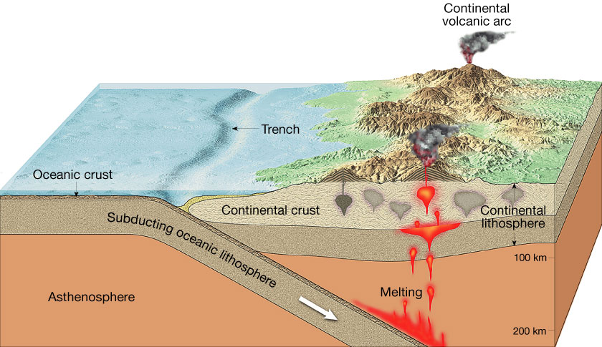
Oceanic-Continental Convergent Boundary

Slide 45
Convergent Boundaries
Oceanic-Oceanic
Continental-Continental
Two oceanic slabs converge and one descends beneath the other
Often forms volcanoes on ocean floor
Volcanic island arcs form as volcanoes emerge from sea
Ex. Aluetian, Mariana,and Tonga Islands
When subducting plates contain continental material, two continents collide
Can produce new mountain ranges
Ex. Himalayas

Slide 46
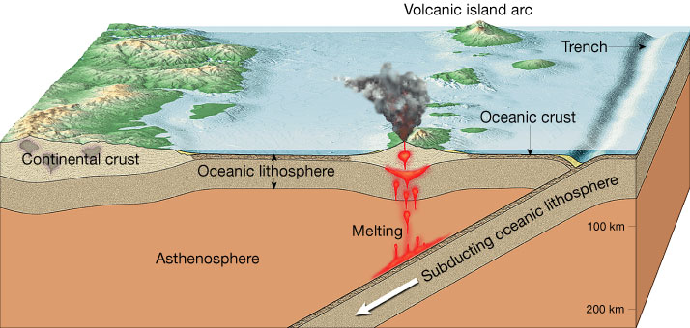
Oceanic-Oceanic Convergent Boundary

Slide 47
Continental-Continental Convergent Boundary

Slide 48
Collision of Asia and India

Slide 49
Transform Fault Boundary
At a transform fault boundary, plates grind past each other without destroying lithosphere
Transform Faults
Most join two segments of a mid-ocean ridge
At the time of formation, they roughly parallel the direction of plate movement
They aid in the movement of oceanic crustal material
Can lead to earthquakes
Ex. San Andreas Fault of California

Slide 50
Transform Fault Boundary

Slide 51
9.4 Testing Plate Tectonics

Slide 52
Evidence for Plate Tectonics
Paleomagnetism
The natural remnant magnetism in rock bodies
This permanent magnetization acquired by rock can be used to determine the location of the magnetic poles at the time the rock became magnetized
Normal Polarity: when rocks show the same magnetism as the present magnetism field
Reverse Polarity: when rocks show the opposite magnetism as the present magnetism field

Slide 53
Paleomagnetism Preserved in Lava Flows

Slide 54
More evidence for Plate Tectonics
Discovery of strips of alternating polarity, which lie as a mirror image across the oceanic ridges
One of the strongest pieces of evidence for seafloor spreading

Slide 55
Polarity of the Ocean Crust

Slide 56
Evidence for Plate Tectonics
Earthquake patterns
Close link between deep-focus earthquakes and ocean trenches
Absence of deep-focus earthquakes along the oceanic ridge system was shown to be consistent with plate tectonics
Ocean Drilling
Data on the edges of seafloor sediment confirmed what the seafloor spreading hypothesis predicted
Youngest oceanic crust is at the ridge crust; oldest is at the continental margins

Slide 57
Evidence for Plate Tectonics
Hot Spots
Hot spot: a concentration of heat in the mantle capable of producing magma, which rises to the Earth’s surface
The pacific plate moves over a hot spot, producing the Hawaiian Islands
Hot spot evidence supports that plates move over the Earth’s surface

Slide 58
Hot Spot

Slide 59
9.5 Mechanisms of Plate Motion

Slide 60
Causes of Plate Motion
Scientists generally agree that convection occurring in the mantle is the basic driving force for plate movement!
During convection, warm, less dense material rises and cooler, more dense material sinks
Convective flow: the motion of matter resulting from changes in temperature
The heat is generated by the radioactive decay of elements like Uranium found in the Earth’s crust and mantle

Slide 61
Causes of Plate Motion
Slab-Pull and Ridge-Push
Slab pull: a mechanism that contributes to plate motion in which cool, dense oceanic crust sinks into the mantle and “pulls” the trailing lithosphere along. It is thought to be the primary downward arm of convective flow in the mantle
Ridge-push: causes oceanic lithosphere to slide down the sides of the oceanic ridge under the pull of gravity. May contribute to plate motion

Slide 62
Causes of Plate Motion
Mantle Convection
Mantle plumes are masses of hotter-than-normal mantle material ascend toward the surface, where they may lead to igneous activity
The unequal distribution of heat within the Earth causes the thermal convection in the mantle that ultimately drives plate motion

Slide 63
Mantle Convection Models

Slide 64
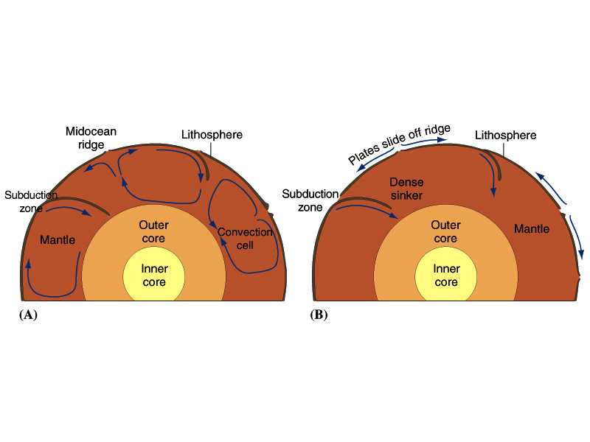
Models of plate tectonic motion

