Slide 1
Chapter 24 Notes-Studying the sun

Slide 2
Why Study the sun?
Understanding the nature of light is basic to modern astronomy
By understanding how the sun works, we can figure out how more distant objects function in space

Slide 3
24.1-The Study of Light
Electromagnetic Spectrum is all of the different types of light based on wavelength and frequency
Includes gamma rays, X-rays, ultraviolet light, visible light, infrared radiation, microwaves, and radio waves
We can only see visible light

Slide 4
The EM spectrum

Slide 5
The Nature of Light
Light can be described in two ways: as waves or as photons (particles)
In the wave sense, light can be thought of as swells in the ocean. This motion is characterized by a property known as wavelength, which is the distance from one wave crest to the next.
In some cases, light can act as a stream of particles called photons
These photons “push” on matter
Photons from the sun are responsible for pushing material away from a comet to produce its tail
Shorter wavelength=more energetic photons

Slide 6
Spectroscopy
Spectroscopy-the study of the properties of light that depend on wavelength
Continuous spectrum is produced by an incandescent solid, liquid, or gas under high pressure.
The spectrum in an uninterrupted band of color.
Ex-Light from a light bulb
Absorption Spectrum is a continuous spectrum produced when white light passes through a cool gas under low pressure.
The gas absorbs selected wavelengths of light, and the spectrum looks like it has dark lines superimposed.

Slide 7
Emission Spectrum
An emission spectrum is a series of bright lines of particular wavelengths produced by a hot gas under low pressure.
When the spectrum of a star is studied, the spectral lines act as “fingerprints.” These lines identify the elements present and thus the star’s chemical composition.

Slide 8
Formation of Spectra

Slide 9
Doppler Effect
The Doppler effect is the apparent change in frequency of electromagnetic or sound waves caused by the relative motions of the source and the observer.
The light from a source that is moving away from an observer appears redder than it actually is because its waves are lengthened
The light from a source that is moving closer to an observer appears bluer than it actually is because its waves are shortened
In astronomy, the Doppler effect is used to determine whether a star or other body in space is moving away from or toward Earth.
Large Doppler shifts indicate higher speeds
Small Doppler shifts indicate slower speeds

Slide 10
The Doppler Effect

Slide 11
24.2-Tools For Studying Space
Galileo is considered the first astronomer to use telescopes for astronomical observations
Refracting Telescoipes
A refracting telescope is a telescope that uses a lens to bend or refract light
Focus
The most important lens in a refracting telescope, the objective lens, produces an image by bending light from a distant object so that the light converges at an area called the focus (focus = central point).

Slide 12
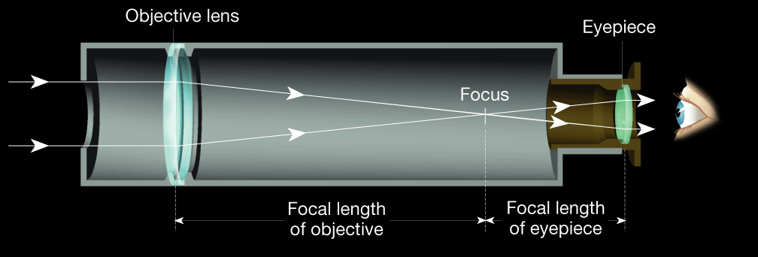
Simple Refracting Telescope

Slide 13
Keck Telescope

Slide 14
Chromatic Aberration- is the property of a lens whereby light of different colors is focused at different places.
This is the defect of early telescopes
As light passes through any lens, the shorter wavelengths of light are bent more than the longer wavelengths
Consequently, when a refracting telescope is in focus, red, blue, and violet light are out of focus
Chromatic Aberration weakens the image and produce a halo of color around it.

Slide 15
Reflecting Telescopes
A reflecting telescope is a telescope that reflects light off a concave mirror, focusing the image in front of the mirror.
Advantages of Reflecting telescopes
Most large optical telescopes are reflectors. Light does not pass through a mirror, so the glass for a reflecting telescope does not have to be of optical quality.

Slide 17
Properties of Optical Telescopes
Both refracting and reflecting telescopes have three properties that aid astronomers in their work:
Light gathering power
Resolving power
Magnifying power
Light gathering power refers to the telescopes ability to intercept more light from distance objects

Slide 18
Detecting Invisible Radiation
Remember there are more kinds of light radiation that what we see, to detect radiowaves we use radio telescopes
Radio Telescopes
is a telescope designed to make observations in radio wavelengths
focuses the incoming radio waves on an antenna, which, just like a radio antenna, absorbs and transmits these waves to an amplifier.

Slide 19
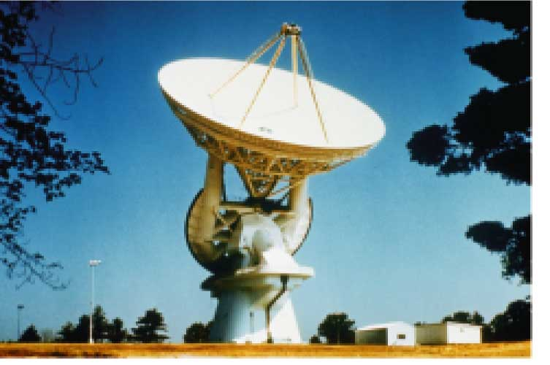
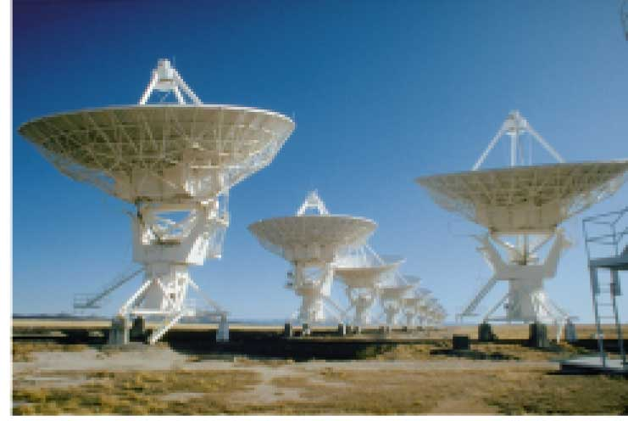
Radio Telescopes

Slide 20
Tools for Studying Space
Advantages of Radio Telescopes
• Radio telescopes are much less affected by turbulence in the atmosphere, clouds, and the weather.
• No protective dome is required, which reduces the cost of construction.
• Radio telescopes can “see” through interstellar dust clouds that obscure visible wavelengths.

Slide 21
Space Telescopes
Space telescopes orbit above Earth’s atmosphere and thus produce clearer images than Earth-based telescopes
Hubble Space Telescopes
The first space telescope, built by NASA was the Hubble Space Telescope.
Started to orbit Earth in April 1990
It has provided information about Pluto, planets that orbit other stars, birth of stars, death of stars, black holes, the age of the universe, and the expansion of the universe

Slide 23
Other Space Telescopes
To study X-rays, NASA uses the Chandra X-Ray Observatory. This space telescope was launched in 1999.
Another space telescope, the Compton Gamma-Ray Observatory, was used to study both visible light and gamma rays.
In 2011, NASA plans to launch the James Webb Space Telescope to study infrared radiation.

Slide 24
Milky Way Galaxy

Slide 25
The Sun
The sun is one of 100 billion stars in our galaxy
Sun is an average star that is not significant to the universe, but it is our solar system’s source of light and heat
Even though it is an “average star”
109 times the diameter of earth
Accounts for over 99% of our solar system’s mass
1.25 times the volume of earth
332 times the mass of earth

Slide 26
24.3 The Sun
Because the sun is made of gas, no sharp boundaries exist between its various layers.
Keeping this in mind, we can divide the sun into four parts:
the solar interior;
the visible surface, or photosphere;
and two atmospheric layers, the chromosphere and corona.

Slide 27
24.3 The Sun
Photosphere
• The photosphere is the region of the sun that radiates energy to space, or the visible surface of the sun.
• It consists of a layer of incandescent gas less than 500 kilometers thick.
• It exhibits a grainy texture made up of many small, bright markings, called granules, produced by convection.
Each granule only survives 10-20 minutes
The composition of the sun is 90% hydrogen, less than 10% helium, and <1% other elements
• Most of the elements found on Earth also occur on the sun.
• Its temperature averages approximately 6000 K (10,000ºF).

Slide 28
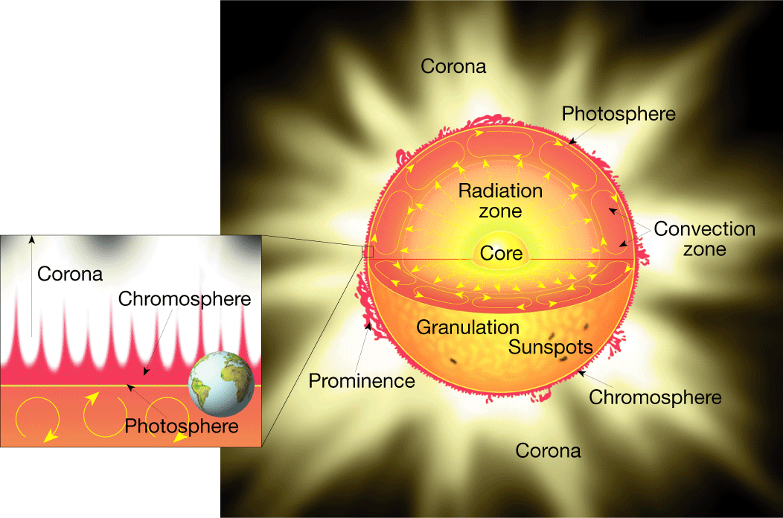
Structure of the Sun
Notes:
Makes no sense without caption in book

Slide 29
24.3 The Sun
Chromosphere
• The chromosphere is the first layer of the solar atmosphere found directly above the photosphere
The chromosphere can be seen for a few moments during a total solar eclipse and appears as a thin red rim around the sun
• It is a relatively thin, hot layer of incandescent gases a few thousand kilometers thick.
• Its top contains numerous spicules, which are narrow jets of rising material.

Slide 30
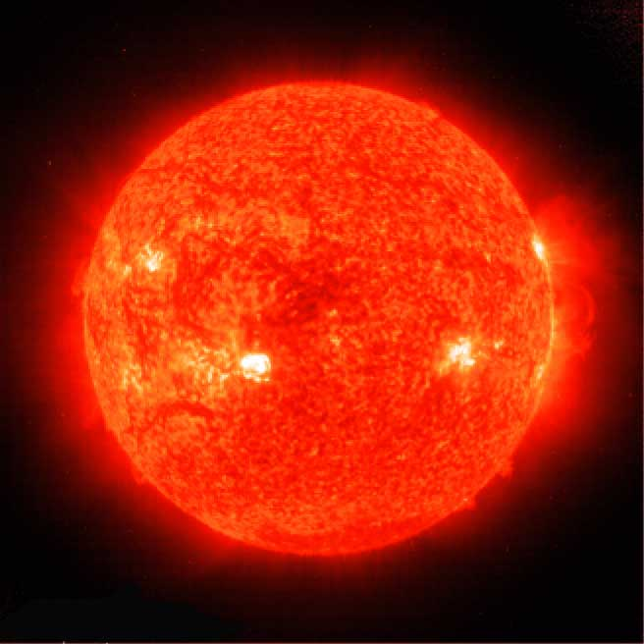
Chromosphere
Notes:
Makes no sense without caption in book

Slide 31
24.3 The Sun
◆ Corona
• The corona is the outer, weak layer of the solar atmosphere.
Extends a million kilometers from the sun, and produces a glow about half as bright as the full moon
• The temperature at the top of the corona exceeds 1 million K.
• Solar wind is a stream of protons and electrons ejected at high speed from the solar corona.
Winds can travel up to 800 km/second
Although the corona is much hotter than the photosphere, it radiates much LESS energy because of its very low density

Slide 32
24.3 The Sun
◆ Sunspots
• First found by Galileo
A sunspot is a dark spot on the sun that is cool in contrast to the surrounding photosphere.
• Sunspots appear dark because of their temperature, which is about 1500 K less than that of the surrounding solar surface.

Slide 33
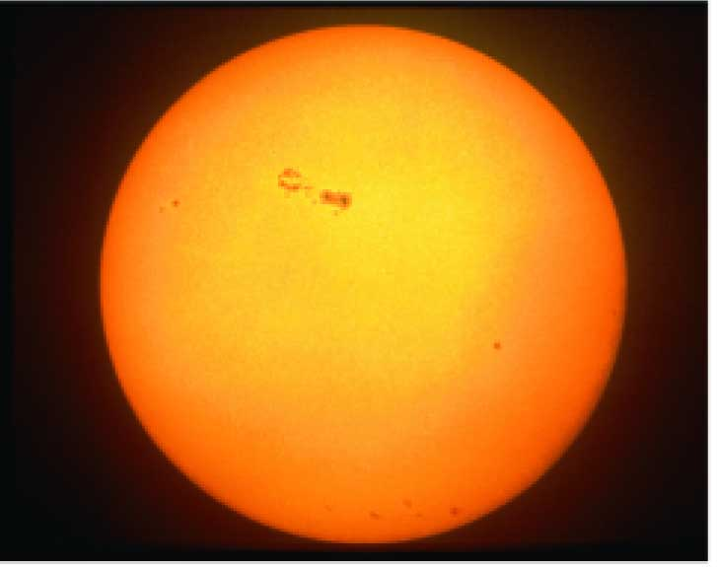
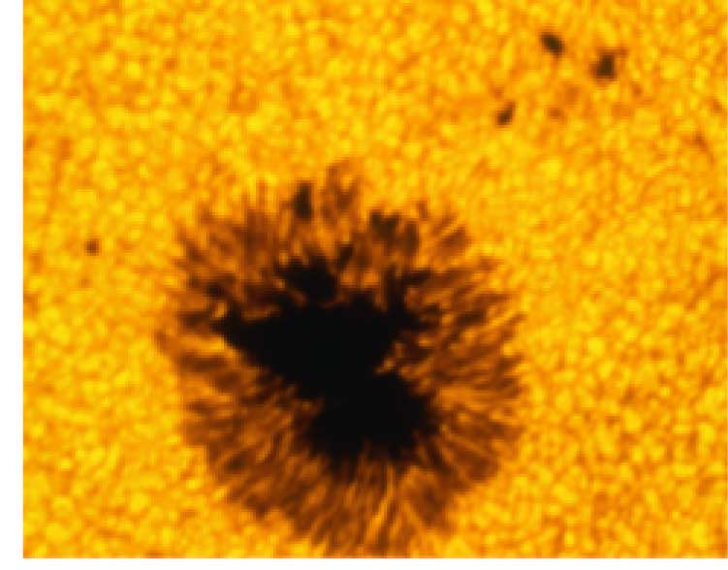
Sunspots
Notes:
Makes no sense without caption in book

Slide 34
24.3 The Sun
◆ Prominences
• Prominences are huge cloudlike structures consisting of chromospheric gases.
Often appear as great arches that extend well into the corona
Reach speed up to 1000 km/second and may leave the sun entirely
• Prominences are ionized gases trapped by magnetic fields that extend from regions of intense solar activity.

Slide 35
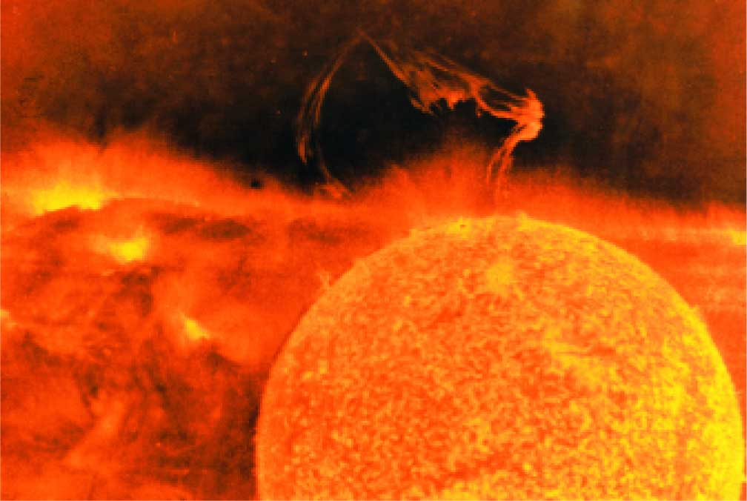
Solar Prominence
Notes:
Makes no sense without caption in book

Slide 36
24.3 The Sun
◆ Solar Flares
• Solar flares are brief outbursts that normally last about an hour and appear as a sudden brightening of the region above a sunspot cluster.
• During their existence, solar flares release enormous amounts of energy, much of it in the form of ultraviolet, radio, and X-ray radiation.
About a day after a large outburst, the ejected particles reach Earth, where they can have large effects on long-distance radio communication
• Auroras, the result of solar flares, are bright displays of ever-changing light caused by solar radiation interacting with the upper atmosphere in the region of the poles.

Slide 37
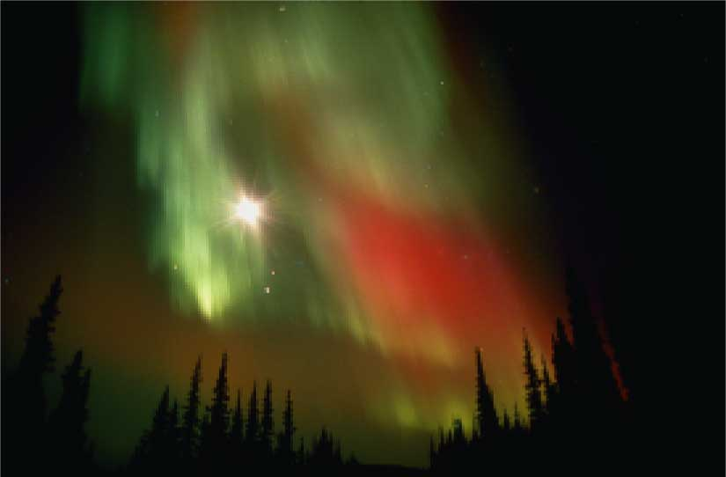
Aurora Borealis
Notes:
Makes no sense without caption in book

Slide 38
24.3 The Sun
◆ Nuclear Fusion
• Nuclear fusion is the way that the sun produces energy. This reaction converts four hydrogen nuclei into the nucleus of a helium atom, releasing a tremendous amount of energy.
• During nuclear fusion, energy is released because some matter is actually converted to energy.
• It is thought that a star the size of the sun can exist in its present stable state for 10 billion years. As the sun is already 4.5 billion years old, it is “middle-aged.”

Slide 39
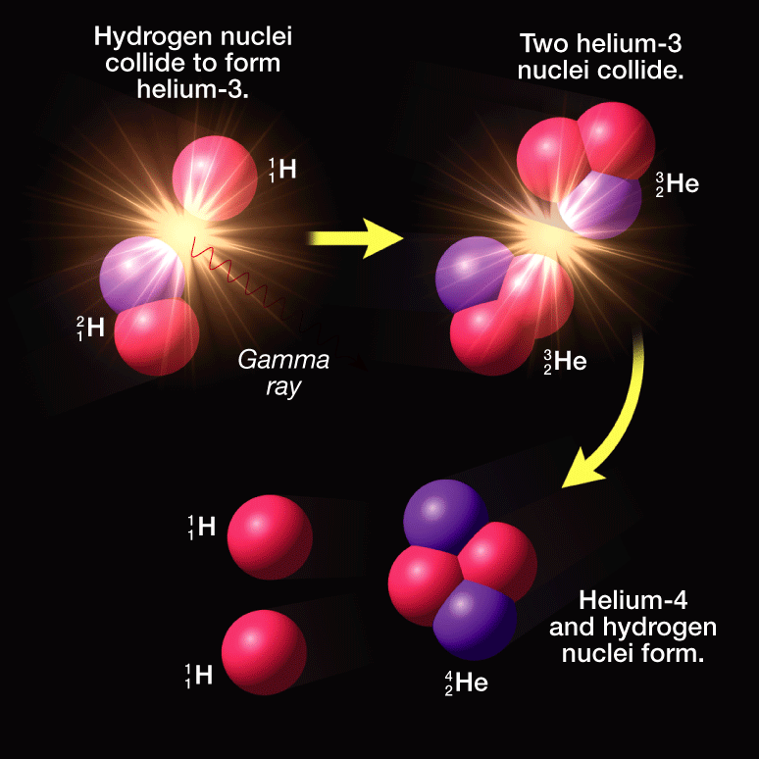
Nuclear Fusion
Notes:
Makes no sense without caption in book

