Slide 1
Chapter 25 Notes
Beyond our Solar System

Slide 2
Section 1: Properties of Stars

Slide 3
What is a star?
Huge spheres of very hot gas that emit light and other radiation
The sun is the nearest star to Earth
The next closest star is Proxima Centauri, which is 100 million times farther away from Earth than the moon
On a clear night you can see about 6000 stars

Slide 4
What is a star?
Stars are driven by nuclear fusion reactions!
A star is made mostly of hydrogen and helium
A star is held together by gravity forces from its own mass
Nuclear fusion takes place in the center of a star
Energy is released as electromagnetic radiation

Slide 5
Characteristics of Stars
Constellations- an apparent group of stars originally named from mythical characters. The sky contains 88 constellations.

Slide 6
Characteristics of Stars
Measuring Distances to Stars
Parallax
The slight shifting of the apparent position of a star due to the orbital motion of Earth
The most basic way to measure distance
The nearest stars have the largest parallax angles, while those of distant stars are too small to measure
“Large” parallax angles still are as small or smaller than 1/3600 of an arc

Slide 7
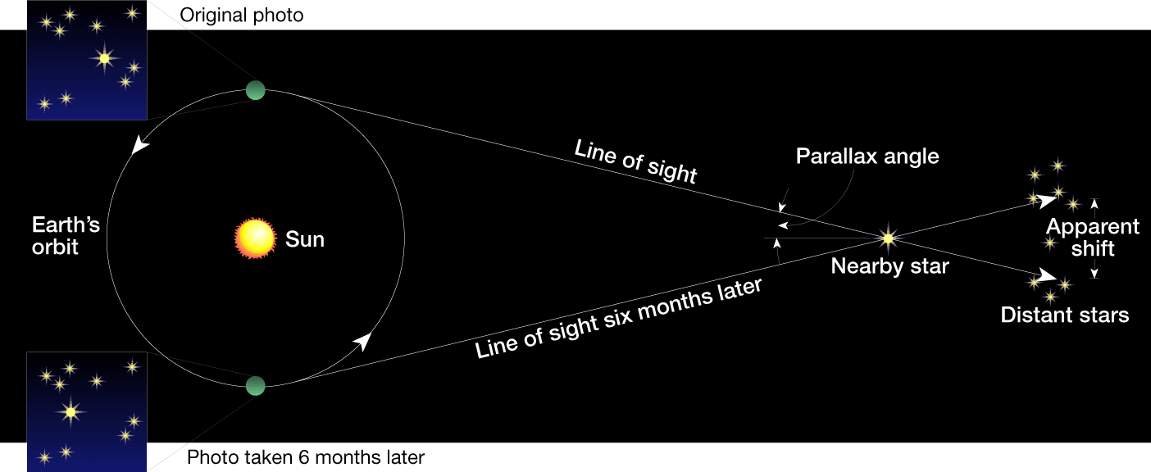
Parallax

Slide 8
Characteristics of Stars
Measuring Distances to Stars
Light-Year
The distance which a ray of light would travel in one year
1 light year=9.5 x 10¹⁵ m
Proxima Centauri is about 4.3 light years away from the sun

Slide 9
Characteristics of Stars-Binary Stars and Stellar Mass
A binary star is one of two stars revolving around a common center of mass under their mutual gravitational attraction
More than 50% of the stars in the universe may occur in pairs or multiples
Binary stars are used to determine the star property most difficult to calculate-its mass

Slide 10
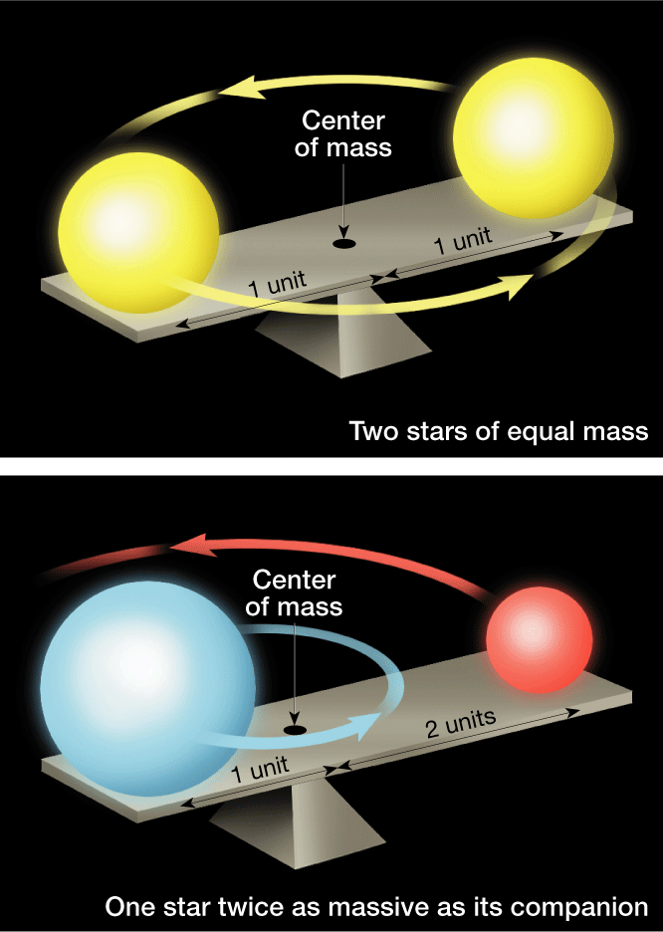
For stars of equal mass, the center of mass lies directly halfway between them.
If one star is more massive than its partner, their common center will be closer to the more massive star. If the size of their orbits are known, the mass can be determined.

Slide 11
Characteristics of Stars-Stellar Brightness
Magnitude (brightness)
A measure of brightness of celestial objects
Smaller (more negative) values represent brighter objects, larger values represent less bright objects
Apparent Magnitude
How bright a star appears to be from Earth
Brightness depends on the star’s temperature, size, and distance from Earth
Absolute Magnitude
How bright a star actually is

Slide 12
Absolute magnitude vs Apparent Magnitude

Slide 13
Star Color and Temperature
Color is a clue to a star’s temperature.
Very hot stars are emit light in short wavelengths, so they appear more blue
Red Stars are much cooler, and their wavelengths are longer
Stars are classified by temperature
Remember: OBAFGKM (Oh, Be A Fine Girl, Kiss Me)

Slide 14
Color and Temperature of Stars
Hotter objects glow with light that is more intense and has shorter wavelengths
The hottest type of star is a Class O (blue)
The coldest type of star is a Class M (red)
The sun is a Class G star (yellow)

Slide 15
Types of Stars-Classification
Class | Temperature | Color
O | 20,000- 60,000 K | Blue
B | 10,000 – 30,000 K | Blue-white
A | 7,500 – 10,000 K | White
F | 6,000 – 7,500 K | Yellow-white
G | 5,000 – 6,000 K | Yellow
K | 3,500 – 5,000 K | Orange
M | 2,000 – 3,500 K | Red

Slide 16
Hertzsprung-Russell Diagram
A graph to study stars
Shows the relationship between the absolute magnitude and the temperature of stars
Y axis: absolute magnitude X axis: temperature

Slide 17
Hertzsprung-Russell Diagram
A graph to study stars
Shows the relationship between the absolute magnitude and the temperature of stars
Y axis: absolute magnitude X axis: temperature

Slide 18
H-R Diagram

Slide 19
Hertzsprung-Russell Diagram
A main sequence star is a star that falls on the man sequence category on the H-R Diagram. This category contains most of the stars and runs diagonally from the upper left corner to the lower right corner.
The hottest blue stars are about 50 times more massive than the sun, while the coolest red stars are only 1/10 the size of the sun
The graph shows stars from more massive blue stars to smaller red stars

Slide 20
Hertzsprung-Russell Diagram
A red giant is a large, cool star of high luminosity; it occupies the upper right portion of the H-R diagram
A supergiant is a very large, very bright red giant star
The white dwarfs (thought not all white in color) are much fainter than main sequence stars of the same temperature. Some are probably no bigger than earth. The occur in the lower-central part of the H-R Diagram

Slide 21
Hertzsprung-Russell Diagram
Variable Stars
A cepheid variable is a star whose brightness changes periodically because it expands and contracts; it is a pulsating type of star
A nova is a star that explosively increases in brightness
Scientists think novas occur binary systems consisting of an expanding red giant and a nearby white dwarf

Slide 22
Hertzsprung-Russell Diagram
Interstellar Matter
A nebula is a cloud of gas and/or dust in space
There are two major types of nebulae
Bright Nebula-if close to a hot star
Emission nebula-mostly hydrogen
Reflection nebula-reflect the light of nearby stars
Dark Nebula-not close enough to a bright star to be lit up

Slide 23
Interstellar Matter

Slide 24
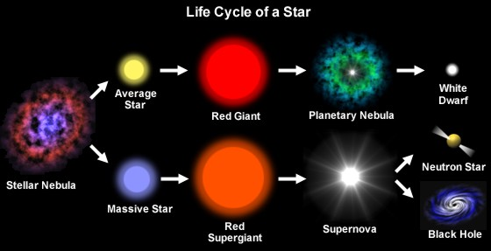
Section 2: Stellar Evolution

Slide 25
Star Birth
Stars begin their lives as nebulae
In the Milky Way, nebulae consist of 92% hydrogen, 7% helium, and 1% other heavier elements
Gravity may cause the nebula to contract
Matter in the gas cloud will begin to condense into a dense region called a protostar
A protostar is a developing star not yet hot enough to engage in nuclear fusion
When the core of a protostar has reached about 10 million K, pressure is so great that nuclear fusion begins, and a star is born

Slide 26
Main Sequence Stage
Once nuclear fusion begins, the star is now in its main sequence stage of life where it spends about 90% of its life
Life span of a star depends on its size
Very large, massive stars burn their fuel much faster than smaller stars
Their main sequences may last only a few hundred thousand years
Smaller stars will live on for billions of years because they burn their fuel much more slowly.
Eventually, the star’s fuel will begin to run out

Slide 27
As nuclear fusion slows, and the hydrogen fuel source is depleted, a star rapidly evolves and dies
With the exception of low-mass red stars, a star can delay its death by fusing heavier elements and becoming a giant
Average/Medium mass stars become red giants
Massive stars become red supergiants

Slide 28
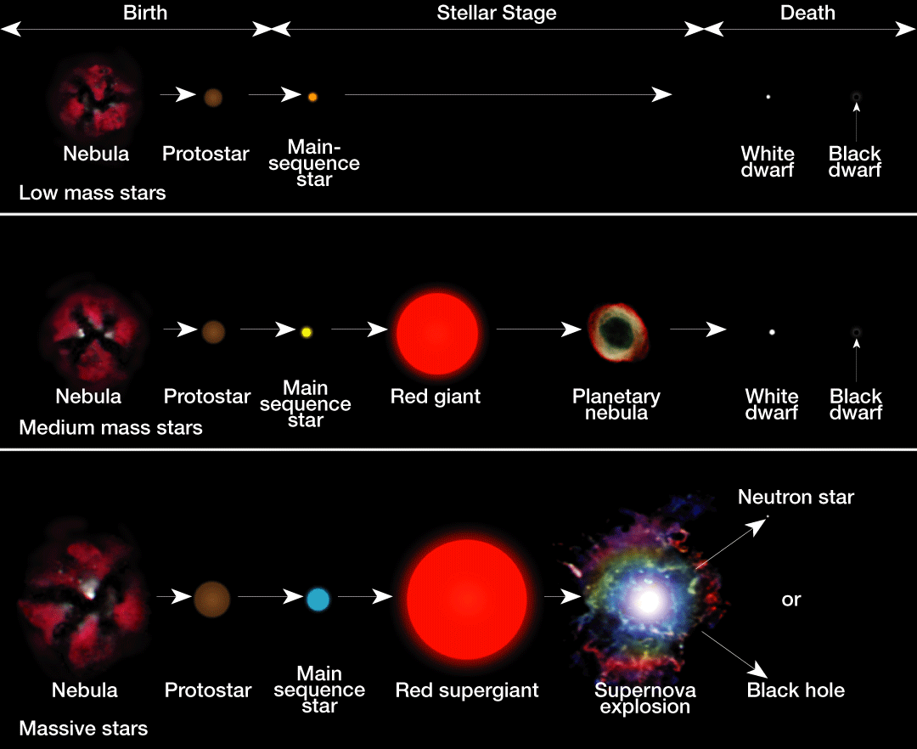

Slide 29
Red Giant/Supergiant Stage
Hydrogen burning migrates outward. The star’s outer envelope expands (and becomes a giant)
Its surface cools and becomes red
The core collapses as helium is converted to carbon. Eventually all nuclear fuel is used and gravity squeezes the star
Average star=red giant
Massive star=red supergiant

Slide 30
Burnout and Death of Stars
All stars, regardless of their size, eventually run out of fuel and collapse due to gravity
Death of Low Mass Stars
Stars less than ½ the mass of the sun never evolve to the red giant stage but remain in the stable main sequence stage until they consume all their hydrogen fuel and collapse into a white dwarf
Low mass stars don’t get hot enough to fuse helium so only fuel source is hydrogen

Slide 31
Death of Medium/Average mass stars
Stars with masses similar to the sun evolve essentially the same way as low-mass stars
During their collapse from red giants to white dwarfs, medium-mass stars are thought to cast off their bloated outer layers, creating an expanding round cloud of gas called planetary nebula

Slide 32
Planetary Nebula

Slide 33
Death of Massive Stars
Stars that over 3x the mass of the sun have relatively short life spans, which end in a supernova explosion event
A supernova is an exploding massive star that increases in brightness many thousands of times
Supernova are rare; none have been observed in our galaxy
The massive star’s interior condenses and may produce a hot, dense object that is either a neutron star or a black hole

Slide 34
Burnout and Death
H-R Diagrams and Stellar Evolution
H-R diagrams have been helpful in formulating and testing models of stellar evolution
They are also useful for illustrating the changes that take place in an individual star during its life span

Slide 35
Stellar Remnants
White Dwarfs
A white dwarf is a star that has exhausted most or all of its nuclear fuel and has collapsed to a very small size, believed to be near its final stage of evolution
The sun begins as a nebula, spends much of its life as a main-star sequence star, and then becomes a red giant, a planetary nebula, a white dwarf, and finally a black dwarf

Slide 36
Stellar Remnants
Neutron Stars
A star of extremely high density composed entirely of neutrons
Neutron stars are thought to be the remnants of supernovae events
Black holes
A massive star that has collapsed to such a small volume that its gravity prevents the escape of everything, including light
Scientists think that as matter is pulled into a black hole, it should become very hot and emit a flood of X-rays before being pulled in

Slide 37
Gases from the Red Supergiant spiral into the black hole

Slide 38
Section 3: The Universe

Slide 39
Types of Galaxies
A galaxy is a group of stars, dust, and gases held together by gravity
There are three types of Galaxies: Spiral, Elliptical, Irregular
Classified based on shape

Slide 40
Spiral Galaxies
About 30% of all galaxies are spiral galaxies
They have large diameters 20,000 to 125,000 light-years and contain both young and old stars
Usually disked shaped like a pinwheel, with a somewhat greater concentration of stars near their centers
A barred spiral galaxy has its stars arranged in the shape of a bar which rotates as a rigid system and attached to the bar are curved spiral arms
The Milky Way may be a Barred Spiral Galaxy

Slide 41
Spiral Galaxies
Have interstellar matter in between stars
Clouds of interstellar matter provide the materials to allow new stars to form

Slide 42
The Milky Way Galaxy
Size of the Milky Way Galaxy
Hard to study because interstellar matter blocks are vision
A large spiral galaxy whose disk is about 100,000 light years thick at the nucleus.
Structure of the Milky Way
Scientists have used radio telescopes to determine the structure of our galaxy
Has at least 3 distinct spiral arms
The sun is in one of the arms about 30,000 ly away from the center of the galaxy
Our solar system orbits the galactic nucleus once every 200 million years

Slide 43
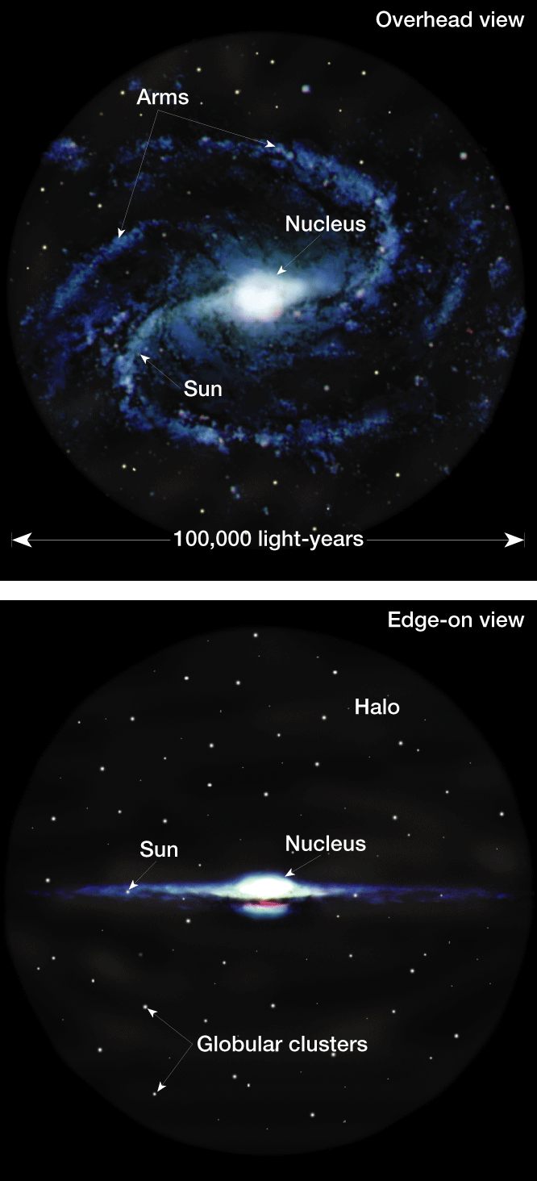

Slide 44
Elliptical Galaxies
60 % of all galaxies are elliptical
Range in shape from round to oval
Most are small, though the largest galaxies (200,000 light years in diameter) are elliptical
No spiral arms
Contains old stars, so often a red color

Slide 45
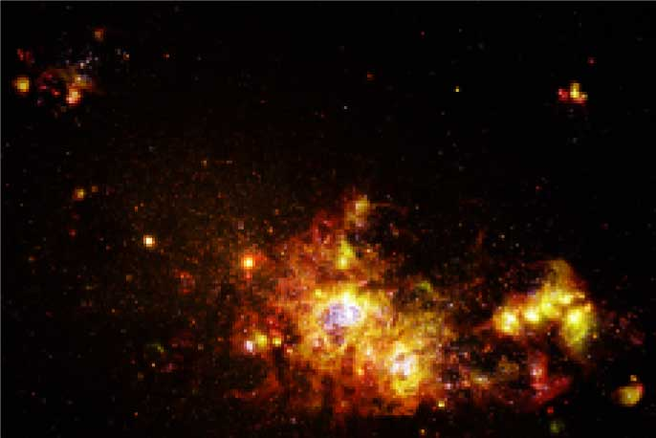
Irregular Galaxies
Only 10% of the known galaxies have irregular shapes
Irregular galaxies contain young stars

Slide 46
Galaxy Clusters
A galaxy cluster is a system of galaxies containing several to thousands of member galaxies
We are in the Local Group cluster which contains at least 28 galaxies (3 spirals, 11 irregular, 14 elliptical)

Slide 47
Galaxy Superclusters
Galaxy clusters also make groups called superclusters
Studies indicate superclusters may be the largest structures in the universe

Slide 48
Origin of the Universe
Remember, a light year is the distance that light travels in 1 year.
This distance is so large that it would take more than 10 million years to travel in a car
When we say the sun’s light is 8 minutes away, we are saying we see it as it was 8 minutes ago, and never as it really is
The same is true for stars, planets, galaxies, or clusters of galaxies
Most of the universe is empty space

Slide 49
The Expanding Universe
Red Shifts
Red shift, or a Doppler shift toward the red end of the spectrum, occurs because wavelengths are stretched, which shows that Earth and the source are moving away from each other
Hubble’s Law
A law that states that the galaxies are retreating from the Milky Way at a speed that is proportional to its distance
The red shift of distant galaxies indicate that the universe is expanding

Slide 50
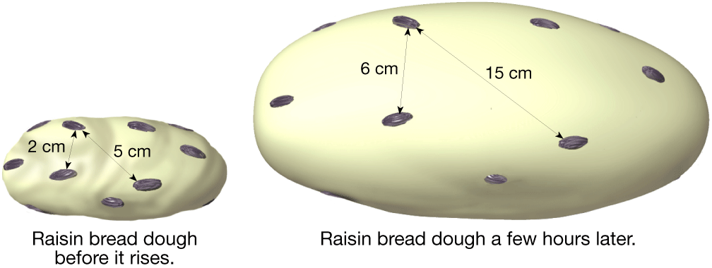
Hubble’s Law
To help visualize the nature of the universe, imagine a loaf of raisin bread dough that has been set out to rise for a few hours.
As the dough doubles in size, so does the distance between all the raisins. Those objects located father apart move away from each other more rapidly.

Slide 51
Big Bang Theory
States that at one time, the entire universe was confined to a dense, hot, supermassive ball. Then about 13.7 billion years ago, a violent explosion occurred, hurling this material in all directions
All matter and space were created at that instant. After several hundred thousand years, the universe became cool enough for atoms to form. Gases in the universe continued to cool and condense. They eventually formed the stars that make up the galaxies we now observe moving away from us

Slide 52
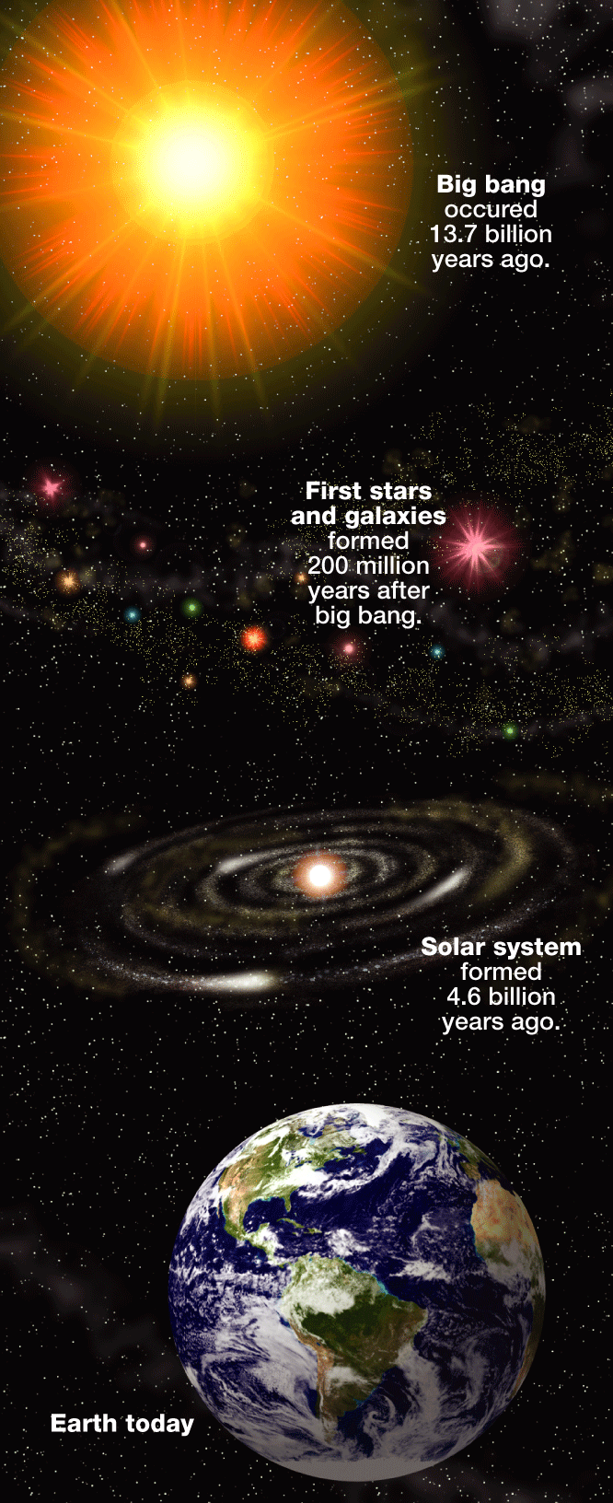

Slide 53
Supporting Evidence for Big Bang
Red Shift of galaxies
Scientists discovered a type of energy called cosmic background radiation. Scientists think that this radiation was produced during the big bang.

Slide 54
Predicting the Future of the Universe……
The future is uncertain, but there are 3 possible outcomes
The universe will keep expanding forever
The expansion of the universe will gradually slow down, and the universe will approach a limit in size
The universe will stop expanding and start to fall back in on itself (big crunch)

Slide 56
Fate of Universe depends on mass
If there is not enough mass, the gravitation force will be too weak to stop the expansion, and the universe will expand forever
If there is just the right amount of mass, the expansion will continually slow down, but will never stop completely
If there is too much mass, gravity will eventually overcome the expansion and the universe will stat to contract
Could be known as the “Big Crunch”

Slide 57
New technology helps scientists test theories
Analyzing the background radiation, scientist have discovered that 23% of the universe is made of a type of matter that does not give off light but that has gravity that we can detect, we call this matter dark matter.
There is a debate about dark matter, may be planets, black holes, or brown dwarfs
Brown dwarfs are star-like objects that lack enough energy to begin nuclear fusion

Slide 58
A material called, dark energy is relatively unknown, scientists think it acts as a force that opposes gravity

