Slide 1
Minerals

Slide 2
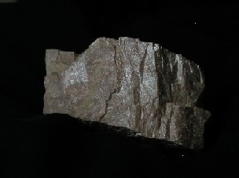
So what is a mineral? What are the characteristics of all minerals?

Slide 3
Do you
Know?

Slide 4
Mineral
Characteristics

Slide 5
1. A mineral occurs naturally.

Slide 6
2. A mineral is solid.

Slide 7
3. A mineral has a definite chemical composition.

Slide 8
4. A mineral’s atoms are arranged in an orderly pattern (characteristic crystalline structure).

Slide 9
5. A mineral is inorganic (was never alive)

Slide 10
Mineral characteristics
Definition of a Mineral:
naturally occurring
inorganic
solid
characteristic crystalline structure
definite chemical composition
steel plastic sugar table salt mercury ice coal
no, #1
no, #1
no, #1,2
YES!
no, #3
YES!
no, #2
basalt obsidian mica gold paper chalk coral
no, #5
no, #4
YES!
YES!
no, #1,2
no, #2
no, #2

Slide 11
Mineral characteristics
Naturally formed
No substance created artificially is a mineral.
examples: plastic, steel, sugar, paper
Inorganic
Anything formed by a living organism and containing organic materials is not a mineral.
examples: wood, plants, shells, coal
Solid
Liquids and gases are not minerals.
examples: water, petroleum, lava, oxygen

Slide 12
Mineral characteristics
Characteristic crystalline structure
must have an ordered arrangement of atoms
displays repetitive geometric patterns in 3-D
glass not a mineral (no internal crystalline structure)
Definite chemical composition
must have consistent chemical formula
examples: gold (Au), quartz (SiO₂), orthoclase (KAlSi₃O₈)
basalt (like many other rocks) contains variable ratios of different minerals; thus, has no consistent formula

Slide 13
Mineral Terminology
Mineraloids: Naturally occurring but don’t fit the definition of a mineral (ex. Glass)
Polymorphs: two minerals with the same composition but different structures (diamond and graphite)

Slide 14
Mineral Formation
Many minerals grow by crystallization: atoms are arranged in a specific, repeating geometric pattern:
Precipitated from aqueous (water) solutions
From a melt (magma)
Some minerals result from the alteration of other minerals during:
Weathering
Metamorphism

Slide 15
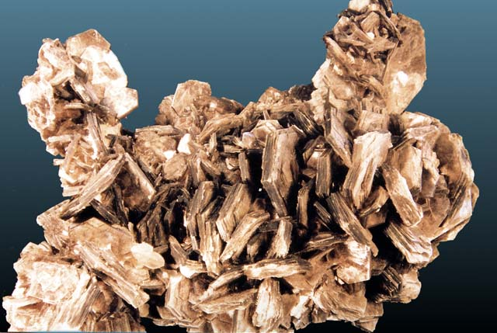
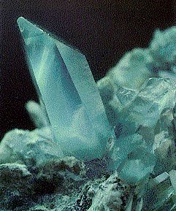
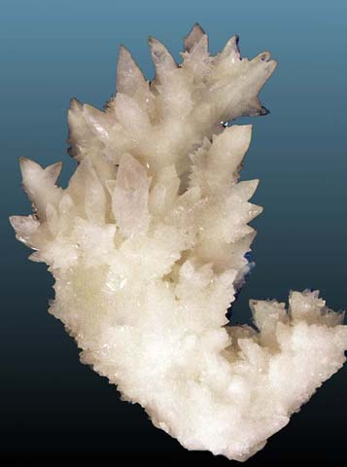
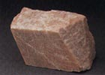
Of the almost 4000 known minerals, only about 30 are common.

Slide 16
These minerals make up most of the rocks found in the Earth’s crust.

Slide 17
In fact, over 60% of the Earth’s crust is made up of the family of minerals known as feldspar!

Slide 18
Mineral Diversity
More than 3,500 minerals have been identified, but only @ 2 dozen are common.
Only 8 elements make up the bulk of the earth’s crust.
Oxygen and Silicon constitute 74% of the earth’s crust and nearly 84% of the atoms available to form compounds.
When oxygen and silicon combine they are called silicates

Slide 19
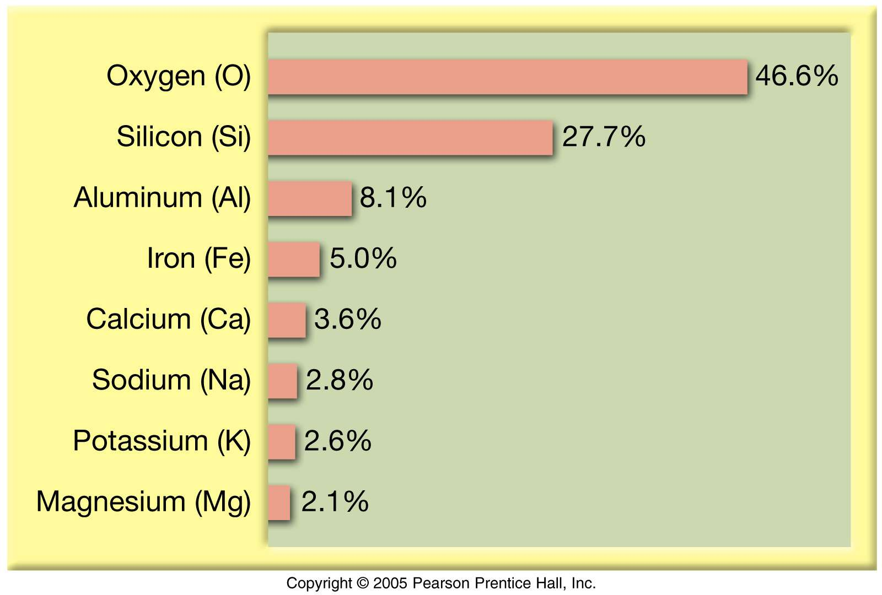
Element abundances in the crust
All others: 1.5%

Slide 20
Mineral Groups
Rock-forming minerals
~30 common minerals make up most rocks in Earth’s crust
Composed mainly of the 8 elements that make up over 98% of the crust

Slide 21
Mineral Groups
Element Abundances
Silica
(SiO₄)⁴⁻
SILICATES
Common cations that
bond with silica anions
All others: 1.5%

Slide 22
Mineral Groups
Silicates (most abundant)
Non-silicates (~8% of Earth’s crust):
Oxides O²⁻
Carbonates (CO₃)²⁻
Sulfides S²⁻
Sulfates (SO₄)²⁻
Halides Cl⁻, F⁻, Br⁻
Native elements (single elements; e.g., Au)

Slide 23
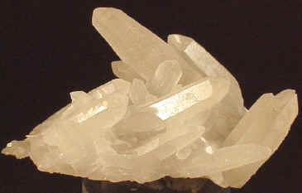
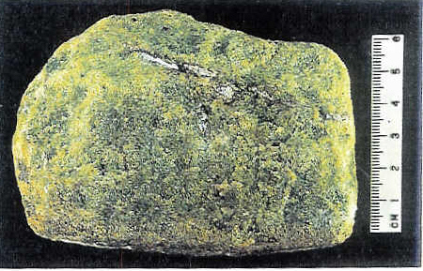
Mineral Groups – Silicates
Silicate Minerals
A combination of oxygen and silica is a silicate.
Quartz is pure SiO₂
Most silicates have one or more additional elements.
Orthoclase feldspar KAlSi₃O₈
Olivine (Mg, Fe) 2 SiO₄

Slide 24
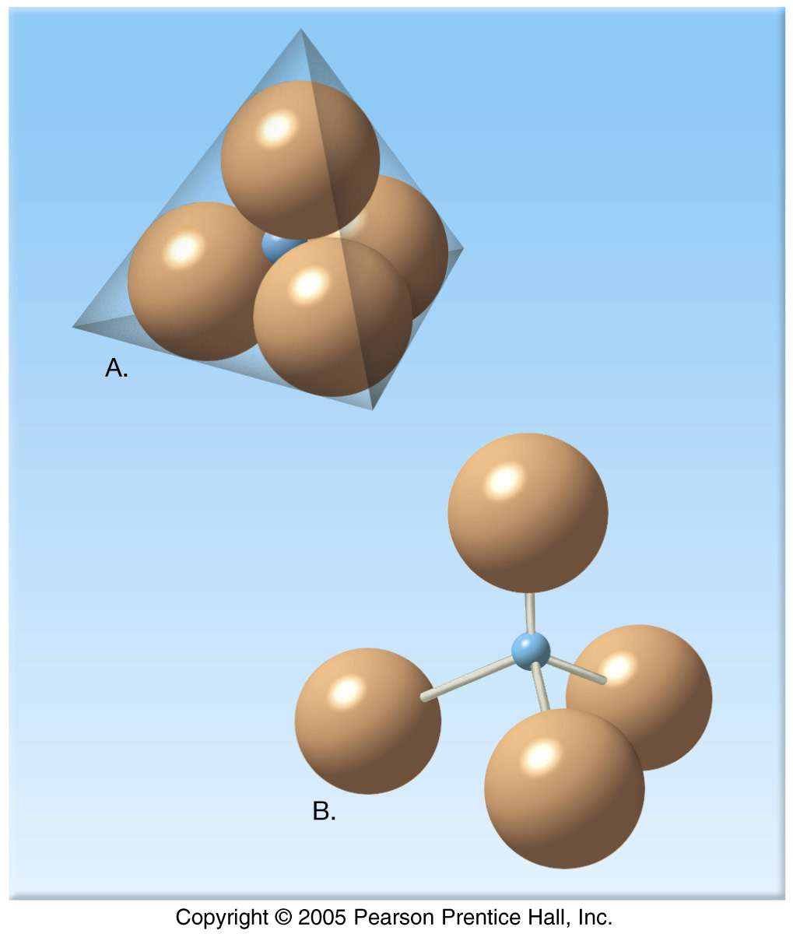
Mineral Groups – Silicates
Silicates
Tetrahedron
fundamental building block
4 oxygen ions surrounding a much smaller silicon ion
Silicon-oxygen
tetrahedron
(SiO₄)⁴⁻

Slide 25
Mineral Groups – Silicates
Joining Silicate Structures
How tetrahedra may be linked:
independent tetrahedra
single chains
double chains
sheets
3-D framework

Slide 26
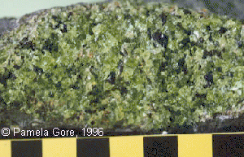
Mineral Groups – Silicates
Olivine Group
dark silicates (Fe-Mg)
→ ferromagnesian
No cleavage

Slide 27
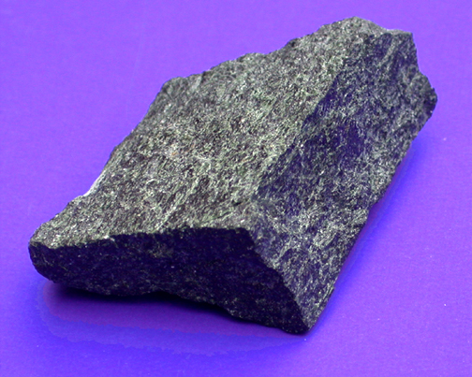
Mineral Groups – Silicates
Pyroxene Group
Ferromagnesian / dark silicates (Fe-Mg)
Augite
2-directions
of cleavage
(at nearly 90 degrees)

Slide 28
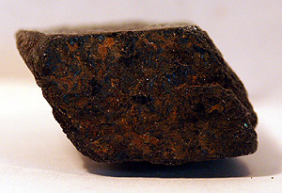
Mineral Groups – Silicates
Amphibole Group
Ferromagnesian / dark silicates (Ca, Fe-Mg)
Hornblende
2-directions
of cleavage
(not at 90 degrees)

Slide 29
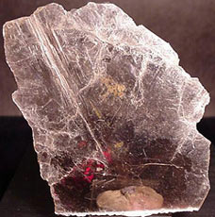
Mineral Groups – Silicates
Mica Group and Clay Minerals
light silicates (K, Al)
→ non-ferromagnesian
Muscovite
1-direction
of cleavage

Slide 30
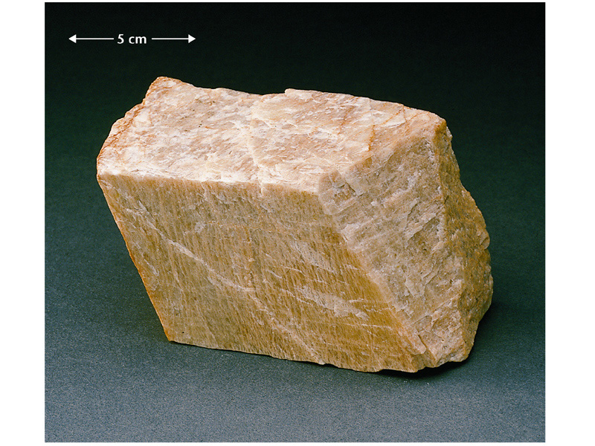
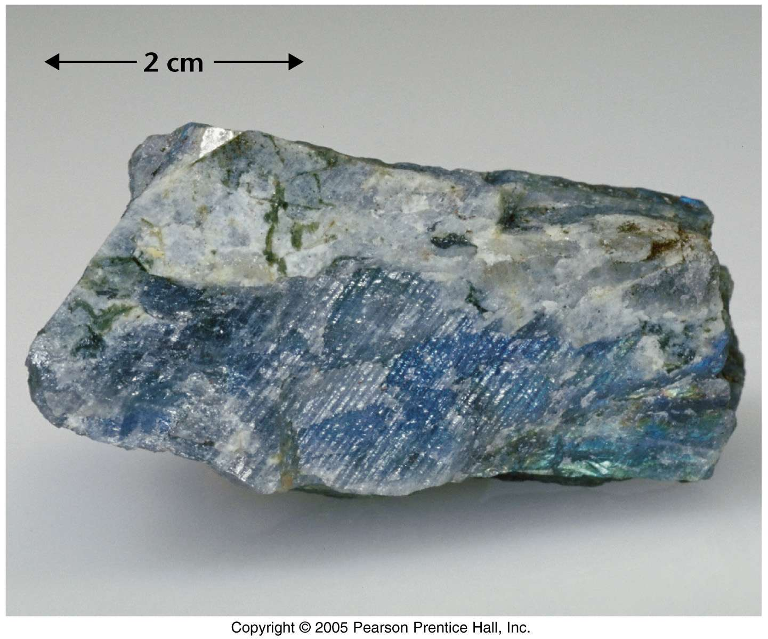
Mineral Groups – Silicates
Feldspar Group
light silicates (K-Na-Ca, Al)
K-feldspar
Most common mineral group!!
Orthoclase
Plagioclase
2-directions
of cleavage
(at 90 degrees)
Ca/Na-feldspar

Slide 31
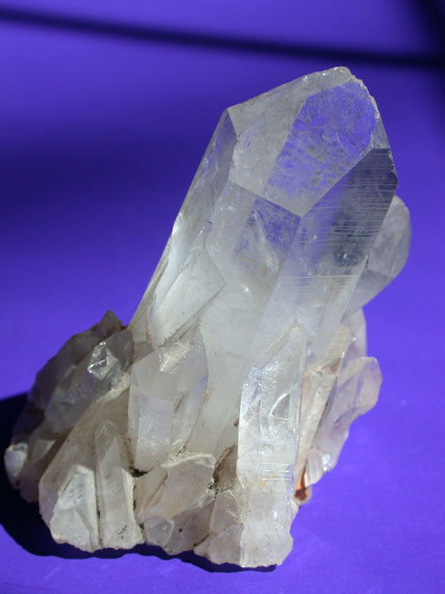
Mineral Groups – Silicates
Quartz
light silicates (pure SiO₂)
no cleavage
(conchoidal fracture)
hard, resistant to weathering
Quartz

Slide 32
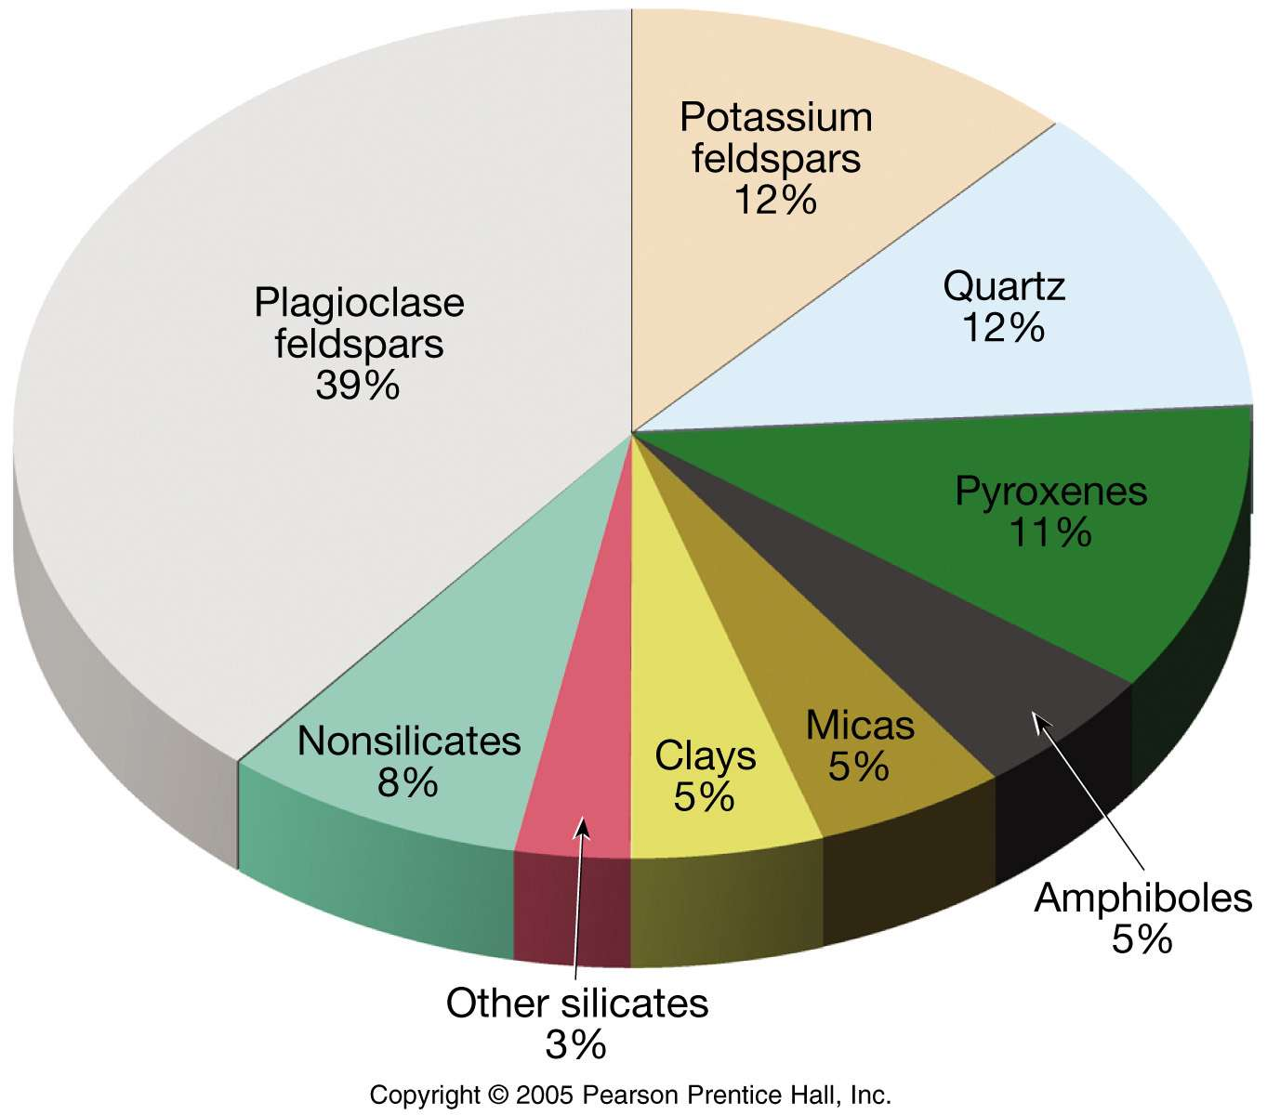
Mineral Groups
Non-ferromagnesian
Silicates (K, Na, Ca, Al)
Ferromagnesian
Silicates (Fe, Mg)
Oxides
Carbonates
Sulfides/sulfates
Native elements

Slide 33
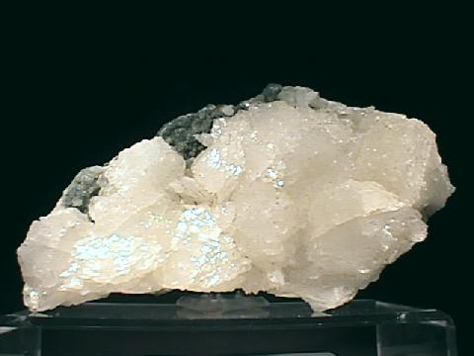
Carbonates
Contain negatively charged carbonate ion (CO₃)-₂.
Calcite or calcium carbonate: (CaCO₃)₂
Calcite is the main constituent of sedimentary rock: limestone
Dolomite [CaMg(CO₃)₂] is formed by the alteration of calcite, replacing it in ancient rocks with Mg.

Slide 34
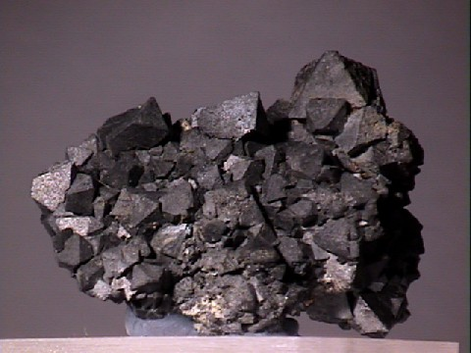
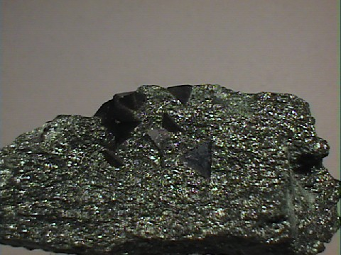
Oxides
• Oxides: an element (usually a metal) combined with Oxygen.
Iron oxides: Hematite – (Fe2)3) and Magnetite (Fe3O4)
Important sources of iron ore for steel manufacture

Slide 35
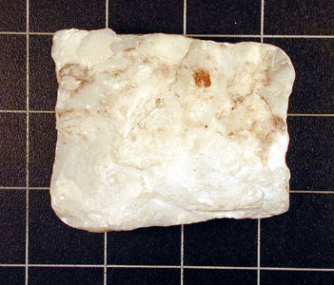
Sulfides and Suflates
Sulfatess: have a + ion combined with sulfate ion (SO₄⁻²)
Gypsum (CaSO₄ ● H₂O)
Sulfides: have a + ion combined with sulfur (S⁻²)
Galena (PbS)
Iron Pyrite (FeS)

Slide 36
Other Mineral Groups
Halides: contain halogen elements: Chlorine (Cl-1) & fluorine (F-1)
Halite: (NaCl) and fluorite (CaF₂)
Native Elements: exist in pure elemental form
Silver, copper, gold

