Slide 1
Chapter 3 Review
States of Matter

Slide 2
Which state of has definite volume but indefinite shape?
Solid
Liquid
Gas
Plasma

Slide 3
Which state of has definite volume but indefinite shape?
Solid
Liquid
Gas
Plasma

Slide 4
Which state of matter CANNOT be a fluid?
Solid
Liquid
Gas
Plasma

Slide 5
5. Which state of matter CANNOT be a fluid?
Solid
Liquid
Gas
Plasma

Slide 6
Which state of matter is highly compressible?
Solid
Liquid
Gas
Plasma

Slide 7
Which state of matter is highly compressible?
Solid
Liquid
Gas
Plasma

Slide 8
Which state of matter has particles that vibrate?
Solid
Liquid
Gas
Plasma

Slide 9
Which state of matter has particles that vibrate?
Solid
Liquid
Gas
Plasma

Slide 10
Which state of matter conducts electricity?
Solid
Liquid
Gas
Plasma

Slide 11
Which state of matter conducts electricity?
Solid
Liquid
Gas
Plasma

Slide 12
4. Which particles move the fastest?
Heavy
Big
Light
Small

Slide 13
Which particles move the fastest?
Heavy
Big
Light
Small

Slide 14
5. Which state of matter has the highest Kinetic Energy?
Solid
Liquid
Gas
Plasma

Slide 15
5. Which state of matter has the highest Kinetic Energy?
Solid
Liquid
Gas
Plasma

Slide 16
6. Which state of matter can be fluids?

Slide 17
6. Which state of matter makes up most of the universe?
LIQUID, GAS, PLASMA

Slide 18
7. What do all state of matter have in common?
All particles have high kinetic energy
All particles can change shape
All particles are in constant motion
All particles collide and break into charged particles

Slide 19
7. What do all state of matter have in common?
All particles have high kinetic energy
All particles can change shape
All particles are in constant motion
All particles collide and break into charged particles

Slide 20
8. Temperature is a measure of what kind of energy?
Potential
Thermal
Kinetic
Elastic

Slide 21
8. Temperature is a measure of what kind of energy?
Potential
Thermal
Kinetic
Elastic

Slide 22
9. What does the law of conservation and mass and energy say?
We cannot create them
We cannot destroy them
We can transform them
All of the above

Slide 23
9. What does the law of conservation and mass and energy say?
We cannot create them
We cannot destroy them
We can transform them
All of the above

Slide 24
10. Which of the following describes thermal expansion?
When things are cooled they expand
When things are heated the expand
When things are heated they contract
A&C

Slide 25
10. Which of the following describes thermal expansion?
When things are cooled they expand
When things are heated the expand
When things are heated they contract
A&C

Slide 26
11c. When we go from liquid to solid it is called:
Melting
Freezing
Sublimation
evaporation

Slide 27
11c. When we go from liquid to solid it is called:
Melting
Freezing
Sublimation
evaporation

Slide 28
11a. When we go from solid to gas it is called:
Melting
Freezing
Sublimation
evaporation

Slide 29
11a. When we go from solid to gas it is called:
Melting
Freezing
Sublimation
evaporation

Slide 30
11d. When we go from liquid to gas below the boiling point it is called:
Melting
Condensation
Vaporization
Evaporation

Slide 31
11d. When we go from liquid to gas below the boiling point it is called:
Melting
Condensation
Vaporization
Evaporation

Slide 32
11f. When we go from gas to liquid it is called:
Melting
Condensation
Vaporization
Evaporation

Slide 33
11f. When we go from gas to liquid it is called:
Melting
Condensation
Vaporization
Evaporation

Slide 34
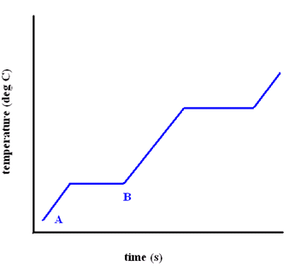
12. If At point A the substance is a solid, what state is reached at point B?
Solid
Liquid
Gas
plasma

Slide 35
12. If At point A the substance is a solid, what state is reached at point B?
Solid
Liquid
Gas
plasma

Slide 36
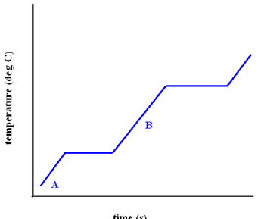
12. If At point A the substance is a solid, what process is occurring at point B?
condensation
melting
vaporization
evaporation

Slide 37
12. If At point A the substance is a solid, what process is occurring at point B?
condensation
melting
vaporization
evaporation

Slide 38
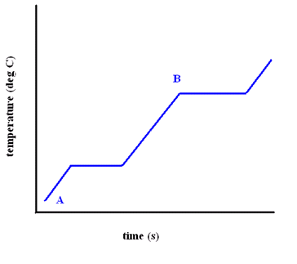
12. If At point A the substance is a solid, what is reached at point B?
Freezing point
Melting point
Boiling point
A&B

Slide 39
12. If At point A the substance is a solid, what is reached at point B?
Freezing point
Melting point
Boiling point
A&B

Slide 40
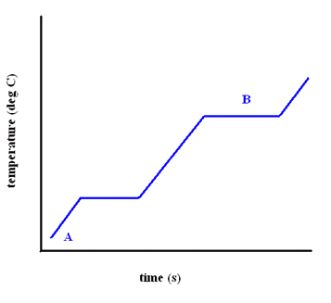
12. If At point A the substance is a solid, what is process is occurring at point B?
Condensation
Evaporation
Vaporization
Melting

Slide 41
12. If At point A the substance is a solid, what is process is occurring at point B?
Condensation
Evaporation
Vaporization
Melting

Slide 42
23. Buoyant forces push:
Upward
Downward
Sideways
All ways

Slide 43
13. Buoyant forces push:
Upward
Downward
Sideways
All ways

Slide 44
13. If I am looking for the buoyant force what word do I look for in a problem?:
object
weighs
N
displaces

Slide 45
13. If I am looking for the buoyant force what word do I look for in a problem?:
object
weighs
N
displaces

Slide 46
14. The notion that an object floats if the buoyant force on the object is equal to the object’s weight was described by:
Pascal
Archimedes
Bernoulli
Boyle

Slide 47
14. The notion that an object floats if the buoyant force on the object is equal to the object’s weight was described by:
Pascal
Archimedes
Bernoulli
Boyle

Slide 48
15. Pascal’s Principle states that a contained fluid exerts pressure:
Equally in all directions
Downwards
Upwards
sideways

Slide 49
15. Pascal’s Principle states that a contained fluid exerts pressure:
Equally in all directions
Downwards
Upwards
sideways

Slide 50
16. As a you decrease pressure on a liquid, its speed
Stays the same
Increases
Decreases
Both A&C

Slide 51
16. As a you decrease pressure on a liquid, its speed
Stays the same
Increases
Decreases
Both A&C

Slide 52
17. Bernoullis’ principle states that the faster an object is moving, the pressure exerted on it by a fluid:
Stays the same
Increases
Decreases
Both A&C

Slide 53
17. Bernoullis’ principle states that the faster an object is moving, the pressure exerted on it by a fluid:
Stays the same
Increases
Decreases
Both A&C

Slide 54
18. Boyle’s law relates:
Pressure and temperature
Pressure and volume
Volume and temperature
Pressure, volume, and temperature

Slide 55
18. Boyle’s law relates:
Pressure and temperature
Pressure and volume
Volume and temperature
Pressure, volume, and temperature

Slide 56
19. Charles’s law relates:
Pressure and temperature
Pressure and volume
Volume and temperature
Pressure, volume, and temperature

Slide 57
19. Charles’s law relates:
Pressure and temperature
Pressure and volume
Volume and temperature
Pressure, volume, and temperature

Slide 58
20. Gay-Lussac’s law relates:
Pressure and temperature
Pressure and volume
Volume and temperature
Pressure, volume, and temperature

Slide 59
20. Gay-Lussac’s law relates:
Pressure and temperature
Pressure and volume
Volume and temperature
Pressure, volume, and temperature

Slide 60
21. If you increase pressure, you ______ volume (at constant temperature):
Increase
Do nothing to
Decrease
Never change

Slide 61
21. If you increase pressure, you ______ volume (at constant temperature):
Increase
Do nothing to
Decrease
Never change

Slide 62
If you increase pressure, you ______ temperature (at constant pressure):
Increase
Do nothing to
Decrease
Never change

Slide 63
If you increase temperature, you ______ volume (at constant pressure):
Increase
Do nothing to
Decrease
Never change

Slide 64
22. I have an object that weighs 25 N; it displaces a volume of 100 N. What is the buoyant force? Does it float or sink?

Slide 65
I have an object that weighs 25 N; it displaces a volume of 10 N. What is the buoyant force? Does it float or sink?

Slide 66
23. Viscosity is:
Resistance to flow
Something only fluids have
How fast something flows
All of the above

Slide 67
23. Viscosity is:
Resistance to flow
Something only fluids have
How fast something flows
All of the above

Slide 68
23. If you increase temperature, you _____ viscosity
Decrease
increase

Slide 69
23. If you increase temperature, you _____ viscosity
Decrease
increase

Slide 70
24. A gas occupies a volume of 100 mL at a pressure of kPa. Find its volume at a pressure of 300 kPa

Slide 71
25. A gas occupies a volume of 324 cm³ at 400 Kelvin temperature. Find its volume at 450 Kelvin.

Slide 72
26. A gas’ pressure is 1.3 atm at 23 degrees Celsius (don’t forget to change to Kelvin). At what temperature will the pressure be 0.75 atm?

