Slide 1
Chemical Bonding

Slide 2
Outline
Bond Formation
Electronegativity, Dipole Moments & Polarity
Lewis Structures for individual atoms
Lewis Structures for Ionic Compounds
Lewis Structures for Covalent Compounds
VSEPR (Molecular Geometry)

Slide 3
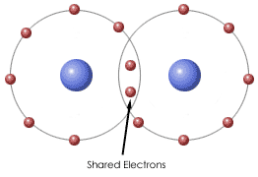
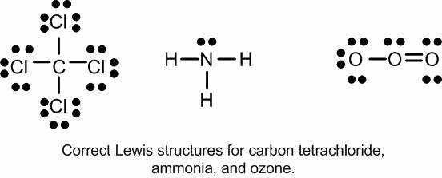
Remember from awhile ago…
Chemical Bonds
  Force that holds atoms together
  Form to decrease energy
  It’s all about the electrons (e-)
    Electrons are attracted to positively charged nucleus of other atom

Slide 4
There are three types of bonds
Metallic
  between two metals
  “sea of electrons”
Ionic:
  Metal + NM
  Electrons are transferred
Covalent
  NM + NM
  Electrons are shared
    1 pair shared: single bond
    2 pair shared: double bond
    3 pair shared: triple bond

Slide 5
We can also look at electronegativity to predict what kind of bond will form!

Slide 6

Electronegativity – REMEMBER!!!
The ability of an atom in a molecule to attract shared electrons to itself.
Linus Pauling
1901 - 1994

Slide 7
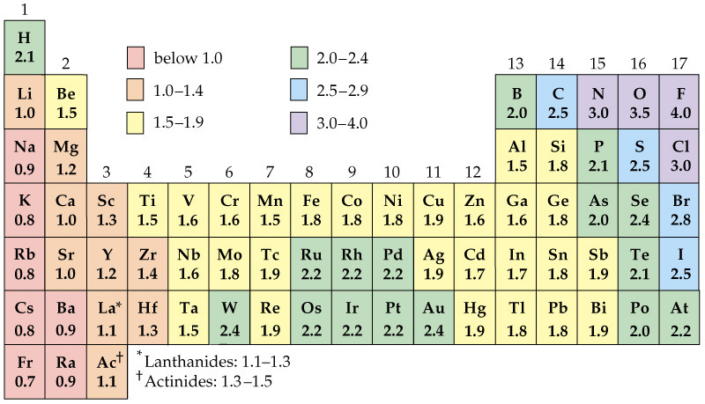
Table of Electronegativities

Slide 8
We can look at the difference between two atoms to determine if a ionic, polar covalent, or non-polar covalent bond will form
Type of Bond | Definition | Electronegativity difference
Ionic | Large difference in electronegativity, electrons are transferrered | >1.7
Polar Covalent | Small difference in electronegativity, electrons are shared UNEQUALLY | 0.4-1.7
Non-Polar Covalent | Very smalll to NO difference in electronegativity, electrons are shared EQUALLY | 0-0.3

Slide 9
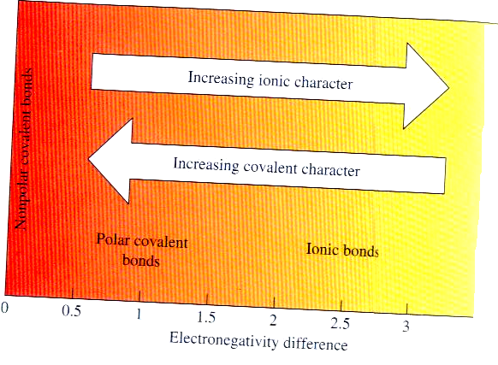
Bond Character

Slide 10
Practice
Nonpolar covalent = 0 to 0.3
Polar covalent = 0.3 to 1.7
Ionic = greater than 1.7
Bonding Elements | Electronegativity Values |  | Absolute Difference | Type of Bond
H & H
Cl & H
Li & Cl

Slide 11
Practice
Nonpolar covalent = 0 to 0.3
Polar covalent = 0.3 to 1.7
Ionic = greater than 1.7
Bonding Elements | Electronegativity Values |  | Absolute Difference | Type of Bond
H & H | 2.1 | 2.1
Cl & H
Li & Cl

Slide 12
Practice
Nonpolar covalent = 0 to 0.3
Polar covalent = 0.3 to 1.7
Ionic = greater than 1.7
Bonding Elements | Electronegativity Values |  | Absolute Difference | Type of Bond
H & H | 2.1 | 2.1 | 0
Cl & H
Li & Cl

Slide 13
Practice
Nonpolar covalent = 0 to 0.3
Polar covalent = 0.3 to 1.7
Ionic = greater than 1.7
Bonding Elements | Electronegativity Values |  | Absolute Difference | Type of Bond
H & H | 2.1 | 2.1 | 0 | Nonpolar- Covalent
Cl & H
Li & Cl

Slide 14
Practice
Nonpolar covalent = 0 to 0.3
Polar covalent = 0.3 to 1.7
Ionic = greater than 1.7
Bonding Elements | Electronegativity Values |  | Absolute Difference | Type of Bond
H & H | 2.1 | 2.1 | 0 | Nonpolar- Covalent
Cl & H | 3.0 | 2.1
Li & Cl

Slide 15
Practice
Nonpolar covalent = 0 to 0.3
Polar covalent = 0.3 to 1.7
Ionic = greater than 1.7
Bonding Elements | Electronegativity Values |  | Absolute Difference | Type of Bond
H & H | 2.1 | 2.1 | 0 | Nonpolar- Covalent
Cl & H | 3.0 | 2.1 | 0.9 | Polar-Covalent
Li & Cl

Slide 16
Practice
Nonpolar covalent = 0 to 0.3
Polar covalent = 0.3 to 1.7
Ionic = greater than 1.7
Bonding Elements | Electronegativity Values |  | Absolute Difference | Type of Bond
H & H | 2.1 | 2.1 | 0 | Nonpolar- Covalent
Cl & H | 3.0 | 2.1 | 0.9 | Polar-Covalent
Li & Cl | 1.0 | 3.0

Slide 17
Practice
Nonpolar covalent = 0 to 0.3
Polar covalent = 0.3 to 1.7
Ionic = greater than 1.7
Bonding Elements | Electronegativity Values |  | Absolute Difference | Type of Bond
H & H | 2.1 | 2.1 | 0 | Nonpolar- Covalent
Cl & H | 3.0 | 2.1 | 0.9 | Polar-Covalent
Li & Cl | 1.0 | 3.0 | 2.0 | Ionic

Slide 18
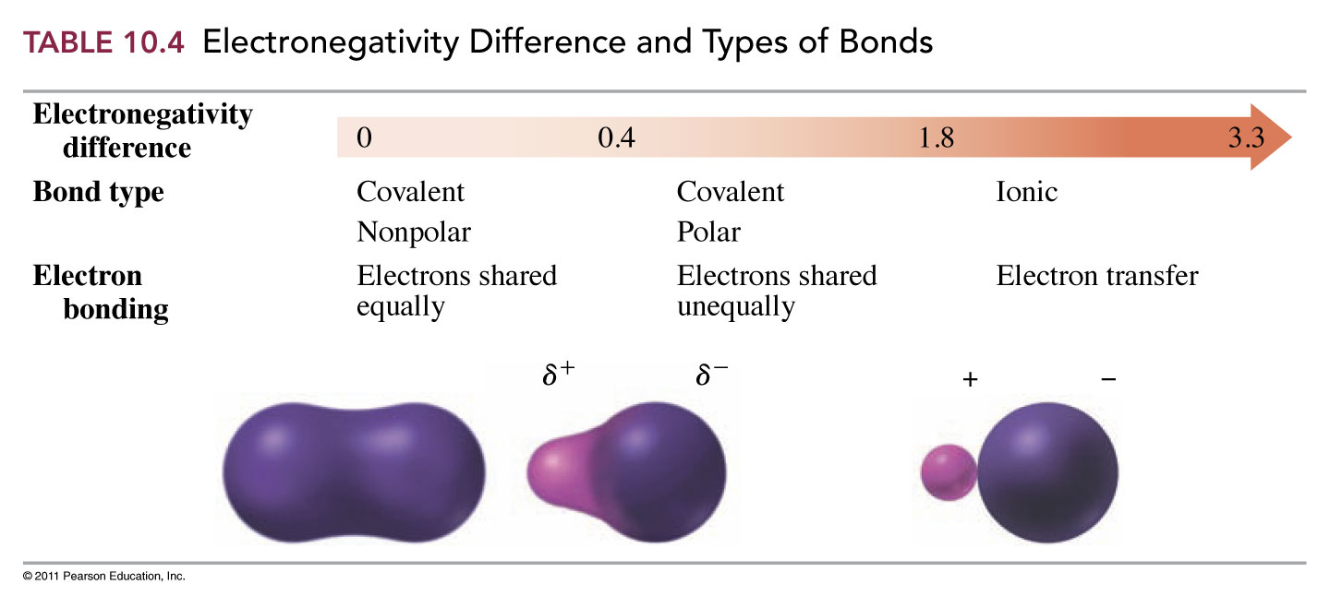
Electronegativity and Bond Types

Slide 19
Polar and Nonpolar Covalent Bonds
The polarity of a covalent bond is measured using its dipole moment.
  Large dipole moment = more polar
  Small dipole moment = more nonpolar
The distribution of electron density in a bond can be depicted using:
  Partial charges
    δ⁺ and δ⁻
  Direction of dipole moment

Slide 20
Polar and Nonpolar Covalent Bonds
Partial charges:
  Place the partial negative charge (δ⁻) over (or under) the more electronegative element
  Place the partial positive charge (δ⁺) over (or under) the less electronegative element
Direction of dipole:
  Place the positive end of the arrow over (or under) the less electronegative element.
  Point the arrow in the direction of the more electronegative element

Slide 21
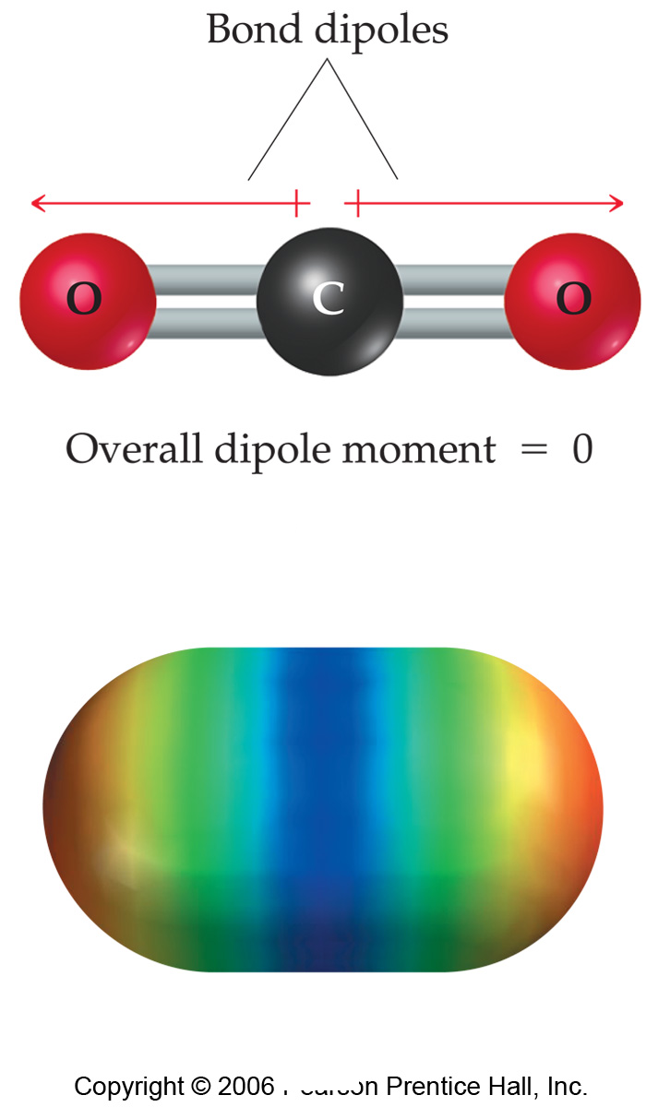
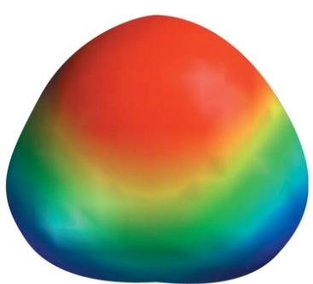

Polar and Nonpolar Molecules
Carbon dioxide contains 2 polar covalent bonds.
  It is a nonpolar molecule, however.
Water also contains 2 polar covalent bonds.
  It is a polar molecule!

Slide 22
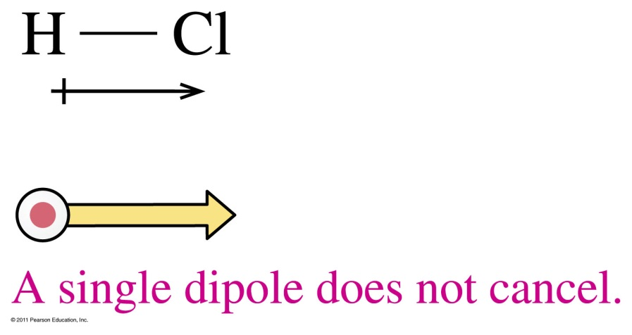
Polar Molecules
A polar molecule
- contains polar bonds
- has a separation of positive and negative charge called a dipole indicated by a dipole arrow (dipoles always point towards most EN atom)
- has dipoles that do not cancel

Slide 23
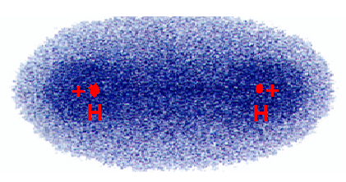
Non-polar Molecules
The electron density plot for H₂.
Two identical atoms do not have an electronegativity difference The charge distribution is symmetrical.
The molecule is non-polar.
23

Slide 24

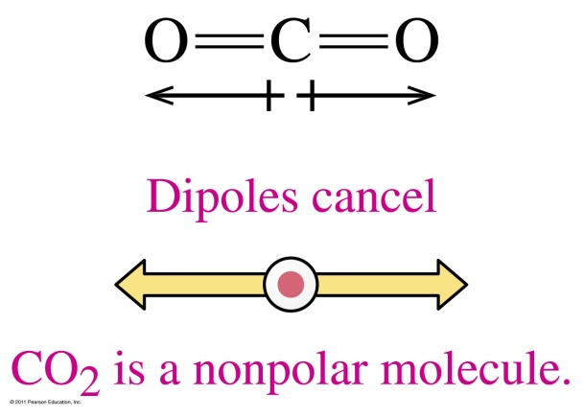
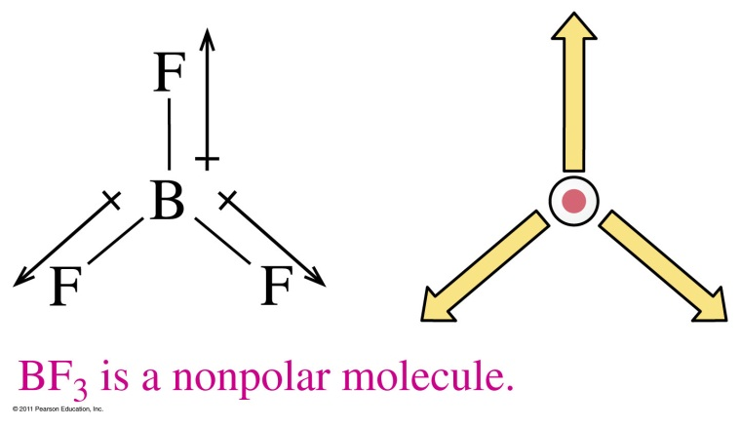
Nonpolar Molecules
A nonpolar molecule
1) may contain identical atoms (nonpolar bonds)
2) may have a symmetrical arrangement of polar bonds that cancel dipoles

Slide 25
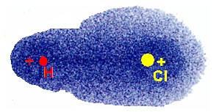
Polar Molecules
The electron density plot for HCl
Chlorine is more electronegative than Hydrogen
The electron cloud is distorted toward Chlorine
The unsymmetrical cloud has a dipole moment
HCl is a polar molecule.
25

Slide 26
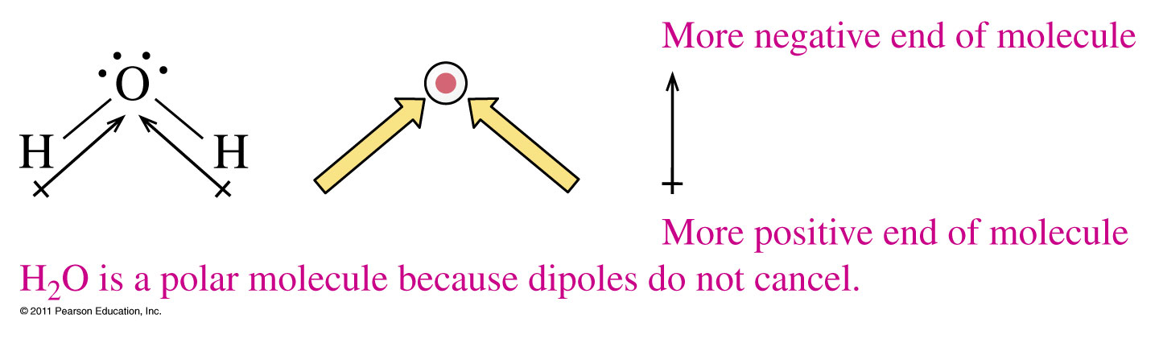
Determining Molecular Polarity
The polarity of a molecule is determined from its
electron-dot formula
shape
polarity of the bonds
dipole cancellation

Slide 27
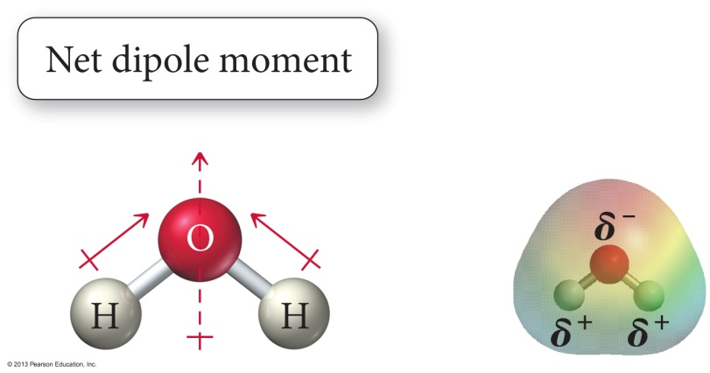
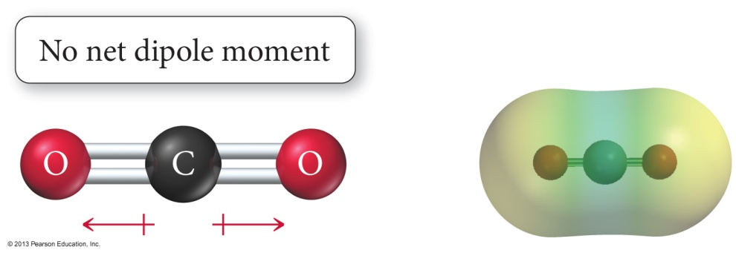
Polar or Nonpolar?
Which one is polar: CO₂ or H₂O?
H₂O CO₂

Slide 28
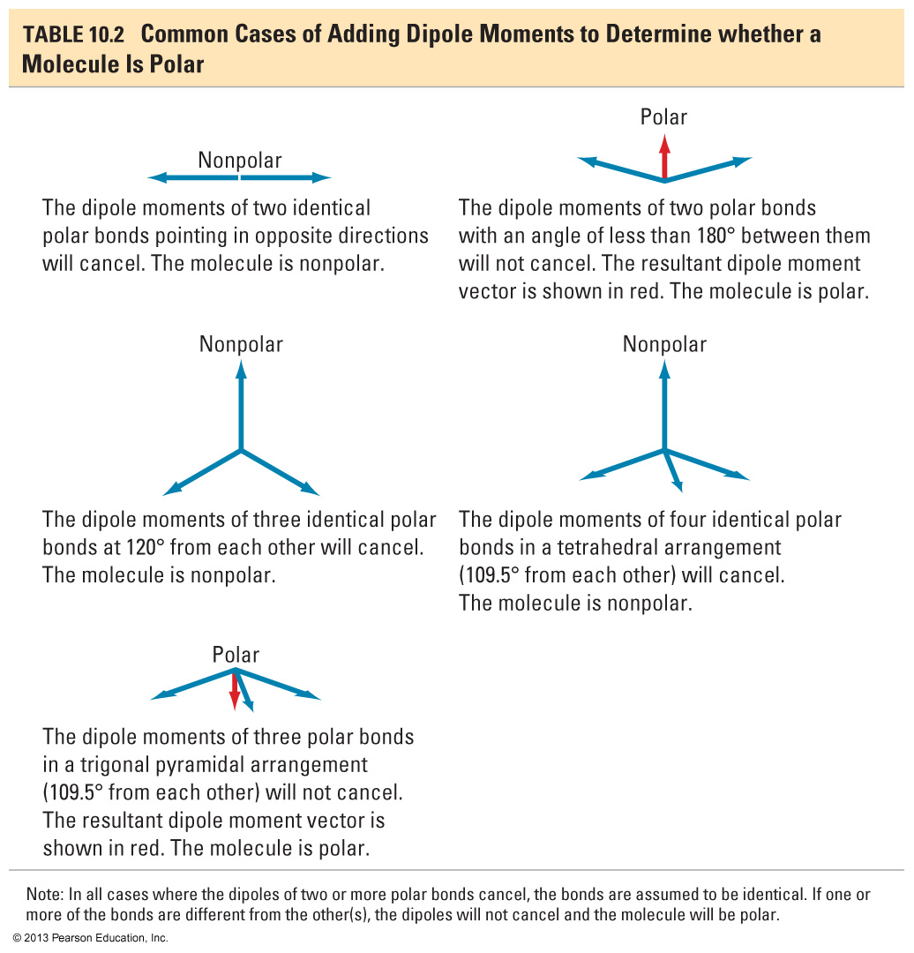
Dipole Moment and Polarity

Slide 29
Lewis Dot Structures
Gilbert Lewis came up with the idea of electron dot diagrams, or Lewis Dot structures
These diagrams represent an atom’s number of valence electrons
It also shows us how many paired and unpaired valence electrons an atom has
Lewis Dot structures help us figure out how elements bond

Slide 30
Lewis Dot Diagrams
A Lewis dot diagram depicts an atom as its symbol and its valence electrons.
  Ex: Carbon
.
.
.
C
.
Carbon has four electrons in its valence shell (carbon is in group 14), so we place four dots representing those four valence electrons around the symbol for carbon.

Slide 31
Octet Rule
All atoms, except for Hydrogen and Helium, want 8 valence electrons in their outer shell to be stable.
This is called the octet rule
An atom can have a maximum of 8 valence electrons
Hydrogen an Helium can only have a maximum of two valence electrons in their outer shells.

Slide 32
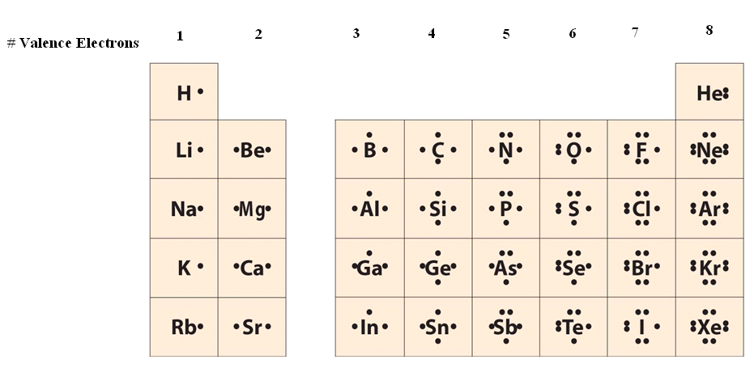
Elements in the same group have the same Lewis Dot Structure

Slide 33
Drawing Lewis Dot Diagrams
Electrons are placed one at a time in a clockwise manner around the symbol in the north, east, south and west positions, only doubling up if there are five or more valence electrons.
  Same group # = Same Lewis Dot structure
    Ex. F, Cl, Br, I, At
  Example: Chlorine (7 valence electrons b/c it is in group 17)
.
.
.
.
Cl
.
.
.

Slide 34
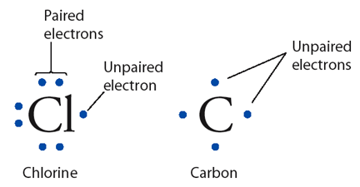
Electron Dot Structure or
Lewis Dot Diagram
A notation showing the valence electrons surrounding the atomic symbol.

Slide 35
Paired and Unpaired Electrons
As we can see from the chlorine example, there are six electrons that are paired up and one that is unpaired.
When it comes to bonding, atoms tend to pair up unpaired electrons.
    A bond that forms when one atom gives an unpaired electron to another atom is called an ionic bond.
    A bond that forms when atoms share unpaired electrons between each other is called a covalent bond.

Slide 36
Writing Lewis Dots Structures for Ions
Uses either 0 or 8 dots, brackets and a superscript charge designate to ionic charge
Ex.) Li⁺, Be⁺², B⁺³, C⁺⁴, N⁻³, O⁻², F⁻¹

Slide 37
Writing Lewis Dots Structures
(Ionic Compounds)
Lewis Dot Diagrams of Ionic Compounds
Ex. 1) NaCl
Ex. 2) MgF₂

Slide 38
Ionic Bonding Practice
1. NaI 2. MgF₂ 3. CsI
4. Li₂S 5. CaCl₂ 6. NaF
7. BeS 8. KI
[Na]⁺¹ [I]⁻¹
[Mg]⁺² [F]⁻¹ [F]⁻¹
[Cs]⁺¹ [I]⁻¹
[Li]⁺¹ [Li]⁺¹ [S]⁻²
[Ca]⁺² [Cl]⁻¹ [Cl]⁻¹
[Na]⁺¹ [F]⁻¹
[Be]⁺² [S]⁻²
[K]⁺¹ [I]⁻¹

Slide 39
Lewis Dot Diagrams for Covalent Compounds
A substance made up of atoms which are held together by covalent bonds is a covalent compound.
  They are also called molecules.

Slide 40


EXCEPTIONS… there are always exceptions!
Electron deficient elements-
      Hydrogen – stable with only 1 pair of electrons
      Beryllium – stable with only 2 pair of electrons
      Boron and Aluminum – stable with only 3 pairs on electrons

Slide 41


More EXCEPTIONS
Expanded octet-
      Phosphorous – can have up to 5 pairs of electrons
      Sulfur – can have up to 6 pairs of electrons

Slide 42
There are Two Methods for Drawing Covalent Compounds
NASL
  (doesn’t work for octet rule excepts other than H)
Valence e- strategy

Slide 43
NASL Method
STEPS
Figure out what element is central (I will tell you this part)
Calculate the N (needed) number of electrons for all atoms to abide by the octet rule (except 2 for H & He)
Calculate the A (available) number of electrons by adding up all the valence electrons for each atom
Calculate the S (shared) number of electrons = N-A
Calculate lone L (lone pairs or dots) as the difference between A – S.
Check to make sure you have used as many electrons in A step

Slide 44
H2O
N
A
S
L

Slide 45
SO₂
N
A
S
L

Slide 46
SOCl₂
N
A
S
L

Slide 47
O₂
N
A
S
L

Slide 48
What if it’s charged?
STEPS
When Calculating N include charge
  Anions GAIN that many electrons
  Cations LOSE that many electrons
Calculate A, S, L just the same
When finished with lewis dot structures, draw brackets around picture with the charge on the outside

Slide 49
(NH₄)⁺¹
N
A
S
L

Slide 50
(NO₃)⁻¹
N
A
S
L

Slide 51
(SO₄)⁻²
N
A
S
L

Slide 52
Drawing Lewis Diagrams (2nd Method)
Find total # of valence e⁻.
Arrange atoms - singular atom is usually in the middle.
Form bonds between atoms (2 e⁻).
Distribute remaining e⁻ to give each atom an octet (recall exceptions).
If there aren’t enough e⁻ to go around, form double or triple bonds.

Slide 53
Drawing Lewis Diagrams
CF₄
1 C × 4e⁻ = 4e⁻
4 F × 7e⁻ = 28e⁻
32e⁻
F
F C F
F
- 8e⁻
24e⁻

Slide 54
Drawing Lewis Diagrams
BeCl₂
1 Be × 2e⁻ = 2e⁻
2 Cl × 7e⁻ = 14e⁻
16e⁻
Cl Be Cl
- 4e⁻
12e⁻

Slide 55
Drawing Lewis Diagrams
CO₂
1 C × 4e⁻ = 4e⁻
2 O × 6e⁻ = 12e⁻
16e⁻
O C O
- 4e⁻
12e⁻

Slide 56
Polyatomic Ions
ClO₄⁻
1 Cl × 7e⁻ = 7e⁻
4 O × 6e⁻ = 24e⁻
31e⁻
O
O Cl O
O
+ 1e⁻
32e⁻
- 8e⁻
24e⁻

Slide 57
Resonance Structures
Molecules that can’t be correctly represented by a single Lewis diagram.
Actual structure is an average of all the possibilities.
Show possible structures separated by a double-headed arrow.

Slide 58
Resonance Structures
SO₃
O
O S O
O
O S O
O
O S O

Slide 59
VSEPR
Once we know the Lewis Dot Structure, we can predict the shape or molecular geometry of a covalent molecule
VSEPR: Valence Shell Electron Pair Repulsion
  Theory of molecular geometry that states electron pairs want to be as far as apart as possible

Slide 60
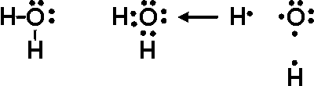
VSEPR: Shapes of Molecules
Electron Pair
  Any two valence e- around an atom that repel other e- pairs
    Lone pair e- (unshared/non-bonding pair only on one atom)
    Shared e⁻ pair (bonding pair shared between two atoms) – can be single, double, or triple bonds

Slide 61
VSEPR Model
(Valence Shell Electron Pair Repulsion)
Lone pair
H N H
H
bonding pair

Slide 62
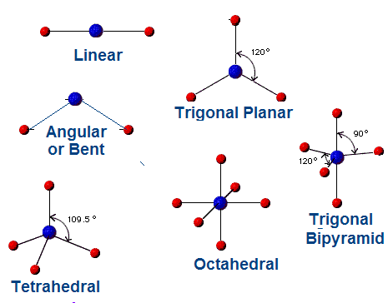
Basic Molecular shapes
The most common shapes of molecules are shown at the right
62

Slide 63
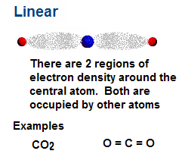
Linear Molecules
Linear molecules have only two regions of electron density.
63

Slide 64
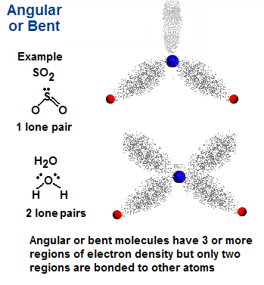
Angular or Bent
Angular or bent molecules have at least 3 regions of electron density, but only two are occupied
64

Slide 65
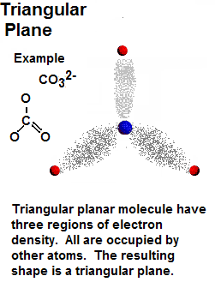
Trigonal Planar
(Triangular Plane)
Triangular planar molecules have three regions of electron density.
All are occupied by other atoms
65

Slide 66
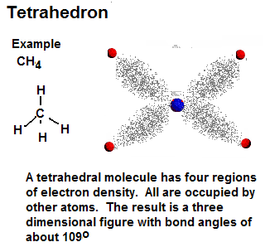
Tetrahedral
Tetrahedral molecules have four regions of electron density.
All are occupied by other atoms
66

Slide 67
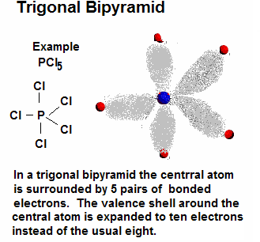
Trigonal Bipyramidal
A few molecules have expanded valence shells around the central atom. Hence there are five pairs of valence electrons. The structure of such molecules with five pairs around one is called trigonal bipyramid.
67

Slide 68
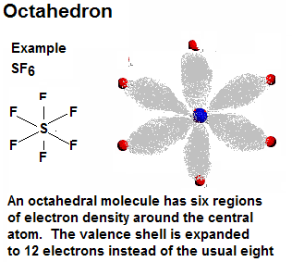
Octahedral
A few molecules have valence shells around the central atom that are expanded to as many as six pairs or twelve electrons. These shapes are known as octahedrons
68

Slide 69
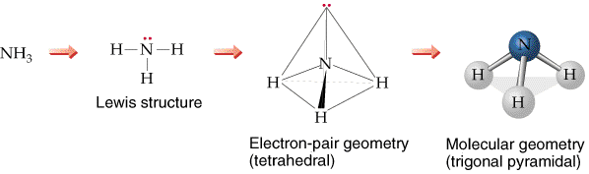
To determine the electron pair geometry:
1. Draw the Lewis structure.
  2. Count the number of bonded (X) atoms and non-bonded or lone pairs (E) around the central atom.
  3. Based on the total of X + E, assign the electron pair geometry.
  4. Multiple bounds count as one bonded atom!

Slide 70






Sum of X + E | Sample Formula | Geometry | Bond Angle (°) | Shared Pairs | # of Lone Pairs | Example
2 | AX or AX₂ | Linear | 180 | 2 | 0 | HCl BeF2
3 | AX₃ | Trigonal Planar | 120 | 3 | 0 | BF3
4 | AX₄ | Tetrahedral | 109.5 | 4 | 0 | CH4
4 | AX₃E | Trigonal Pyramidal | 109.5 | 3 | 1 | NH3
4 | AX₂E₂ | Bent | 109.5 | 2 | 2 | H2O

Slide 71
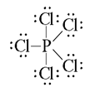
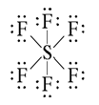
Sum of X + E | Sample Formula | Geometry | Bond Angle (°) | Shared Pairs | # of Lone Pairs | Example
5 | AX₅ | Trigonal Bipyramidal | 120,90 | 5 | 0 | PCl₅
6 | AX₆ | Octahedral | 90 | 6 | 0 | SF₆

Slide 72
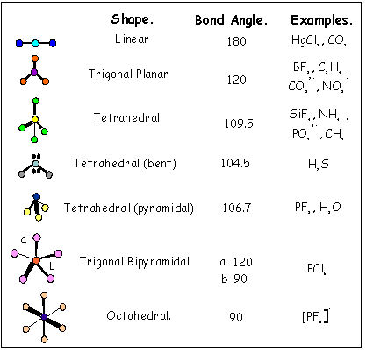
VSEPR SUMMARY

