Slide 1
Chemical Reactions

Slide 2
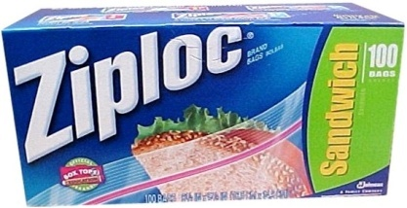
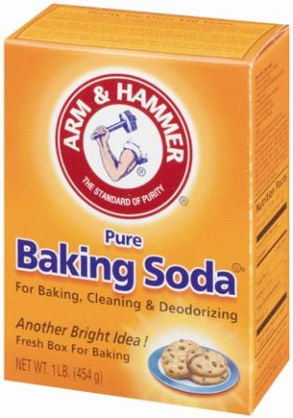
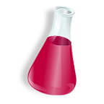
REACTION IN A BAG
Make observations with your bags in groups of four
What is happening? How can you explain this?

Slide 3
Signs of a Chemical Reaction
Evolution of heat and light
Formation of a gas (bubbling)
Formation of a precipitate
Color change

Slide 4
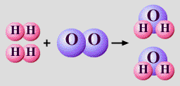
Law of Conservation of Mass
mass is neither created nor destroyed in a chemical reaction
total mass stays the same
atoms can only rearrange
4H
2 O
4H
2 O
36 g
4 g
32 g

Slide 5
Chemical Equations
A+B → C+D
REACTANTS
PRODUCTS

Slide 6
Chemical Equations

Slide 7
Energy and Reactions
Energy must be added to break bonds
Energy is released when bonds are formed
This energy can be in the form of heat as well as other things like electricity, sound, or light
Chemical Energy: the energy released when a chemical compound reacts to produce a new compound
Total Energy of Reactants=Total Energy of Products

Slide 8
Endothermic vs Exothermic
Endothermic
Exothermic
A chemical reaction that requires heat
More energy is needed to break the bonds in the reactants than is given off by forming bonds in the products
Examples: melting ice, photosynthesis, evaporating water, cooking an egg, baking bread
A chemical reaction that does not require heat
Heat is given off in the reaction as a product; heat is released to surrounding
More energy is released by forming products than is needed to break the bonds of the reactants
Examples: all combustion reactions, digestion, condensation, explosions

Slide 9
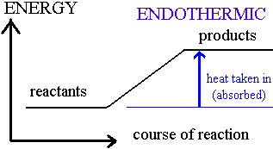
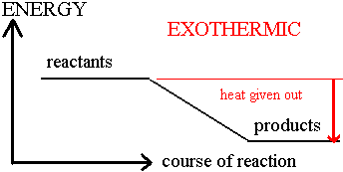
Reaction Profiles
Endothermic
Exothermic

Slide 10
Types of Chemical Reactions
Synthesis
Decomposition
Single Replacement (Displacement)
Double Replacement (Displacement)
Combustion
Oxidation-Reduction

Slide 11
Types: Synthesis
Example C + O₂
C
+
O
O
→
O
C
O
O
C
O
C
O
O
C
O
O
C
O
C
O
O
O
C
C
C
C
O
O
O
C
C
C
O
O
O
C
O
O
O
O
O
O
O
O
O
O
General: A + B → AB

Slide 12
Types: Synthesis
A and B can be elements or compounds
A and B combine to form 1 product
Another example:
Fe₂O₃ + H₂O → Fe(OH)₃
General: A + B → AB

Slide 13
Types: Decomposition
Example: NaCl
Cl
Na
→
Cl
+
Na
General: AB → A + B

Slide 14
Types: Decomposition
Example 2HgO
O
Hg
Hg
→
+
O
O
O
Hg
Hg
General: AB → A + B

Slide 15
Types: Decomposition
Kind of like the reverse of synthesis
Start with only one reactant and break down into multiple parts
If Binary (two things making it up) it breaks down into elements
Others are harder to tell and you don’t need to worry about these!
General: AB → A + B

Slide 16
Types: Single replacement
Example: Al + CuCl₂
Cu
+
Zn
+
Al
→
Cu
Cl
Cl
Al
Al
General: AB + C → AC + B

Slide 17
Types: Single Replacement
one element replaces another in a compound
metal replaces metal (+)
nonmetal replaces nonmetal (-)
A more reactive element will take the place of a less reactive one (Activity Series-do NOT need to know this)
When have a alkali metal with water, write like this:
This will make it look like other single replacement reactions and will help you out! Just remember diatomics!
K + HOH → KOH + H₂

Slide 18
Types: Double replacement
Example: MgO + CaS
Mg
Ca
Mg
Ca
+
→
+
O
S
S
O
General: AB + CD → AD + CB

Slide 19
Types: Double Replacement
ions in two compounds “change partners”
cation of one compound combines with anion of the other
Occurs when a precipitate, water or a gas forms
Precipitate – insoluble compound that comes out of solution during this type of reaction
General: AB + CD → AD + CB

Slide 20
Types: Combustion
the burning of any substance in O₂ to produce heat
Substance A is usually an organic compound
Must have good air supply for complete combustion (we’re just going to worry about full combustions)
CH₄(g) + 2O₂(g) → CO₂(g) + 2H₂O(g)
When A is organic: A + O₂ → CO₂ + H₂O
General: A + O₂ → B

Slide 21
Combustion
Combustion Video:
http://www.youtube.com/watch?v=SJCcH0ATMQ4

Slide 22
Types: Oxidation & Reduction
Any chemical change in which one species is oxidized (loses electrons) and one species is reduced (gains electrons)
REDOX Reactions: Remember OIL RIG!!
The single replacement reaction was an example of a redox reaction
Rust is a REDOX reaction (iron in oxygen)
Let’s try one and look at it in a few days
Iron Nail in a solution of CuSO4

Slide 23
Radicals
Radicals have at least one unpaired electron formed when covalent bonds are broken
They are very reactive to form other covalent bonds with other substances making new compounds
Also known as free radicals
Too many free radicals in the body can lead to cardiovascular disease, cancer, Alzheimer's disease, and Parkinson's disease.
To combat unwanted free radicals, consume antioxidants that can be found in Vitamin C

Slide 24
Writing and Balancing Chemical Reaction

Slide 25
Balancing Steps
1. Write the unbalanced equation.
2. Count atoms on each side.
3. Add coefficients to make #s equal.
Coefficient × subscript = # of atoms
4. Reduce coefficients to lowest possible ratio, if necessary.
5. Double check atom balance!!!

Slide 26
Helpful Tips
Balance one element at a time.
Update ALL atom counts after adding a coefficient.
If an element appears more than once per side, balance it last.
Balance polyatomic ions as single units.
“1 SO₄” instead of “1 S” and “4 O”

Slide 27
Balancing Example
Aluminum and copper(II) chloride react to form copper and aluminum chloride.
Al + CuCl₂ → Cu + AlCl₃
2
3
3
2
⁄ 2
⁄ 6
1 1
1 1
2 3
2 ⁄
Al
Cu
Cl
3 ⁄
6 ⁄
⁄ 3

Slide 28
Writing Equations
Two atoms of aluminum react with three units of aqueous copper(II) chloride to produce three atoms of copper and two units of aqueous aluminum chloride.
How many?
Of what?
In what state?

Slide 29
Describing Equations
Describing Coefficients:
individual atom = “atom”
covalent substance = “molecule”
ionic substance = “unit”
3CO₂ ⇒
2Mg ⇒
4MgO ⇒
3 molecules of carbon dioxide
2 atoms of magnesium
4 units of magnesium oxide

Slide 30
Describing Equations
Zn(s) + 2HCl(aq) → ZnCl₂(aq) + H₂(g)
How many?
Of what?
In what state?

Slide 31
Law of Definite Proportions
A compound always contains the same elements in the same proportions, regardless of the how the compound is made or how much of the compound is formed

Slide 32
Mole Ratios
The relative amount of moles of substance required to produce a given amount of product in a chemical reaction
Look at this chemical equation (remember to balance):
The mole ratio from the BALANCED reaction is 2 moles of H₂O: 2 moles H₂ : 1 mole O₂
H₂O → H₂ + O₂
2H₂O → 2H₂ + O₂

Slide 33
Example
Determine the mass of hydrogen gas (H₂) and oxygen gas (O₂) produced by 4 moles of water in the following chemical reaction
H₂O → H₂ + O₂

Slide 34
Rates of Change

Slide 35
Factors affecting Reaction Rate
Reaction rate-how fast the reaction goes from reactants to products
Factors affecting reaction rate
Temperature
Surface Area
Concentration
Pressure
Size and shape of molecules
Presence of a catalyst

Slide 36
Temperature and Surface Area
Temperature
Most reactions go faster at a higher temperature
This is because of the Kinetic theory
Higher temp means molecules going faster, more likely to collide
Surface Area
A large surface area speeds up reactions
Solids that have a large surface area react more quickly because more particles come in contact with the other reactants

Slide 37
Concentration and Pressure
Concentration
Most reactions go faster at a higher concentration (3% vs 30% solution)
Think of doing laundry
Pressure
Reactions are faster at a higher pressure
Gases are more concentrated at higher pressures because it has been squeezed into a smaller volume and have more collisions

Slide 38
Size/Shape and Catalysts
Size and Shape
Massive, Bulky molecules react slower
Because of Kinetic Molecular theory:
Bigger molecules move more slowly, collide less
Catalyst
A substance that changes the rate of a chemical rxn without being consumed
Not reactants or products
Do not play a role in the equilbrium (we will get to this)

Slide 39
Catalysts
Catalysts: speed up reactions
Inhibitors: slow down reactions
Enzymes: biological catalysts
Ex. Lipase breaks down fat into smaller molecules
Substrate: the reactant in reactions catalyzed by enzymes

Slide 40
END PHYSICAL SCIENCE NOTES!

Slide 41
Equilibrium
Reactions don’t always go to completion, some are REVERSIBLE
At equilibrium, you can’t see any changes
When the rate of the forward reaction is equal to the rate of the reverse reaction and the concentration of products and reactants remain unchanged
CaCO₃ ↔ CaO + CO₂

Slide 42
Le Chatlier’s Principle
States that:
Any change in equilibrium conditions upsets the equilibrium of the system
A system at equilibrium will shift to relieve the stress
There will be a change in the rate of the forward or reverse reaction to return the system to equilibrium

Slide 43
Temperature
Increasing temperature favors the rxn that absorbs energy
Increasing heat to an endothermic reaction will favor the products
Increasing heat to an exothermic reaction will favor the reactants
Nitrogen + Hydrogen ↔ Ammonia (+ heat)
N2 + 3H2 ↔2 NH3 (+ heat)

Slide 44
Pressure
Increasing pressure favors the rxn that produces fewer gas molecules
Decreasing Pressure favors the rxn that produces more gas molecules
Nitrogen + Hydrogen ↔ Ammonia (+ heat)
N₂(g) + 3H₂(g) ↔2 NH₃(g) + heat

Slide 45
Concentration
Increasing concentration of one substance favors the reaction that produces less of that substance
Increasing the amount of a reactant, will favor more product production (forward reaction)
Increasing the amount of a product will favor more reactant production (reverse reaction)
Nitrogen + Hydrogen ↔ Ammonia (+ heat)
N₂(g) + 3H₂(g) ↔2 NH₃(g) + heat

