Slide 1
Lab Safety & Scientific Method

Slide 2
Lab Safety Rules
Always Follow instructions given by your instructor and contained in your lab procedure. Pay attention to any SAFETY or CAUTION statements in the procedure
Never directly smell chemical fumes, use the wafting technique
When working with open flame, chemicals, or hot liquids
  NO gum, eating, drinking
  Wear closed-toed shoes
  Tie back long hair
  Wear Safety Goggles
Do NOT rub your eyes or face while in lab

Slide 3
Lab Safety Rules
In case of an accident, notify the instructor immediately!
Use safety equipment if necessary:
  Eye wash: if corrosive chemicals get into eyes
  Safety shower: if large amounts of chemicals get on your skin or clothes
  Fire blanket: if clothing catches on fire
Notify the instructor if glassware is broken. Do NOT clean it up yourself!
Playing around in lab are unsafe and is not permitted
Use only your assigned work area and leave in clean, dry, and in the same order that you found it.

Slide 4
Lab Safety
If I feel you are working unsafely, you will be removed from the lab area and lose all credit on that particular lab
Be safe! If you are ever unsure of what to do, ask me first!

Slide 5
Lab Equipment
You should have a basic understanding of the function of lab equipment that will be used throughout this year.

Slide 6
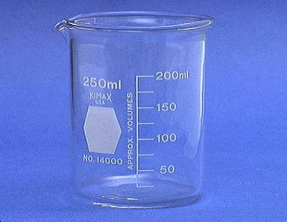
Beaker
Beakers hold solids or liquids that will not release gases when reacted or are unlikely to splatter if stirred or heated.

Slide 7
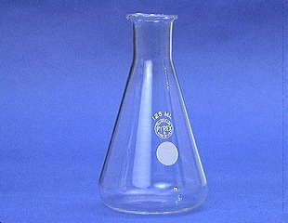
Erlenmeyer Flask
Erlenmeyer flasks hold solids or liquids that may release gases during a reaction or that are likely to splatter if stirred or heated.

Slide 8
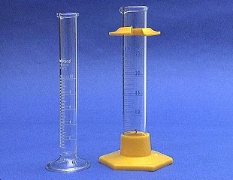
Graduated Cylinder
A graduated cylinder is used to measure volumes of liquids.

Slide 9
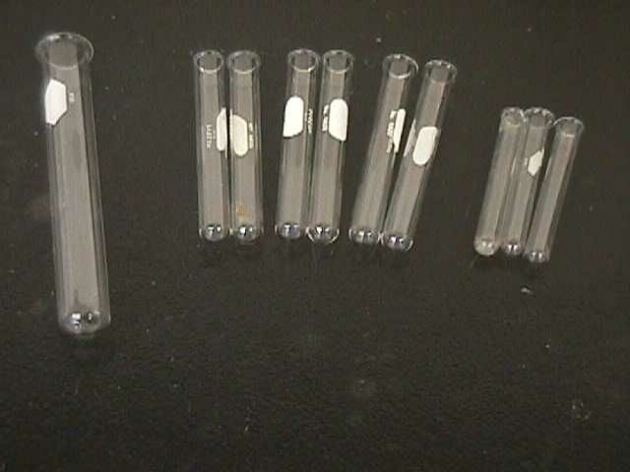
Test Tubes
13 x 100 mm test tubes
Ignition
tube
10 x 75 mm test tubes

Slide 10
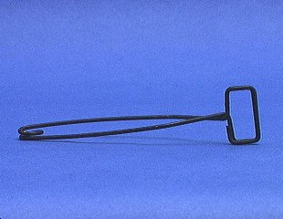
Test Tube Holder
A test tube holder is useful for holding a test tube which is too hot to handle.

Slide 11
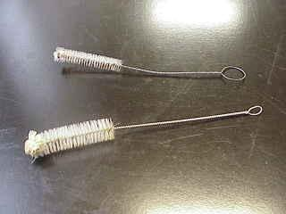
Test Tube Brushes
Test tube brushes are used to clean test tubes and graduated cylinders.
Forcing a large brush into a small test tube will often break the tube.

Slide 12
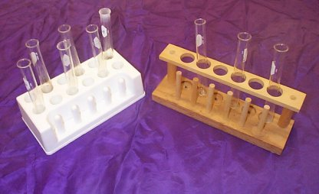
Test Tube Racks
Test tube racks are for holding and organizing test tubes on the laboratory counter. Plastic racks may melt in contact with very hot test tubes.

Slide 13
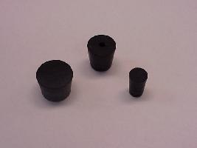
Rubber Stoppers
Rubber stoppers are used to close containers to avoid spillage or contamination.
Containers should never be heated when there is a stopper in place.

Slide 14
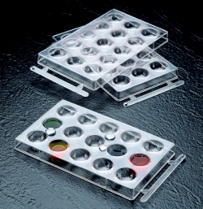
Well Plates
Well plates are used when we want to perform many small scale reactions at one time. We will use these many times during the year.

Slide 15
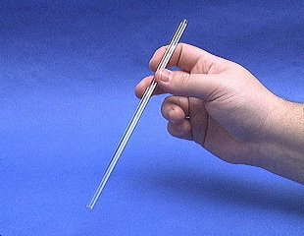
Glass Stir Rod
A glass rod is used to manually stir solutions. It can also be used to transfer a single drop of a solution.

Slide 16
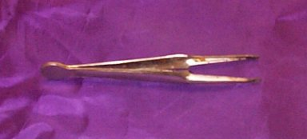
Forceps
Forceps (or tweezers) are used to pick up small objects.

Slide 17
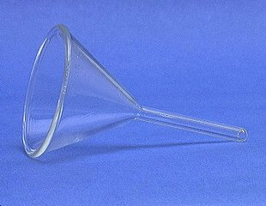
Funnel
A funnel is used to aid in the transfer of liquid from one vessel to another.

Slide 18
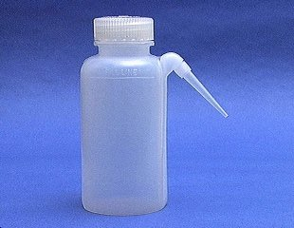
Wash Bottle
A wash bottle has a spout that delivers a wash solution to a specific area. Distilled water is the only liquid that should be used in a wash bottle.

Slide 19
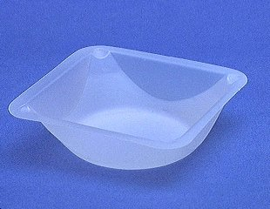
Weighing Boat
Weighing boats are used to weigh solids that will be transferred to another vessel.

Slide 20
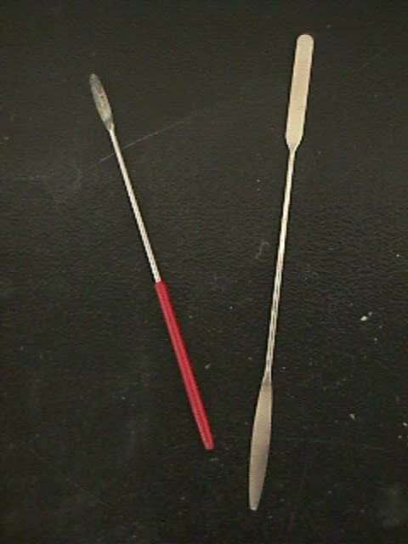
Spatulas
Spatulas are used to dispense solid chemicals from their containers.
Chemicals should never be transferred with your bare hands.

Slide 21
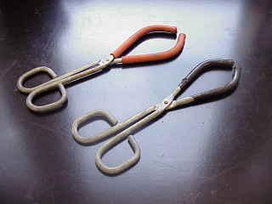
Beaker Tongs
Beaker tongs are used to move beakers containing hot liquids

Slide 22
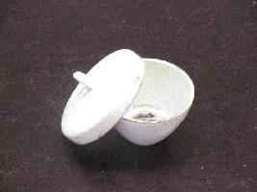
Crucible
Crucibles are used for heating certain solids, particularly metals, to very high temperatures.

Slide 23
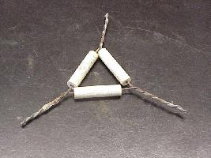
Clay Triangle
The clay triangle is used as a support for porcelein crucibles when being heated over a Bunsen burner.

Slide 24
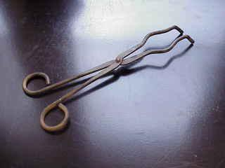
Crucible Tongs
For handling hot crucibles; also used to pick up other hot objects. NOT to be used for picking up beakers!

Slide 25
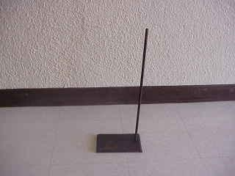
Ringstands and their Components
Ringstands are a safe and convenient way to perform reactions that require heating using a Bunsen burner.

Slide 26
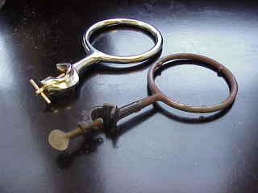
Ringstands and their Components
Iron Rings
Iron rings connect to a ringstand and provide a stable, elevated platform for the reaction.

Slide 27
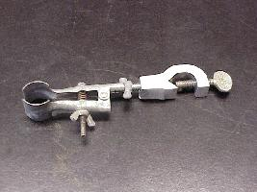
Ringstands and their Components
Utility Clamps
Utility clamps are used to secure test tubes, distillation columns, and burets to the ringstand.

Slide 28
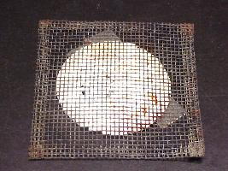
Ringstands and their Components
Wire Gauze
Wire gauze sits on the iron ring to provide a place to stand a beaker.
On older wire gauze, the white material is asbestos!

Slide 29
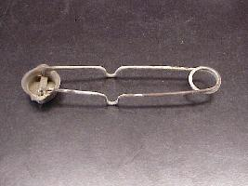
Strikers
Strikers are used to light Bunsen burners.
The flints on strikers are expensive. Do not operate the striker repeatedly just to see the sparks!

Slide 30
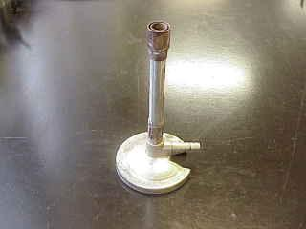
Bunsen Burner
Bunsen burners are used for the heating of nonvolatile liquids and solids.

Slide 31
What are the parts of a Bunsen burner?
Label the diagram using these words.
air hole, chimney, collar (collar and air hole and chimney make up the air tube), tubing, and gas tap
chimney
gas tap
tubing
collar
air hole

Slide 32
How do we use a Bunsen burner?
1. Join the burner to a gas tap.

Slide 33
How do we use a Bunsen burner?
2. Close the air tube. Then open ½ to ¾ of a turn. Then close serrated burner valve on bottom of burner and open ½ to ¾ of a turn

Slide 34
How do we use a Bunsen burner?
3. Take the striker hold it over the chimney.
Turn on the gas tap. Strike the striker

Slide 35
The Bunsen flame I
What will be the color of the flame be if it is not getting enough air (oxygen)?

Slide 36
The Bunsen flame II
Open the air hole slowly, until flame is proper color.
What will be the color of the flame when the air hole is opened properly?
Then adjust height of flame to 3-5 inches.

Slide 37
Which kind of flame is hotter?
Flame I
with air hole CLOSED
yellow in color
luminous
Flame II
with air hole OPENED
blue in color
non-luminous
?
?

Slide 38
Conclusion
The Blue flame is better for heating

Slide 39
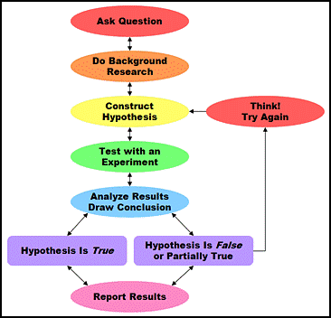
Scientific Method

Slide 40
Observations
Gathered through your senses
A scientist notices something in their natural world

Slide 41
Observations
An example of an observation might be noticing that many salamanders near a pond have curved, not straight, tails

Slide 42
Hypothesis
A suggested solution to the problem.
Must be testable
Sometimes written as If…Then… statements
Predicts an outcome

Slide 43
Hypothesis
An example of a hypothesis might be that the salamanders have curved tails due to a pollutant in the moist soil where they live.

Slide 44
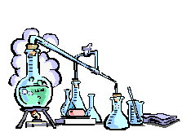
Experiment
A procedure to test the hypothesis.

Slide 45
Experiment
Variable – factor in the experiment that is being tested

Slide 46
Setting up a useful experiment…
The factors that affect a phenomenon are called variables.
Independent Variable- manipulated/changed (ex. Amount of fertilizer used on the plants.)
Dependent Variable- what is measured for change in response to ind.var. (ex. Growth in plants.)
Constants- All factors are kept the same in the experiment so other variables can be studied.

Slide 47
Example of Controls & Variables
For example, suppose you want to figure out the fastest route to walk home from school.
You will try several different routes and time how long it takes you to get home by each one.
Since you are only interested in finding a route that is fastest for you, you will do the walking yourself.

Slide 48
What are the Variables in Your Experiment?
Varying the route is the independent variable
The time it takes is the dependent variable
Keeping the same walker throughout makes the walker a control variable.

Slide 49

Data
Results of the experiment
May be quantitative (numbers) or qualitative

Slide 50
Data
Must be organized
Can be organized into charts, tables, or graphs

Slide 51
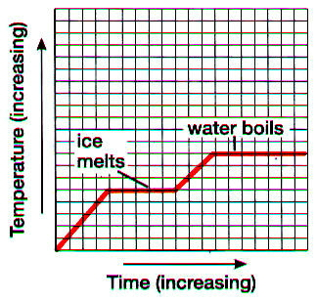
Types of Graphs
Line Graph
  shows the relationship between 2 variables
  X axis: Independent Variable: (what you manipulate)
  Y Axis: Dependent variable (what is measured/responding)
Dependent Variable
Independent Variable
DRY MIX

Slide 52
Independent vs Dependent
Independent
  Goes on X axis
  Does not depend on the other variable
  Manipulated/ Changed
  Examples: year, time, class period,
Dependent
  Goes on Y axis
  Y has a vertical line
  Does depend on other variable
  It is what you measure in the lab
  Examples: number of deer, number of students, etc

Slide 53
Conclusion
The answer to the hypothesis based on the data obtained from the experiment

Slide 54
Retest
In order to verify the results, experiments must be retested.

Slide 55
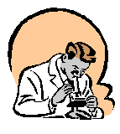
Sci Method Review
1)Identify a Problem
2) State Observations about the problem
3) Form a Hypothesis about the problem (if…then…)
4) Design an Experiment to test the hypothesis
5) Collect Data
6) Form a Conclusion
7) Retest

Slide 56
Hypothesis or scientific theory?
A Scientific Theory is an explanation (OR WHY) for a phenomenon or mechanism that is widely supported by a large body of data.
A proposal is elevated to ‘theory’ only after MANY tests and multiple types of experiments.
A Hypothesis is a predicted answer to a question based on prior knowledge.
A hypothesis can be supported or rejected based on data gathered from an experiment.

Slide 57
Scientific Theory vs Law
Examples
  Law of gravity
  Newton’s Laws of Motion
  Law of Definite Proportions
  Laws of Thermodynamics
  Law of Reflection
A scientific law is a summary of many experimental results and observations
A law tells how things work(the what)
  Tells you the action-you know an apple will fall when you drop it
A law does NOT tell you why it happens, theory tells you the why

Slide 58
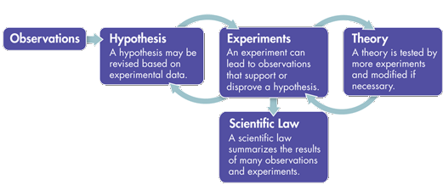

Slide 59
Hypothesis: Educated Guess
Theory: Explanation WHY something happens, a highly tested hypothesis through many experiments
Law: Explanation of WHAT happens because of a theory

