Slide 1
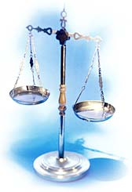
Unit 1: Measurement Notes

Slide 2
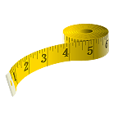
Why do we measure? What do we measure?
Matter: anything that has mass or takes up space.

Slide 3
Nature of A Measurement
A measurement consists of 2 parts:
1. Quantitative component (aka the number part)
2. Unit – IMPORTANT! Gives meaning to the quantitative component
Part 1 – number
Part 2 - scale (unit)
Examples:
20 grams
6.63 x 10⁻³ m

Slide 4
A Short History of Standard Units
Humans did not always have standards by which to measure temperature, time, distance, etc.
It wasn’t until 1790 that France established the first metric system.

Slide 5
The First Metric System
The French established that one meter was one ten-millionth of the distance of the from the Equator to the North Pole.
One second was equal to 1/86,400 of the average day.

Slide 6
Today’s Standards
The techniques used today to establish standards are much more advanced than in 1790…
One meter is equal to the distance traveled by light in a vacuum in 1/299,792,458 of a second.
One second is defined in terms of the number of cycles of radiation given off by a specific isotope of the element cesium.

Slide 7
S.I. Units
The International System of Units is used ALMOST exclusively worldwide (the U.S. is one the of the exceptions).
ALL science is done using S.I. units.

Slide 8
The United States’ System of Measurement
In 1975, the U.S. government attempted to adopt the metric system with little success.
The U.S. currently uses the English System of Measurement.

Slide 9
So why S.I.?

Slide 10
So why S.I.?
Decimals are more “computationally friendly”
Multiples of ten
Eliminate LARGE numbers by using prefixes
Scientifically based

Slide 11
Measurements and SI Units
Quantitative measurements must include a number AND a unit.
Base units are used with prefixes to indicate fractions or multiples of a unit.
Try to fill in your table.

Slide 12
The Fundamental SI Units (le Système International, SI)

Slide 13
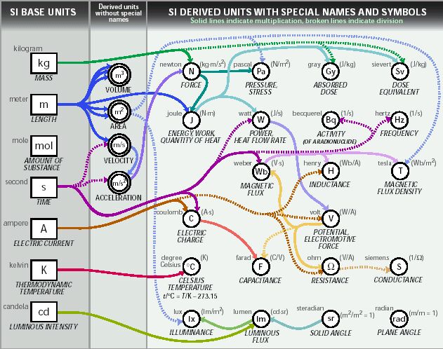
SI Units

Slide 14
SI Prefixes Common to Chemistry
Prefix | Abbrv | Exponent | Factor
Giga | G | 10⁹ | 1,000,000,000
Mega | M | 10⁶ | 1,000,000
Kilo | k | 10³ | 1,000
Hecto | h | 10² | 100
Deka | aa | 1o¹ | 10
BASE UNIT (gram/meter/liter/second) |  | 10⁰ | 1
Deci | d | 10⁻¹ | 0.1
Centi | c | 10⁻² | 0.01
Milli | m | 10⁻³ | 0.001
Micro | µ | 10⁻⁶ | 0.000001
Nano | n | 10⁻⁹ | 0.000000001
Pico | p | 10⁻¹² | 0.000000000001

Slide 15
Uncertainty in Measurement
Whenever a measurement is made with a device such as a graduated cylinder or ruler, an estimate is required.

Slide 16
Uncertainty in Measurement
Based on the ruler here, the nail is somewhere between 6.3 cm and 6.4 cm – there are no graduations on the ruler between 6.3 and 6.4 cm.
Ahhh… what to do?!

Slide 17
Uncertainty in Measurement
ANSWER: One has to estimate how far between 6.3 and 6.4 cm the nail measures.
If you break down the distance between 6.3 cm and 6.4 cm in 10 equal divisions, we can estimate that the nail, since it is half-way between 6.3 and 6.4 cm, that the length could be written as 6.35 cm

Slide 18
Uncertainty in Measurement
Because the last number of the measurement is based on a visual estimate, it may be different when another person makes the same measurement…..
Therefore, there is some uncertainty in measurements.

Slide 19
Uncertainty in Measurement
Different people may come up with the following results:
6.34 cm
6.35 cm
6.36 cm
The “6.3” part of the measurements are the certain numbers because they are read directly from the instrument

Slide 20
Uncertainty in Measurement
6.34 cm
6.35 cm
6.36 cm
The third digit is estimated and can vary based on the person reading the instrument -
It is known as the uncertain number

Slide 21
Uncertainty in Measurement
Measurements have some degree of uncertainty and the uncertainty of a measurement depends on the measuring device.
THE NUMBERS RECORDED IN A MEASUREMENT (*ALL THE CERTAIN NUMBERS PLUS THE FIRST UNCERTAIN NUMBER*) ARE KNOWN AS
SIGNIFICANT FIGURES

Slide 22
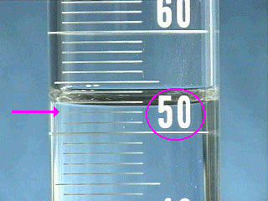
Use the graduations to find all certain digits
There are two unlabeled graduations below the meniscus, and each graduation represents 1 mL, so the certain digits of the reading are…
52 mL.

Slide 23
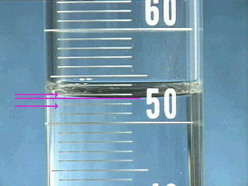
Estimate the uncertain digit and take a reading
The meniscus is about eight tenths of the way to the next graduation, so the final digit in the reading is…
0.8 mL
Therefore the volume in the graduated cylinder is…
52.8 mL

Slide 24
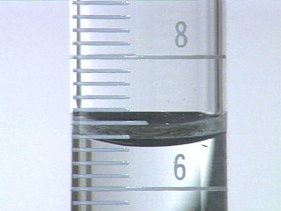
10 mL Graduate
What is the volume liquid in the graduate?
6
_ . _ _ mL
6
2

Slide 25
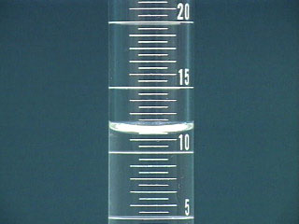
25mL graduated cylinder
What is the volume of liquid in the graduate?
1
1
_ _ . _ mL
5

Slide 26
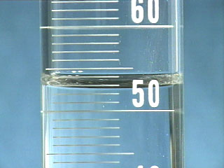
100mL graduated cylinder
What is the volume of liquid in the graduate?
5
2
7
_ _ . _ mL

Slide 27
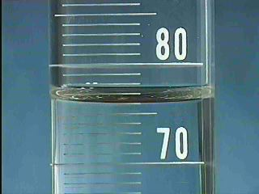
Self Test
Examine the meniscus below and determine the volume of liquid contained in the graduated cylinder.
The cylinder contains:
7
6
_ _ . _ mL
0

Slide 28
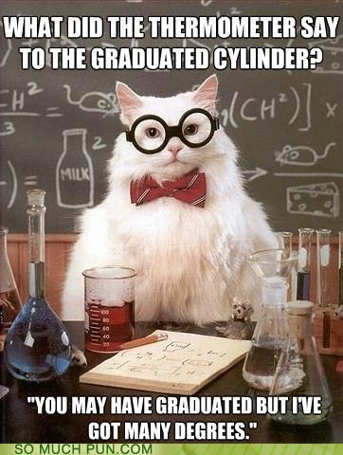
Some science humor for you ☺

Slide 29
Uncertainty in Measurement
Remember, a digit that must be estimated in a measurement is called uncertain. A measurement always has some degree of uncertainty.
We signify the degree of certainty for a measurement by the number of significant figures we record.

Slide 30
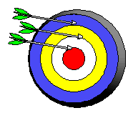
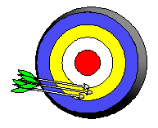
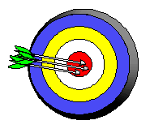
Precision and Accuracy
Accuracy refers to the agreement of a particular value with the true value.
Precision refers to the degree of agreement among several measurements made in the same manner.
Neither accurate nor precise
Precise but not accurate
Precise AND accurate

Slide 31
Scientific Notation
In science, we deal with some very LARGE numbers:
1 mole = 602000000000000000000000
In science, we deal with some very SMALL numbers:
Mass of an electron =
0.000000000000000000000000000000091 kg

Slide 32
Imagine the difficulty of calculating the mass of 1 mole of electrons!
0.000000000000000000000000000000091 kg
x 602000000000000000000000
???????????????????????????????????
Ahhh… that is cray cray!

Slide 33
Scientific Notation:
A method of representing very large or very small numbers in the form:
M x 10^{n}
M is a number between 1 and 10
n is an integer

Slide 34
.
2 500 000 000
9
8
7
6
5
4
3
2
1
Step #1: Insert an understood decimal point
Step #2: Decide where the decimal must end
up so that one number is to its left
Step #3: Count how many places you bounce
the decimal point
Step #4: Re-write in the form M x 10^{n}

Slide 35
2.5 x 10⁹
The exponent is the number of places we moved the decimal.

Slide 36
0.0000579
1
2
3
4
5
Step #2: Decide where the decimal must end
up so that one number is to its left
Step #3: Count how many places you bounce
the decimal point
Step #4: Re-write in the form M x 10^{n}

Slide 37
5.79 x 10⁻⁵
The exponent is negative because the number we started with was less than 1.

Slide 38
Using Scientific Notation
Any number can be represented as the product of a number between 1 and 10 AND a power of 10 (either positive or negative).
The power of 10 depends on the number of places the decimal point is moved and in which direction.

Slide 39
Using Scientific Notation
When changing a standard number TO scientific notation, the direction that the decimal moves in the number to form a coefficient between one and 10 will affect the charge of the power of 10 in the scientific notation:
If the decimal point is moved to the left the power of 10 is positive.
Ex. 340002 → 3.40002 x 10⁵

Slide 40
Using Scientific Notation
If the decimal point is moved to the right from the original number to the scientific notation format the power of 10 is negative
Ex: .00789 → 7.89 x 10⁻³

Slide 41
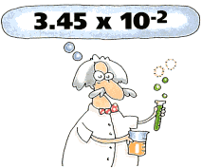
PERFORMING CALCULATIONS IN SCIENTIFIC NOTATION
ADDITION AND SUBTRACTION

Slide 42
Review:
Scientific notation expresses a number in the form:
M x 10^{n}
n is an integer
1 ≤ M < 10

Slide 43
4 x 10⁶
IF the exponents are the SAME, we simply add or subtract the numbers in front and bring the exponent down unchanged.
+ 3 x 10⁶
7
x 10⁶

Slide 44
The same holds true for subtraction in scientific notation.
4 x 10⁶
- 3 x 10⁶
1
x 10⁶

Slide 45
4 x 10⁶
If the exponents are NOT the same, we must move a decimal to make them the same.
+ 3 x 10⁵

Slide 46
40.0 x 10⁵
4.00 x 10⁶
Student A
+ 3.00 x 10⁵
To avoid this problem, move the decimal on the smaller number!
NO!
43.00
x 10⁵
← Is this good scientific notation?
= 4.300 x 10⁶

Slide 47
4.00 x 10⁶
Student B
.30 x 10⁶
+ 3.00 x 10⁵
YES!
4.30
x 10⁶
← Is this good scientific notation?

Slide 48
A Problem for you…
2.37 x 10⁻⁶
+ 3.48 x 10⁻⁴

Slide 49
Solution…
002.37 x 10⁻⁶
2.37 x 10⁻⁶
0.0237 x 10⁻⁴
+ 3.48 x 10⁻⁴
3.5037 x 10⁻⁴

Slide 50
Multiplying Exponential Numbers
When multiplying numbers in scientific notation, first multiply the coefficients, then ADD the exponents of the powers of 10
EX. (3.2 x 10³) (4.5 x 10⁵) =
14.4 x 10⁸

Slide 51
Dividing Exponential Numbers
When dividing numbers in scientific notation, first divide the coefficients, then SUBTRACT the exponents of the powers of 10
EX. 8.2 x 10⁶
4.5 x 10⁵ = 1.8 x 10¹

Slide 52
Using your Calculator with Scientific Notation
(5.44 × 10⁷ g) ÷ (8.1 × 10⁴ mol) =
Type on your calculator:
EXP
EXP
=
5.44
7
÷
8.1
4
EE
EE
ENTER
= 671.6049383
= 670 g/mol
= 6.7 × 10² g/mol

Slide 53
Significant Figures & Calculations
Chemistry involves many types of calculations that contain measurements and thus numbers with uncertainties.
Mathematicians have studied how uncertainty accumulates through series of calculations and have designed a set of rules to determine how many significant figures the calculations should have.
First, we need to learn how to count the significant figures in a given number.

Slide 54
Rules for Counting Significant Figures - Details
Nonzero integers: always count as significant figures.
3456 has
4 sig figs.

Slide 55
Rules for Counting Significant Figures - Details
Zeros: There are 3 classes of “zeros”
1. Leading zeros (zeros to the left)do not count as significant figures.
0.0486 has
3 sig figs.

Slide 56
Rules for Counting Significant Figures - Details
Zeros:
Captive zeros (zero sandwiches)always count as significant figures.
16.07 has
4 sig figs.

Slide 57
Rules for Counting Significant Figures - Details
Zeros:
3. Trailing zeros (zeros to the right) are significant only if the number contains a decimal point anywhere in the number.
9.300 has
4 sig figs.

Slide 58
Rules for Counting Significant Figures - Details
Exact numbers: have an infinite number of significant figures. These are numbers that are determined by counting or by definition:
1 inch = 2.54 cm, exactly
Ex. 25 students /class

Slide 59
Sig Fig Practice #1
How many significant figures in each of the following?
1.0070 m →
5 sig figs
17.10 kg →
4 sig figs
100,890 L →
5 sig figs
3.29 x 10³ s →
3 sig figs
0.0054 cm →
2 sig figs
3,200,000 →
2 sig figs

Slide 60
Rules for Significant Figures in Mathematical Operations
Multiplication and Division: number of sig figs in the result equals the number in the least precise measurement used in the calculation.
6.38 x 2.0 =
12.76 → 13 (2 sig figs)

Slide 61
Sig Fig Practice #2
Calculation
Calculator says:
Answer
3.24 m x 7.0 m
22.68 m²
23 m²
100.0 g ÷ 23.7 cm³
4.219409283 g/cm³
4.22 g/cm³
0.02 cm x 2.371 cm
0.04742 cm²
0.05 cm²
710 m ÷ 3.0 s
236.6666667 m/s
240 m/s
1818.2 lb x 3.23 ft
5872.786 lb·ft
5870 lb·ft
1.030 g ÷ 2.87 mL
2.9561 g/mL
2.96 g/mL

Slide 62
Rules for Significant Figures in Mathematical Operations
Addition and Subtraction: The number of decimal places in the result equals the number of decimal places in the least precise measurement.
6.8 + 11.934 =
18.734 → 18.7

Slide 63
Sig Fig Practice #3
Calculation
Calculator says:
Answer
3.24 m + 7.0 m
10.24 m
10.2 m
100.0 g - 23.73 g
76.27 g
76.3 g
0.02 cm + 2.371 cm
2.391 cm
2.39 cm
713.1 L - 3.872 L
709.228 L
709.2 L
1818.2 lb + 3.37 lb
1821.57 lb
1821.6 lb
2.030 mL - 1.870 mL
0.16 mL
0.160 mL

Slide 64
Commonly Used Prefixes in the SI (metric system)
Prefix Symbol Meaning Power of 10 for
Scientific Notation
mega M 1 000 000 10⁶
kilo k 1 000 10³
deci d 0.1 10⁻¹
centi c 0.01 10⁻²
milli m 0.001 10⁻³
micro μ 0.000 0001 10⁻⁶

Slide 65
Length Units in Metric System
Unit Symbol Meter Equivalent
kilometer km 1 000 m or 10³ m
meter m (BASE UNIT) 1 M
decimeter dm 0.1 m or 10⁻¹ m
centimeter cm 0.01 m or 10⁻² m
millimeter mm 0.001 m or 10⁻³ m
micrometer μm 0.000 0001 m or 10⁻⁶ m

Slide 66
FACTOR LABELING/DIMENSIONAL ANALYSIS
Much of chemistry involves solving problems.
Scientists use conversion factors to help change from one unit to another.

Slide 67
CONVERSION EXAMPLE
A person wants to order a belt from another country. His waist is 26” but the belt comes in metric units of cm. What size should he order?
First, determine the relationship between the two units:
1 in = 2.54 cm

Slide 68
CONVERSION EXAMPLE
Next, establish a conversion factor
Since 1 in = 2.54 cm ………
Possible conversion factors for this relationship would be:
2.54 cm or 1 in
1 in 2.54 cm

Slide 69
CONVERSION EXAMPLE
Next, use the conversion factor to convert the size of the belt from the one unit to another with a format known as factor-label or dimensional analysis.
Given value Conversion = Answer
Factor
26 inches 2.54 cm
in = 66.04 cm → 66 cm

Slide 70
CONVERSION EXAMPLE
When choosing which conversion factor to use, put the unit that corresponds to the given value unit in the denominator of the conversion factor so that the given units cancel each other out.
Given value Conversion = Answer
Factor
26 inches 2.54 cm
in = 66.04 cm → 66 cm

Slide 71
METRIC CONVERSIONS
Suppose you want to determine the number of cm in 3 meters?
Relationship: 1 m = 100 cm
First, identify your GIVEN: 3 meters
Next, identify the UNKNOWN: # cm?????

Slide 72
METRIC CONVERSIONS
Determine the relationship between the GIVEN units (m) and the UNKNOWN units (cm)
Relationship: 1 m = 100 cm
Possible conversion factors
1 m or 100 cm
100 cm 1 m
Factor Label:
3 m 100 cm = 300 cm
1 m

Slide 73
Problem #1
Convert 10 meters to mm
10 m
1 000
mm
10 000
mm
=
1
m
= 1x10⁴ mm

Slide 74
Problem #2
Convert 0.02 kilometers to m
0.02 km
1 000
m
20
m
=
1
km

Slide 75
Problem #3
Convert 20 centimeters to m
20 cm
1
m
0.20
m
=
100
cm

Slide 76
Problem #4
Convert 5.2 kg to mg
5.2 kg
1 000
g
mg
1 000
mg
=
1
kg
1
g
= 5 200 000 mg
= 5.2x10⁶ mg

Slide 77
Problem #5
Convert 1.4 days into minutes
5.2 kg
1 000
g
mg
1 000
mg
=
1
kg
1
g
= 5 200 000 mg
= 5.2x10⁶ mg

Slide 78
Another Tip……
When setting up conversion factors, determine which unit is the “bigger” unit. For example, a meter is bigger than a cm.
Place a “1” next to the larger unit in the conversion factor and equate the smaller unit accordingly.
It will make calculations “easier”.

Slide 79
Conversion Tips
For example: Convert from meters to cm
Relationship between units:
1 meter = 100 cm OR 0.01 m = 1 cm
Possible conversion factors:
1 meter VS 1 cm
100 cm 0.01 m
*choose this one

Slide 80
Percent Error
Indicates accuracy of a measurement
your value
accepted value

Slide 81
Percent Error
Ex: A student determines the density of a substance to be 1.40 g/mL. Find the % error if the accepted value of the density is 1.36 g/mL.
% error = 2.9 %

