Slide 1
Chapter 10-Volcanoes and Other Igneous Activity

Slide 2
Video
http://www.youtube.com/watch?v=OowFvnlWI90
http://www.youtube.com/watch?v=1mzqG9L2kiM&NR=1&feature=fvwp
What makes this happen?!

Slide 3
Origin of Magma
When solid rock, located in the crust and upper mantle, partially melts
Role of Heat:
Geothermal Gradient: the change in temperature with depth
Role of Pressure:
Pressure increases with depth
Role of Water:
Water causes rock to melt at lower temperatures

Slide 4
Forming Magma
Three Ways:
When heat is added when a magma body from a deeper source intrudes and melts rock in the crust
A decrease in pressure (without the addition of heat) can result in decompression melting
Water can lower the melting temperature of mantle rock to form magma

Slide 5
Factors Affecting Eruption
Magma composition, magma temperature, and the amount of dissolved gases in magma
These factors actually control the viscosity of a given magma

Slide 6
Viscosity
Viscosity: a substance’s resistance to flow
More viscous: flows slower
Less viscous: flows faster
The hotter the temperature, the faster it flows → less viscous
High silica in magma → high viscosity (rhyolitic lava)
Low silica in magma → low viscosity (basaltic lava)

Slide 7
Factors Affecting Eruptions
Dissolved gases
Mostly water vapor and carbon dioxide (CO₂)
Gases expand near the surfaces
A vent is an opening in the surface of Earth through which molten rock and gases are released
Gases trapped in magma provide the force to eject molten rock from vents

Slide 8
Violence of an eruption is related to how easily gases escape from magma
Easily escape from fluid basaltic magma (Hawaii)
Highly viscous magma produces a more violent eruption (Mt. St. Helens)

Slide 9
Magma Composition

Slide 10
The nature of volcanic eruptions
In summary
Basaltic lavas = mild eruptions
Rhyolitic or andesitic lavas = explosive eruptions

Slide 11
Volcanic Material
Lava Flows
Basaltic lavas are more fluid, low silica content
Rhyolitic lavas are less fluid, high silica content
Types of Lava:
Pahoehoe lava (resembles braids in ropes)
Aa (rough jagged blocks)

Slide 12
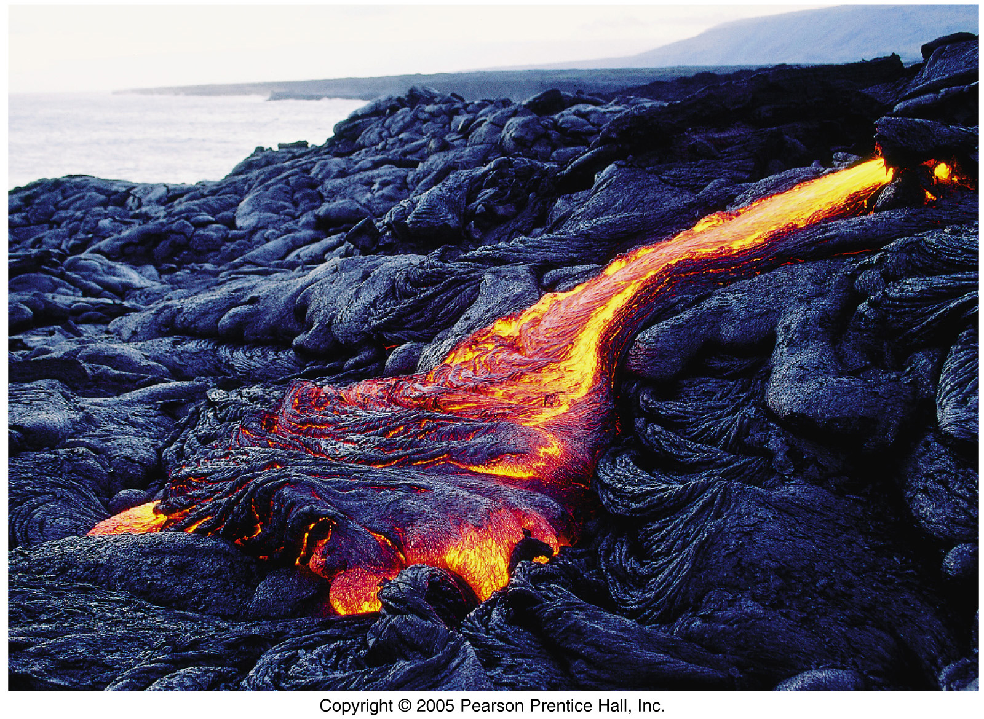
A pahoehoe lava flow

Slide 13
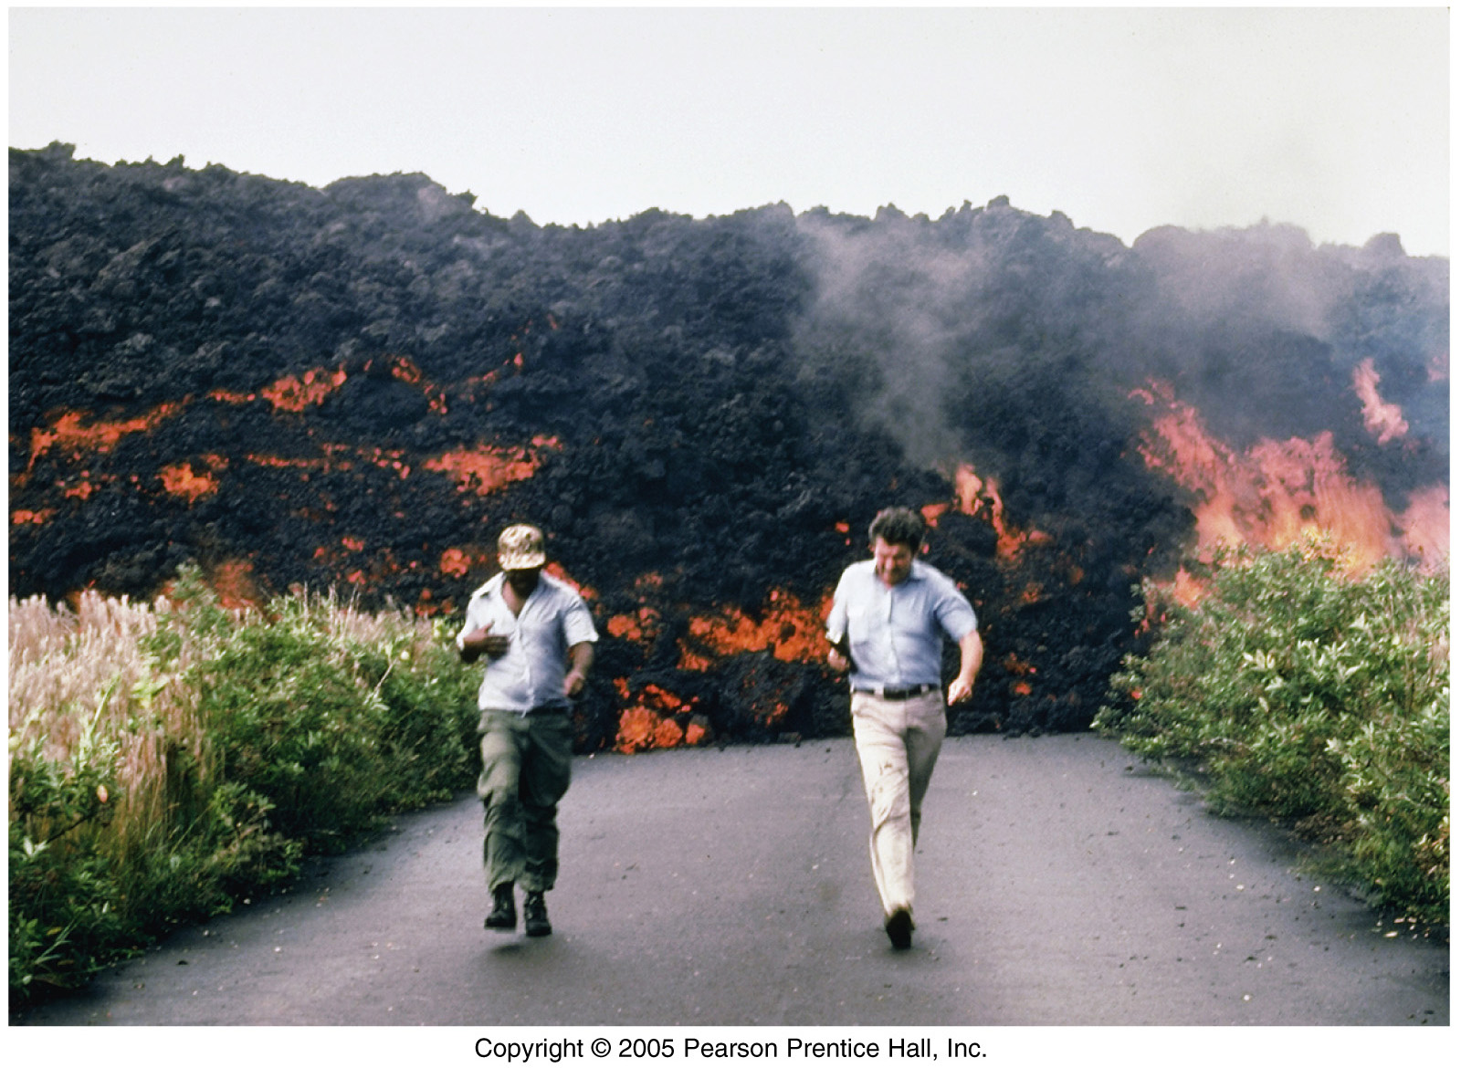
Aa lava flow

Slide 14
Volcanic Material
Gases
Gas portion of most magmas is about 1-6% of total weight
Usually is in the form of water vapor or CO₂
Composition of gases is important because they have contributed to the gases in our atmosphere

Slide 15
Volcanic Material
Pyroclastic materials – “fire fragments”
Types of pyroclastic debris
Ash and dust - fine, glassy fragments
Pumice - porous rock from “frothy” lava
Cinders - pea-sized material
Lapilli - walnut-sized material
Particles larger than lapilli
Blocks - hardened or cooled lava
Bombs - ejected as hot lava

Slide 16
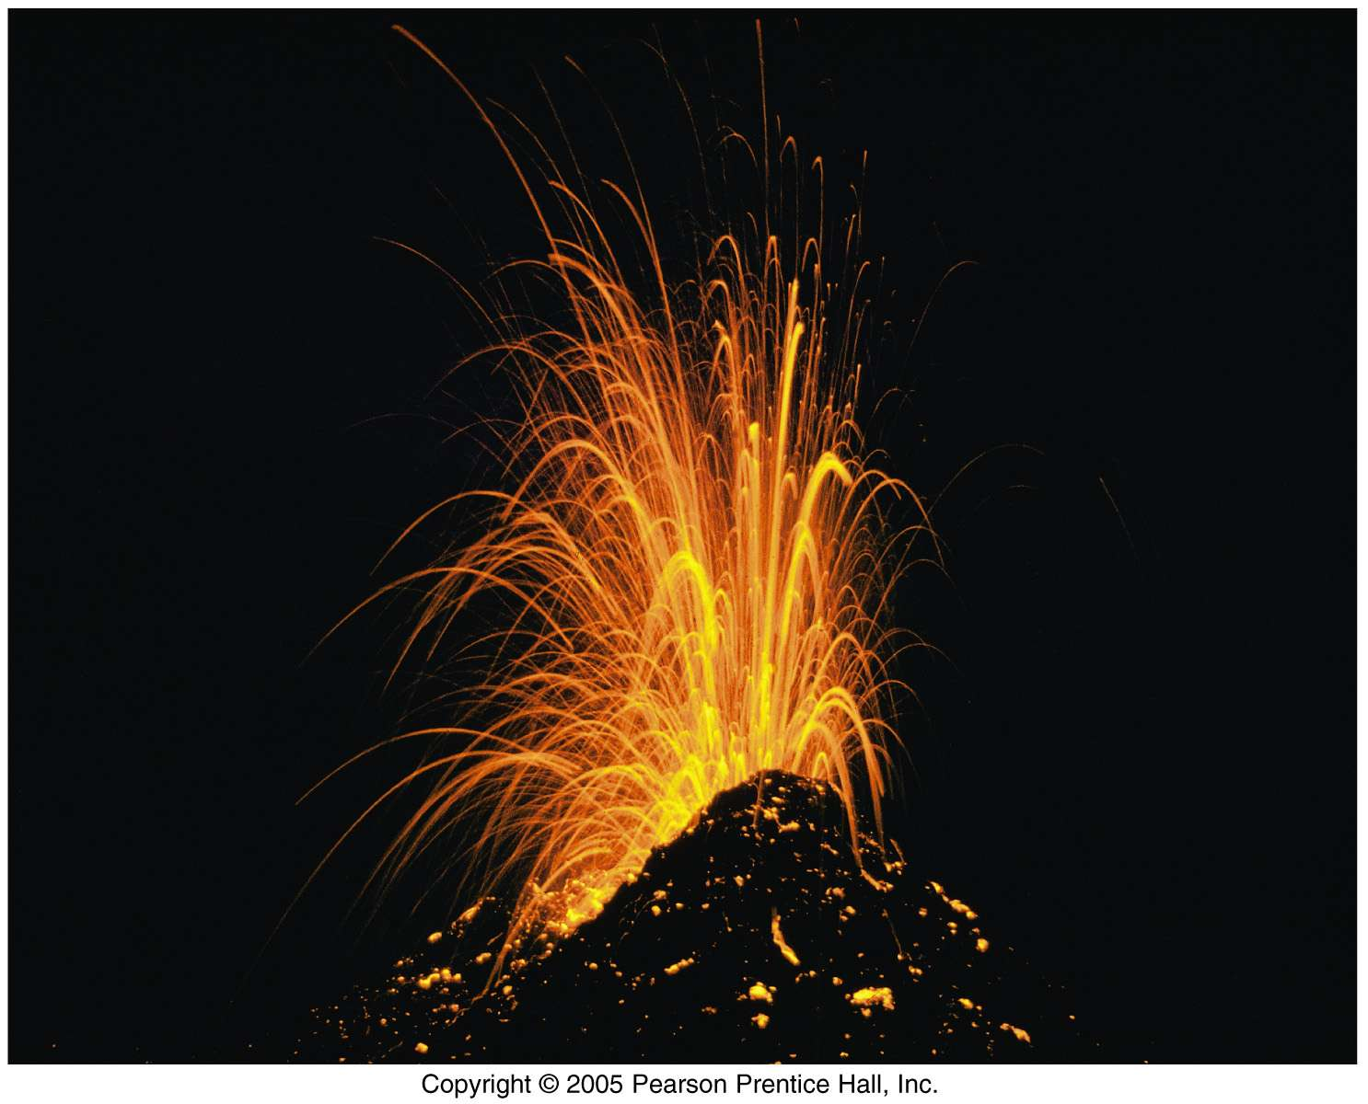
Eruption of Kilauea Volcano in Hawaii

Slide 17
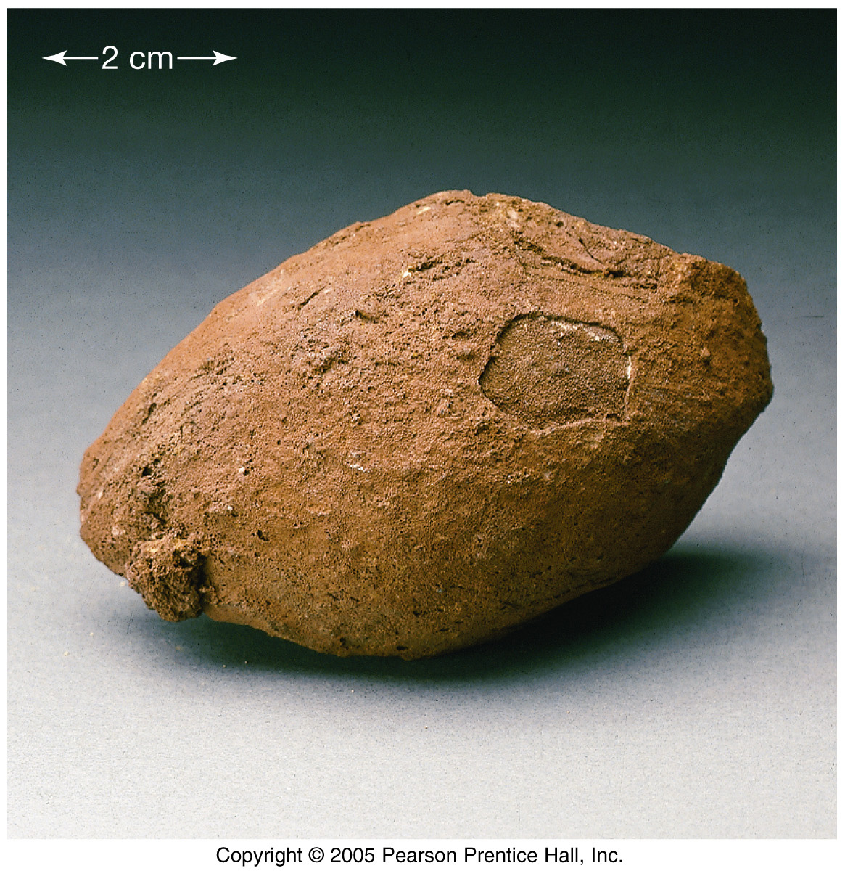
A volcanic bomb
Bomb is approximately 10 cm long

Slide 18
Volcanoes
General features
Opening at the summit of a volcano
Crater - summit depression < 1 km diameter
Caldera - summit depression > 1 km diameter produced by collapse following a massive eruption
Vent – surface opening connected to the magma chamber
Fumarole – emit only gases and smoke

Slide 19
Volcanoes
Types of volcanoes
Shield volcano
Broad, slightly domed-shaped
Generally cover large areas
Produced by mild eruptions of large volumes of basaltic lava
Have caldera openings
Example = Mauna Loa on Hawaii

Slide 20
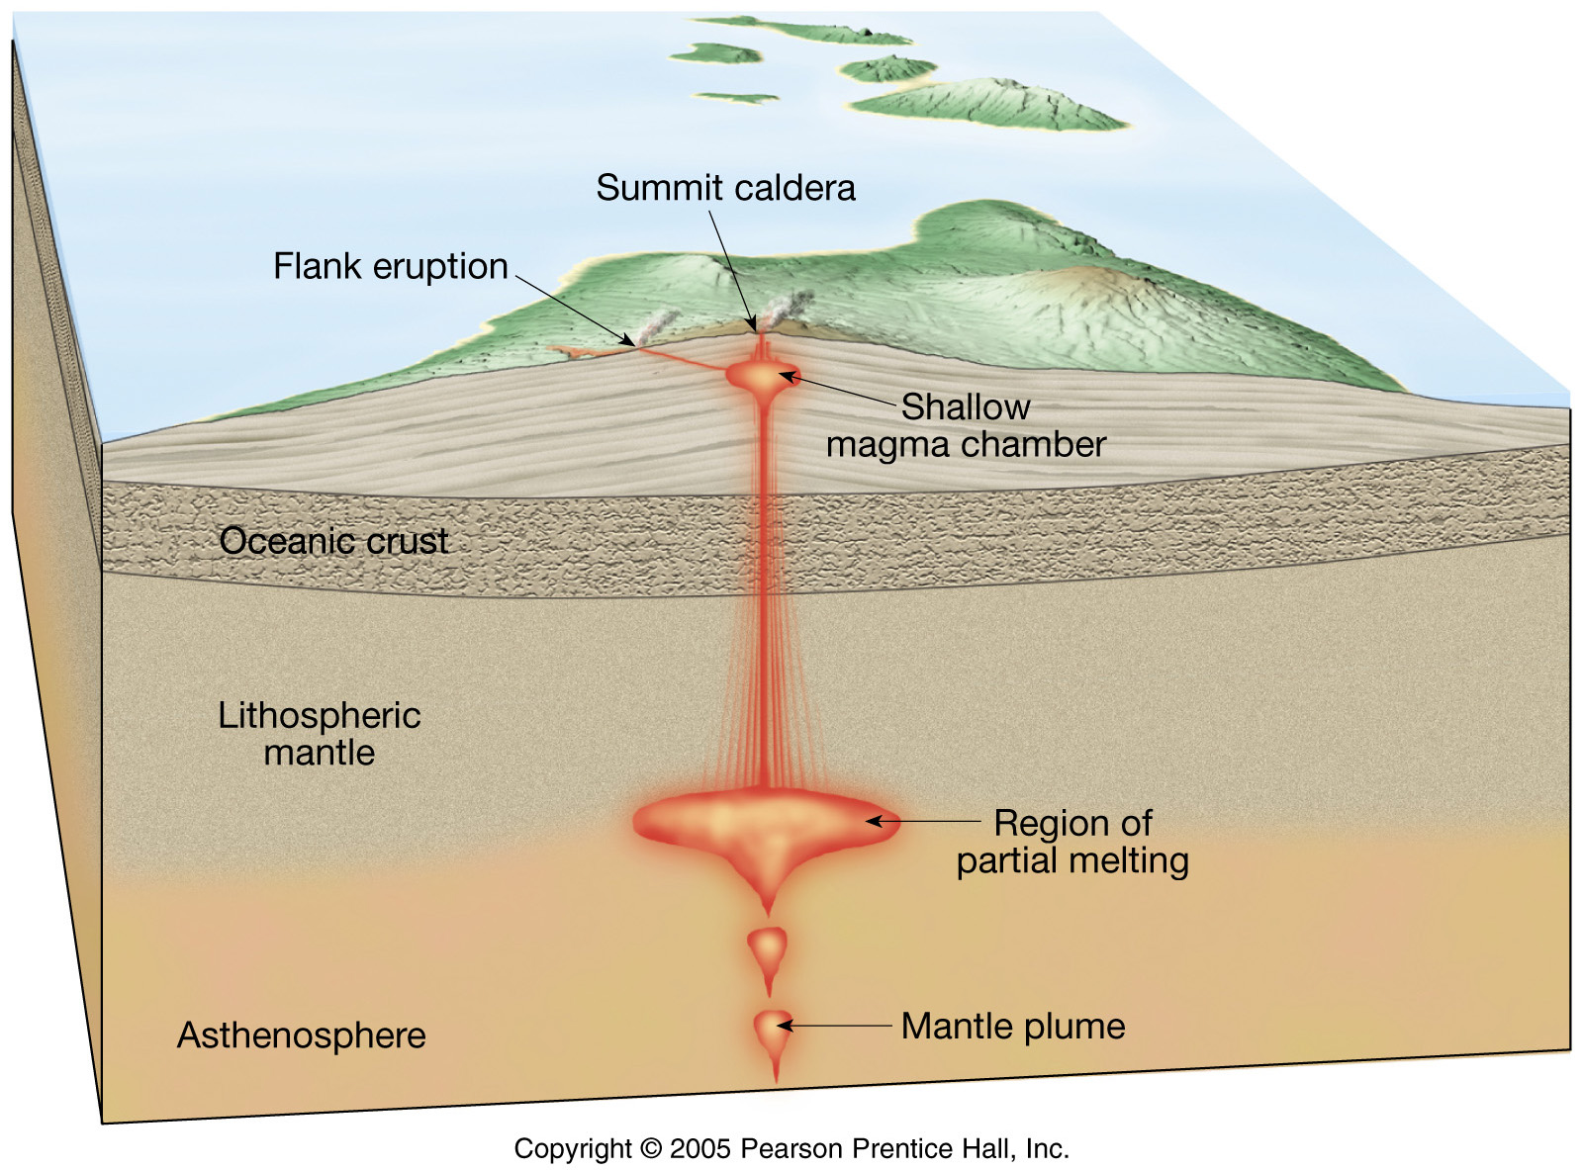
Anatomy of a shield volcano

Slide 21
Climb Mauna Kea (13,796 ft) shield volcano in Hawaii. Highest mountain on the planet from base to crest (almost 30,000 ft). This shows profile of Mauna Loa shield volcano, as seen from summit of Mauna Kea.

Slide 22
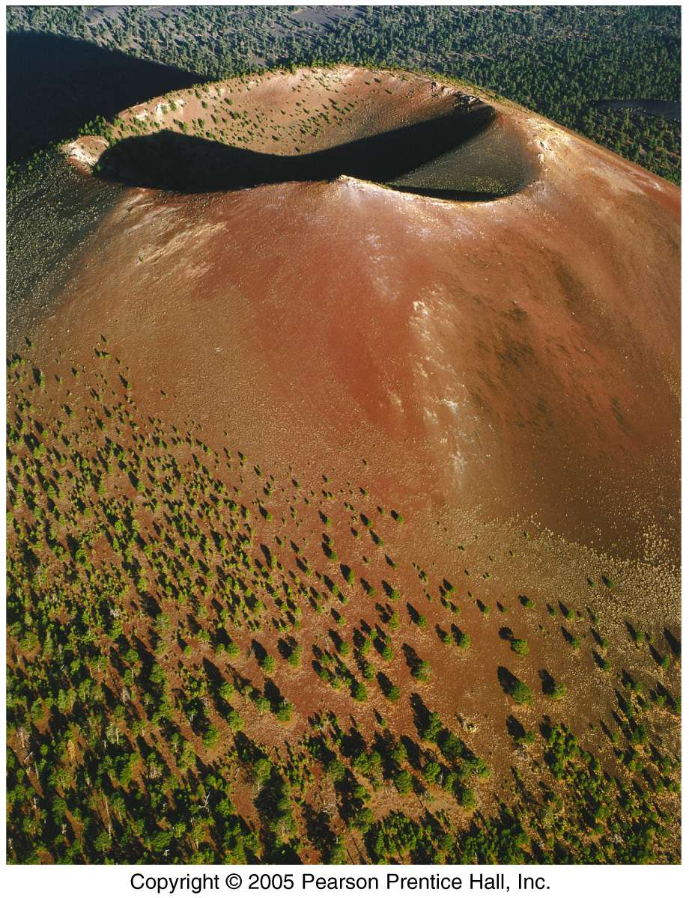
Volcanoes
Cinder cones
Built from ejected lava (mainly cinder-sized) fragments
Steep slope angle
Small size
Frequently occur in groups
Only active for short period of time (weeks-few years)
Pyroclastic material: fine ash-bombs but mostly of lapilli
Basaltic Magma
Usually crater opening

Slide 23
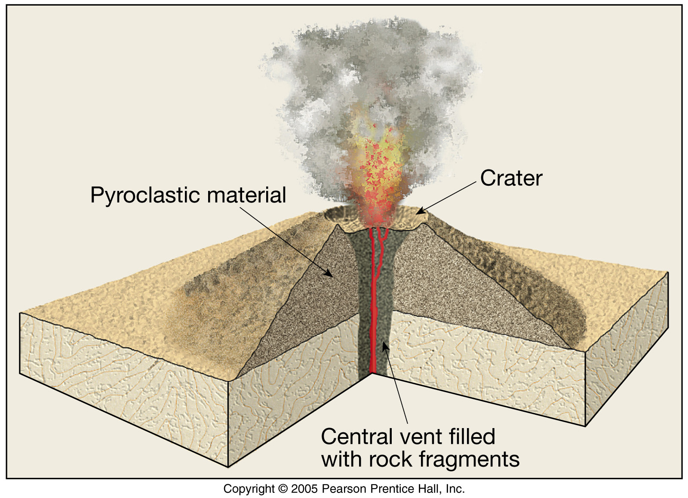
Cinder cone volcano

Slide 24
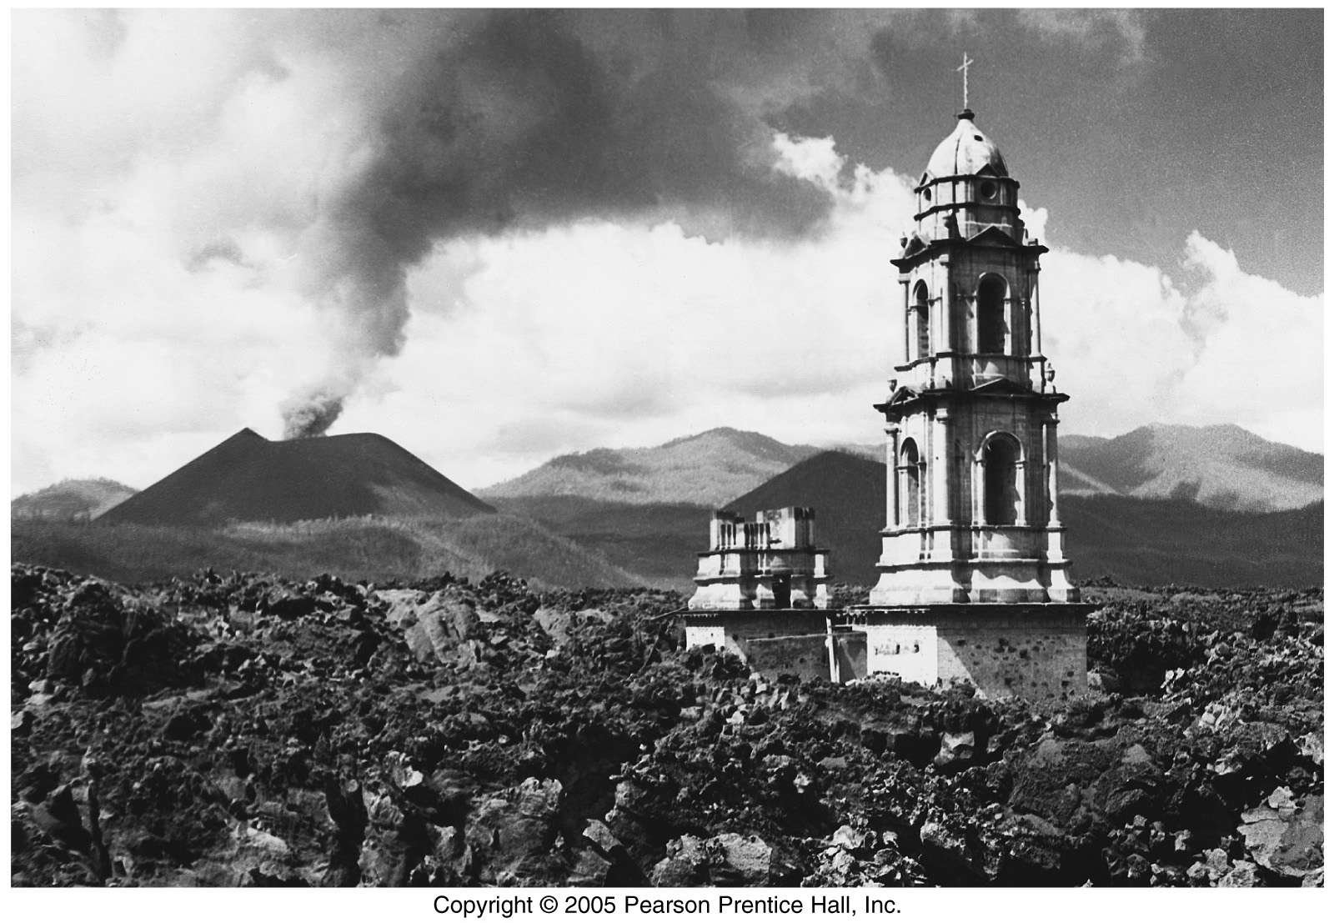
The Paricutin volcano in Mexico erupted in a corn field in 1943, burying the entire town.

Slide 25
Volcanoes
Composite cone (stratovolcano)
Most are located adjacent to the Pacific Ocean (e.g., Fujiyama, Mt. St. Helens)
Large, classic-shaped volcano (1000’s of ft. high and several miles wide at base)
Composed of interbedded lava flows and pyroclastic debris
Most violent type of activity (e.g., Mt. Vesuvius)
Magma mostly andesitic

Slide 26
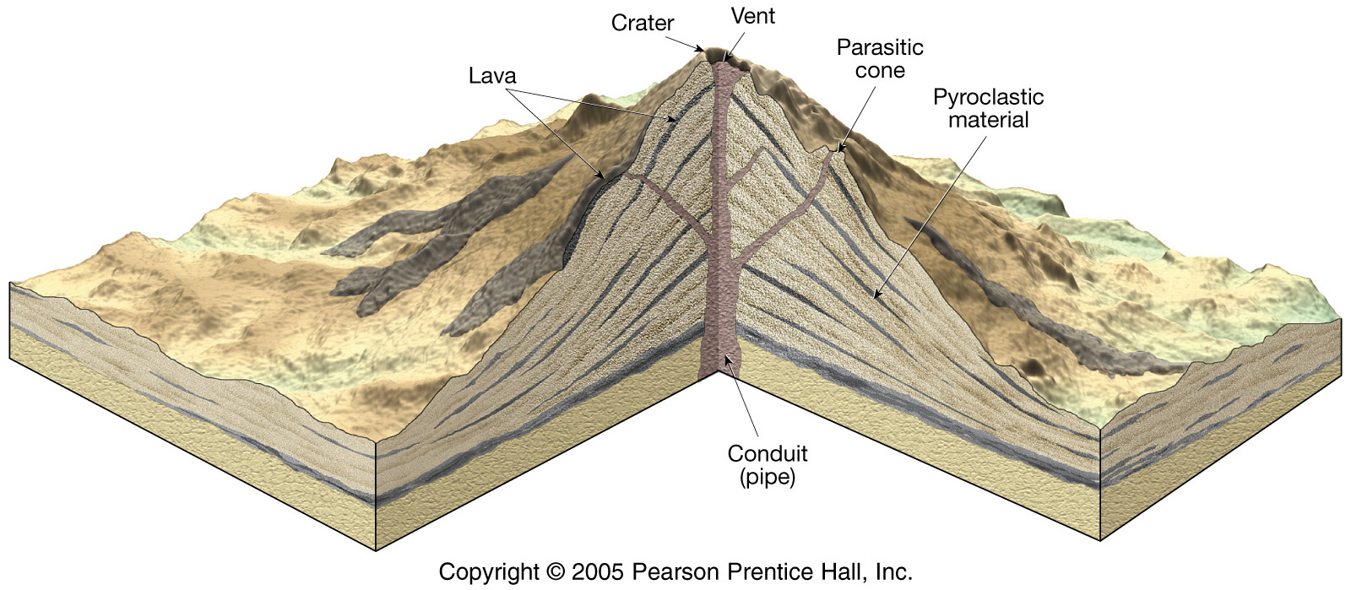
Anatomy of a composite volcano

