Slide 1
Physical Science Review #3
Waves, Sound, Light, Color

Slide 2
Wave Basics
Waves transfer energy
Some waves need a medium to travel through
Light waves do not
A medium is what the wave travels through (like solid, liquid, gas)
Two types of waves
Transverse: medium moves perpendicular to wave motion
Compressional (Longitudinal): medium moves same direction as wave motion

Slide 3
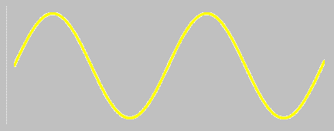
Transverse Wave Parts
Crest: the highest point on a wave
Trough: the lowest point on a wave
Amplitude: the height of a wave from the rest to the crest or from the rest to the trough
Period: one wave cycle from rest to rest
Wavelength: the length from any two identical points on wave
Rest: where the wave is not in motion

Slide 4
Wave interactions
Reflection: Bouncing back of a wave
Refraction: bending of a wave because of two different mediums
Diffraction: change in direction because a wave reaches an opening or edge
Constructive interference: waves interact resulting in a large amplitude (frequency stays the same)
Destructive interference : waves interact resulting in a smaller amplitude wave (frequency stays the same)

Slide 5
Sound Concepts
Sound is energy vibrating the air
Sound waves require mediums and are transverse waves
Pitch=highness or lowness=frequency
Intensity=loudness=energy=amplitude
Hearing range of humans: 20-20,000 Hz
Sound travels fastest at hot temperatures
Sound travels fastest through solids
Doppler Effect: when things move closer they get higher pitched; when things move farther away they get lower pitched

Slide 6
Sound Concepts
When waves constructively interfere, they get louder
When waves destructively interfere, they get quieter
If you want to double your volume, increase your decibel amount by 10. If you want to cut your volume in half, subtract your decibel amount by 10
Remember types of sound
Reflection
Refraction
diffraction

Slide 7
Light Concepts
Light can be described as a wave, photon, or stream of particles
Photon=packet of light energy
Light is a longitudinal wave and does NOT require a medium
Light travels faster when its hotter
Light travels fastest through a vacuum (no matter) and then GASES are the next fastest. Solids are slowest.
Convex Mirrors bulge out, make you look longer and skinnier
Concave mirrors curve inward, make you look fat and short

Slide 8
Light Concepts
Electromagnetic Spectrum: all light waves
We can only see visible light
Should remember uses of each type
Goes from:
Radiowave, microwave, infrared, visible, ultraviolet, X-Ray, Gamma
Lowest energy------------------------------------------Highest Energy
Longest wavelength-------------------------------shortest wavelength
Lowest frequency------------------------------------highest frequency
Visible Spectrum: R O Y G B I V

Slide 9
Color Concepts
Filters: block out every color of light except the color of the filter
Primary Light Colors: Red, Green, Blue
Primary Pigment Colors: Cyan, Magenta, Yellow
A color reflects what makes it up. It absorbs what does not make it up
Example: Red is made by magenta
and yellow. So, it reflect magenta and
Yellow but reflects cyan
Magenta
Red Green Blue
Yellow
Cyan

Slide 10
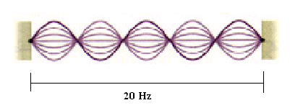
Math Stuff
Triangle: v, λ, f
To solve: v= λ x f, λ=v÷f, f=v÷ λ
Remember in calcuator: EXP button= x 10
Harmonic=how many waves
Fundamental frequency= total frequency÷ harmonic
The larger the harmonic, the higher the pitch
To find a different harmonic, multiply the harmonic number by fundamental frequency.
To find the period, do 1÷fundamental frequency

