Slide 1
Physical Science Review #1 Matter & States of Matter

Slide 2
Matter
Pure Substances: compounds & elements; cannot be broken down physically
Mixtures: homogenous & heterogeneous; can be broken down physically & chemically
Element: cannot be broken down at all chemically or physically
Compound: made of 2 or more elements; can be broken down chemically but not physically
Homogenous: mixture looks the same throughout
Heterogeneous: mixture looks different throughout

Slide 3
Chemical & Physical Properties & changes
Physical Property: a characteristic of a substance, doesn’t have action
Example: boiling point, melting point, density
Chemical Property: a characteristic of a substance that says how it could change
Example: reactive, flammable,
Physical Change: a change that does not change the identity of a substance
Example: boiling water, freezing water
Chemical change: a chemical reaction that changes the identity of a substance
Example: cooking, rotting, oxidizing, burning, combusting

Slide 4
Chemical Changes
How you know they’ve happened:
Bubbles (gas formation)
Color, odor, taste change
Light or heat or sound formation

Slide 5
Density
An example of a physical property
A measure of mass per volume
Denser objects sink, Less dense objects will float

Slide 6
States of Matter
Solid
Definite shape, definite volume
Particles very compact, only vibrate
Not a fluid
Slowest moving state of matter
Usually the most dense
Liquid
Indefinite shape, definite volume
Particles move slowly

Slide 7
States of Matter
Gases
Indefinite shape, indefinite volume
High KE, particles move fast
Usually the least dense
Plasma
Indefinite shape, indefinite volume
VERY high KE, particles move very fast
Conducts electricity because particles break into charaged particles

Slide 8
KMT & Gas Laws
All states of matter are in constant motion
Kinetic Molecular Theory
Particles move faster when its hotter
Things go faster when its hotter

Slide 9
Fluids
Archimedes: how objects float. The buoyant force (fluid pushing up) has to be bigger than the object force
Pascal: pressure applied to a fluid goes equall in all directions
Bernoulli: As pressure on a fluid increases, the fluid goes faster. As a pressure on a fluid increases, the pressure on the fluid’s container decreases

Slide 10
Gas Laws
Boyle:
Relates pressure and volume
Indirectly Related
Charles:
Relates temperature and volume
Directly Related
Gay-Lussac
Relates temperature and pressure
Directly related

Slide 11
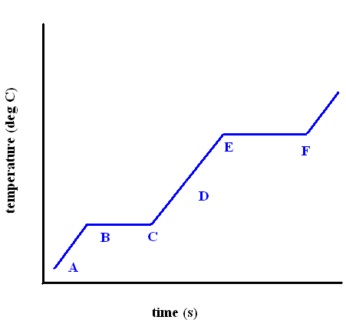
Phase Changes

