Slide 1
CHEMICAL EQUATIONS AND REACTIONS

Slide 2
Part I: Chemical rxns Basics, energy, types of Rxns, Balancing Rxns

Slide 3
CHEMICAL REACTIONS TERMS
REACTANTS - Original substance(s) entering into a chemical reaction
PRODUCTS – The resulting substance(s) from a chemical reaction
CHEMICAL EQUATIONS – Use symbols and formulas to represent & identify the relative amounts of reactants & products in a chemical reaction

Slide 4
CHEMICAL REACTIONS TERMS
REACTANTS ⇒ PRODUCTS
Ex. Chemical Equation
CH₄ + O₂ ⇒ CO₂ + H₂O
reactants products

Slide 5
Signs of Chemical Rxns
Evolution of (you make) heat or light
Production of a gas (fizzy bubbles)
Formation of a Precipitate (the rxn vessel becomes cloudy)
Color Change

Slide 6
INDICATIONS OF A CHEMICAL REACTION
Evolution of heat and light
1. gives evidence of energy being released
2. exothermic reaction

Slide 7
INDICATIONS OF A CHEMICAL REACTION
Production of a gas
Example:
FeS (aq) + H₂SO₄ → FeSO₄ + H₂S (g)↑

Slide 8
INDICATIONS OF A CHEMICAL REACTION
Formation of a precipitate
A precipitate is a solid that is
produced in a chemical reaction
Example:
BaCl₂ + Na₂SO₄ → NaCl(aq) + BaSO₄(s)↓

Slide 9
Energy and Reactions
Energy must be added to break bonds
Energy is released when bonds are formed
Total Energy of Reactants=Total Energy of Products

Slide 10
Endothermic vs Exothermic
Endothermic
Exothermic
A chemical reaction that requires heat
More energy is needed to break the bonds in the reactants than is given off by forming bonds in the products
Examples: melting ice, photosynthesis, evaporating water, cooking an egg, baking bread
A chemical reaction that does not require heat
Heat is given off in the reaction as a product; heat is released to surrounding
More energy is released by forming products than is needed to break the bonds of the reactants
Examples: all combustion reactions, digestion, condensation, explosions

Slide 11
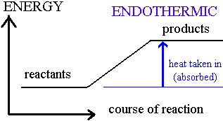
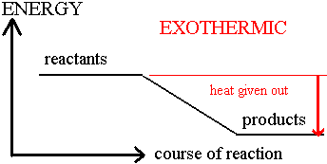
Reaction Profiles
Endothermic
Exothermic

Slide 12
Factors affecting Reaction Rate
Reaction rate-how fast the reaction goes from reactants to products
Factors affecting reaction rate
Temperature
Surface Area
Concentration
Pressure
Size and shape of molecules
Presence of a catalyst

Slide 13
Temperature and Surface Area
Temperature
Most reactions go faster at a higher temperature
This is because of the Kinetic theory
Higher temp means molecules going faster, more likely to collide
Surface Area
A large surface area speeds up reactions
Solids that have a large surface area react more quickly because more particles come in contact with the other reactants

Slide 14
Concentration and Pressure
Concentration
Most reactions go faster at a higher concentration (3% vs 30% solution)
Think of doing laundry
Pressure
Reactions are faster at a higher pressure
Gases are more concentrated at higher pressures because it has been squeezed into a smaller volume and have more collisions

Slide 15
Size/Shape and Catalysts
Size and Shape
Massive, Bulky molecules react slower
Because of Kinetic Molecular theory:
Bigger molecules move more slowly, collide less
Catalyst
A substance that changes the rate of a chemical rxn without being consumed
Not reactants or products
Do not play a role in the equilbrium (we will get to this)

Slide 16
Catalysts
Catalysts: speed up reactions
Inhibitors: slow down reactions
Enzymes: biological catalysts
Ex. Lipase breaks down fat into smaller molecules
Substrate: the reactant in reactions catalyzed by enzymes

Slide 17
TYPES OF CHEMICAL REACTIONS
SYNTHESIS REACTIONS (COMPOSITION REACTIONS)
Two or more substances combine to form a more complex product or substance
A + X ⇒ AX

Slide 18
Examples of Synthesis
4 Al + 3 O₂ → 2 Al₂O₃
MgO + H₂O → Mg(OH)₂

Slide 19
TYPES OF CHEMICAL REACTIONS
DECOMPOSITION REACTIONS
One substance breaks down to form two or more simpler substances.
AX ⇒ A + X

Slide 20
Examples of Decomposition
CaCO₃ → CaO + CO₂
2 NaCl → 2 Na + Cl₂

Slide 21
TYPES OF CHEMICAL REACTIONS
SINGLE-REPLACEMENT REACTIONS
One substance is replaced in its compound by another substance
A + BY → AY + B
Y + BX → BY + X

Slide 22
TYPES OF CHEMICAL REACTIONS
DOUBLE-REPLACEMENT REACTIONS
The ions of two compounds exchange place in an aqueous solution to form two new compounds
AX + BY → AY + BX

Slide 23
Double Replacement Reactions
The ions of two compounds exchange places in an
aqueous solution to form two new compounds.
AX + BY → AY + BX
One of the compounds formed is usually a
precipitate, an insoluble gas that bubbles out of
solution, or a molecular compound, usually water.

Slide 24
TYPES OF CHEMICAL REACTIONS
COMBUSITON REACTIONS
A substance combines with oxygen, releasing a large amount of energy in the form of light and heat

Slide 26
COMBUSTION REACTIONS
H₂ (g) + O₂ (g) → 2 H₂O (g)
Hydrocarbon combustion ALWAYS produces carbon dioxide & water.
2 C₂H₆ (g) + 7 O₂ → 4 CO₂ + 6 H₂O (g)

Slide 27
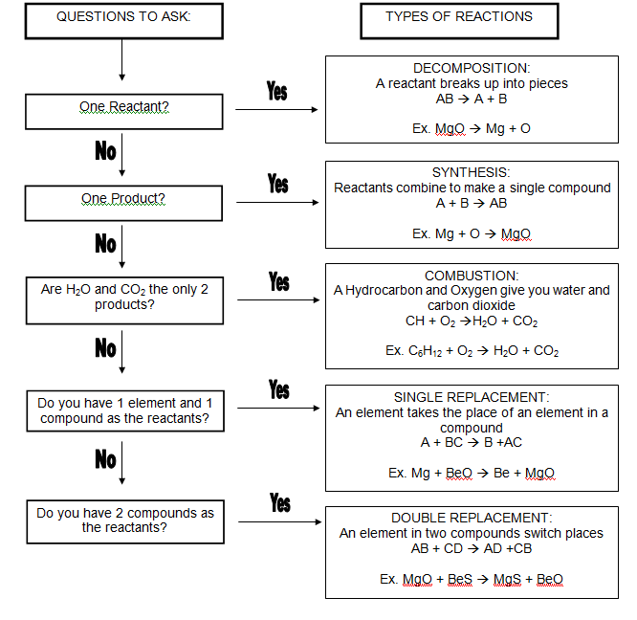
ID Types Flow Chart

Slide 28
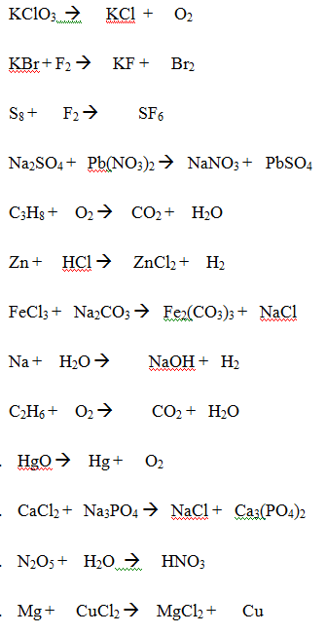
ID Rxn Practice

Slide 29
CHARACTERISTICS OF CHEMICAL EQUATIONS
A. THE EQUATION MUST REPRESENT KNOWN FACTS
This can be done with a word equation
“Hydrogen reacts with oxygen
to form water”
HYDROGEN + OXGYEN ⇒ WATER

Slide 30
CHARACTERISTICS OF CHEMICAL EQUATIONS
B. THE EQUATION MUST CONTAIN THE CORRECT FORMULAS FOR REACTANTS AND PRODUCTS
This can be done with a
formula equation
H₂ + O₂ → H₂O

Slide 31
CHARACTERISTICS OF CHEMICAL EQUATIONS
C. THE LAW OF CONSERVATION OF MASS (ATOMS) MUST BE SATISFIED
Balancing the equation is done with coefficients – small whole numbers that appear in front of a formula
2H₂ + O₂ → 2H₂O
↑ ↑
These numbers are called COEFFICIENTS

Slide 32
NEVER, NEVER, NEVER NEVER……….
YOU CAN NEVER BALANCE AN EQUATION BY CHANGING A FORMULA FOR A REACTANT OR PRODUCT ……………
YOU BALANCE AN EQUATION ONLY BY ADDING OR CHANGING COEFFICIENTS!!

Slide 33
REMEMBER THE “HAPPY ☺ SEVEN”
Whenever any of the diatomic elements are part of the reactants or products of a chemical reaction, they exist as a two-atom MOLECULE
Be sure to write the CORRECT formula for them as a MOLECULE !
Ex Oxygen: O₂ NOT “O”

Slide 34
CHARACTERISTICS OF CHEMICAL EQUATIONS
Symbols are used as a type of shorthand for chemical reactions.
ex. → “yields” ↓ “precipitate”
↑ “gas” Δ “heat “
See your handout for further details.

Slide 35
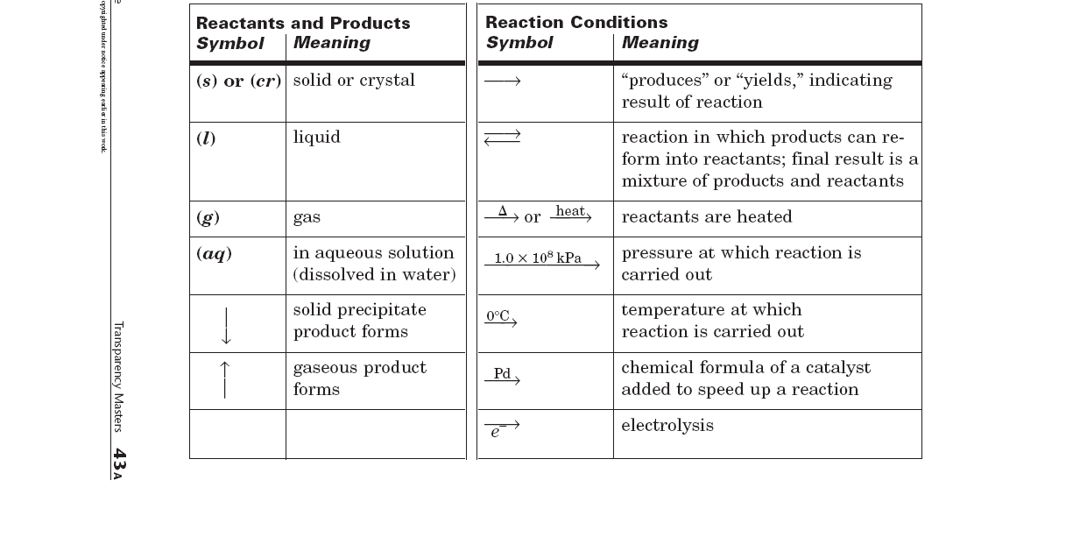
Chemical Symbols

Slide 36
SIGNIFICANCE OF A CHEMICAL REACTION
Gives quantitative information
- shows number of moles, atoms,
and compound in a reaction

Slide 37
SIGNIFICANCE OF A CHEMICAL REACTION
Gives quantitative information
- you start and end with the same number & types of atoms although possibly rearranged

Slide 38
NOTE: The fact that a reaction can be written does not mean that it CAN take place…….

Slide 39
BALANCING CHEMICAL EQUATIONS
Identify reactants & products
List elements in same order on both sides
Count the number of atoms of each element on each side
Starting with the largest difference (or weird like 2/3 must equal 6), Balance the formula equation using coefficients ONLY
Double check the balanced equation by counting the numbers & types of atoms on both sides of the equation

Slide 40
BALANCING CHEMICAL EQUATIONS
BALANCING EQUATIONS IS A TRIAL AND ERROR PROCESS !!!!!

Slide 41
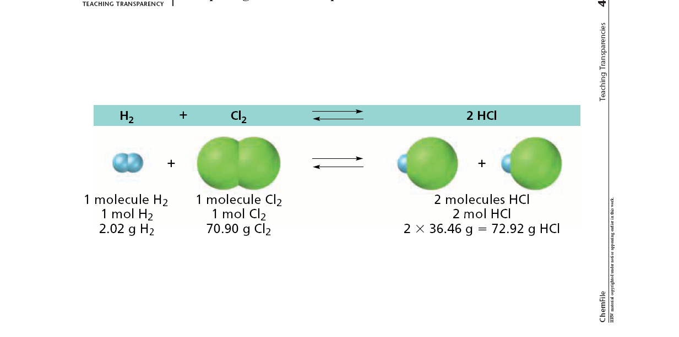
Meaning of Conservation of Mass in Balancing Equations

Slide 42
Practice Problems
___ ZnS (aq) + ___ O₂ (g) --> ___ ZnO (aq) + ___ S (s)
___ Cu + ___ AgNO₃ → ___ Ag + ___ Cu(NO₃)₂
___ H₃PO₄ + ___ NaOH → ___ Na₃PO₄ + ___ H₂O
___ Ca₃(PO₄)₂ + ___ H₂SO₄ → ___ CaSO₄ + ___ H₃PO₄
NOTE: If the coefficient is “1” you don’t need to write anything.

Slide 43
More Practice…
___ H₂O + ___ CH₄ → ___ H₂ + ___ CO₂
___ Cl₂ + ___ NaBr → ___ NaCl + ___ Br₂
___ Al(OH)₃ + ___ H₂SO₄ → ___ H₂O + ___ Al₂(SO₄)₃
___ C₃H₈ + ___ O₂ → ___ H₂O + ___ CO₂

Slide 44
Combustion RXN Practice
C₆H₁₄ + O₂
C₆H₁₂O₆ + O₂
CH₄ + O₂
C₃H₈ + O₂

Slide 45
Starting with words, then balancing
Aqueous iron (III) bromide reacts with chlorine gas to form iron (III) chloride and bromine gas.
Write the formulas in the skeleton equation
Then balance - DO NOT change the subscripts once you decide you have the formulas written correctly!
Solutions of barium hydroxide and sulfuric acid (H₂SO₄) react to yield water and solid barium sulfate.

Slide 46
Part iI: Product Prediction & Solubility

Slide 47
Product Prediction
Depending on the types of reaction we have and the reactants present, we can predict what products will form
You will have access to the following reference on the next quiz!

Slide 48
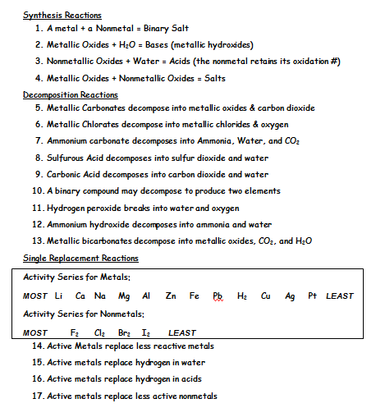

Slide 49
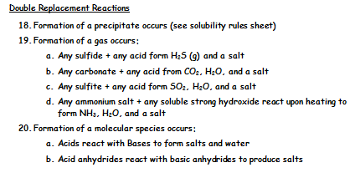

Slide 50
Predict products for the following synthesis RXNs
Ba_{(s)} + S_{8(s)}
Fe(III)_{(s)} + O_{2(g)}
S_{8(s)} + O_{2(g)}
K_{(s)} + F_{2(g)}
H_{2(g)} + O_{2(g)}
MgO_{(s)} + H₂O_{(l)}

Slide 51
Types of Decomposition Reactions
Metallic carbonates, when heated, form metallic oxides & carbon dioxide
CaCO₃ → CaO + CO₂
Metallic hydroxides, when heated, form metallic oxides & water
Ca(OH)₂ → CaO + H₂O

Slide 52
Types of Decomposition Reactions
Metallic chlorates, when heated, decompose into metallic chlorides & oxygen
2KClO₃ → 2KCl + 3 O₂
Some acids, when heated, decompose into nonmetallic oxides and water
H₂SO₄ → H₂O + SO₃

Slide 53
Types of Decomposition Reactions
A few oxides, when heated, decompose
2 PbO₂ → 2PbO + O₂
Some decomposition reactions are produced by an electric current
2 NaCl → 2 Na + Cl₂

Slide 54
Predict products for the following decomposition RXNs
NaClO₃
NaNO₃
NH₄Cl_{(s)}
H₂CO_{3(aq)}
NaOH

Slide 55
SINGLE-REPLACEMENT REACTIONS
Replacement of a metal in a compound by a more active metal
Zn + CuSO₄ (aq) → ZnSO₄ + Cu
Replacement of hydrogen in water by active metals
Ca + H₂O → Ca(OH)₂ + H₂ (g)

Slide 56
SINGLE-REPLACEMENT REACTIONS
Replacement of hydrogen in acids by metals
Zn + H₂SO₄ → ZnSO₄ + H₂
Replacement of halogens by more active halogens
Cl₂ + 2 KBr → 2 KCl + Br₂

Slide 57
The Activity Series of the Metals
Lithium
Potassium
Calcium
Sodium
Magnesium
Aluminum
Zinc
Chromium
Iron
Nickel
Lead
Hydrogen
Bismuth
Copper
Mercury
Silver
Platinum
Gold
Metals can replace other metals
provided that they are above the
metal that they are trying to
replace.
Metals above hydrogen can
replace hydrogen in acids.

Slide 58
The Activity Series of the Halogens
Fluorine
Chlorine
Bromine
Iodine
Halogens can replace other
halogens in compounds, provided
that they are above the halogen
that they are trying to replace.
2NaCl(s) + F₂(g) →
2NaF(s) + Cl₂(g)
???
MgCl₂(s) + Br₂(g) →
No Reaction
???

Slide 59
Predict products for the following RXNs
Na_{(s)} + H₂O_{(l)}
Fe_{(s)} + H₂O_{(l)}
Cl_{2(g)} + KBr_{(aq)}
Br_{2(g)} + KCl_{(aq)}
Mg_{(s)} + HCl_{(aq)}
Ni_{(s)} + Mg(OH)_{2(aq)}

Slide 60
DOUBLE-REPLACEMENT REACTIONS
Formation of a precipitate
BaCl₂(aq) + Na₂SO₄ → 2 NaCl + BaSO₄(s)
Formation of a gas
FeS (aq) + H₂SO₄ → FeSO₄ (aq) + H₂S(g)
Formation of water
NaOH (aq) + HCl (aq) → NaCl (aq) + H₂O

Slide 61
Predict products for the following Double Replacement RXNs
KI_{(aq)} + Pb(NO₃)₂
HNO₃ + Ca(OH)₂
HCl + Na₂S
Na₂CO₃ + HCl
MgSO₃ + HNO₃
NH₄NO₃ + KOH

Slide 62
Solubility
If a reaction forms a precipitate, it is because a produce is INSOLUBLE
You need to be able to read a solubility chart to see if certain compounds are soluble or insoluble and predict if precipitation occurs
It helps to be generally aware of basic solubility rules to help speed up the time it takes to solve problems

Slide 63
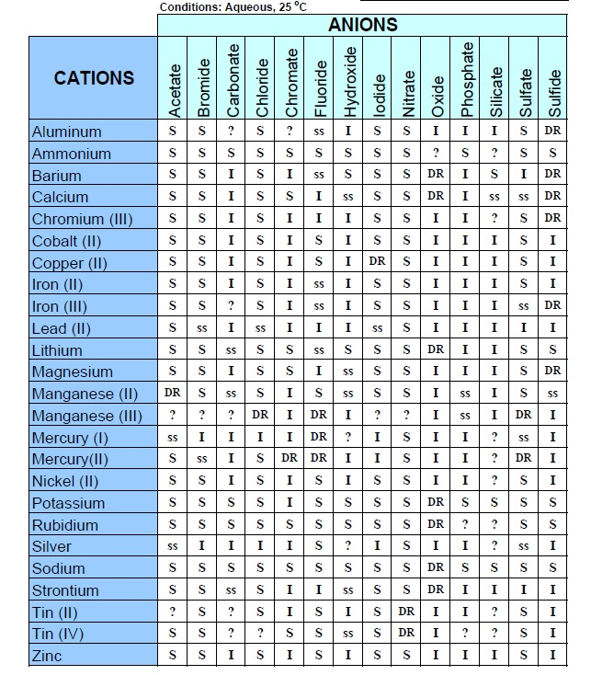
You will be allowed to use this on the exam
S=soluble
I= in solube
ss= slightly soluble
DR= reacts in H₂O

Slide 64
General Solubility Rules
Group IA Salts are Soluble
All Nitrates are Soluble
Most Halides are Soluble (except Ag, Pb, Hg)
Most Sulfates are soluble (except Ba, Pb, Ca)
Most Hydroxides are insoluble (except Na, K, Ca, Ba)
Most sulfides, carbonates, phosphates are insoluble

Slide 65
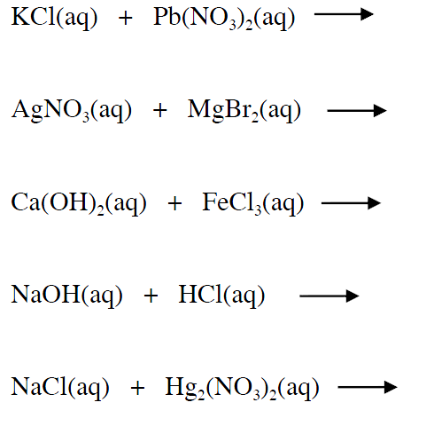
Examples Predict the products and ID the precipitate if one forms

